Slide 1
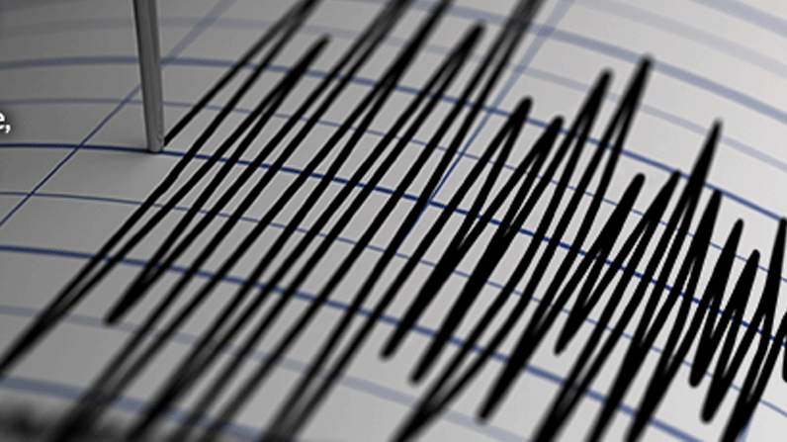
earthquakes
Notes:
What is an earthquake?
An earthquake is a sudden, rapid shaking of the ground caused by the breaking and shifting of rock beneath the Earth's surface. This shaking can cause buildings and bridges to collapse; disrupt gas, electric, and phone service; and sometimes trigger landslides, avalanches, flash floods, fires, and huge, destructive ocean waves (tsunamis). Buildings with foundations resting on unconsolidated landfill, old waterways, or other unstable soil are most at risk. Buildings or trailers and manufactured homes not tied to a reinforced foundation anchored to the ground are also at risk since they can be shaken off their mountings during an earthquake. Earthquakes can occur at any time of the year.

Slide 3
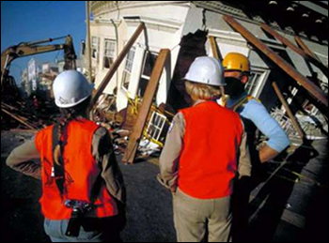
Objectives
Recognize hazards associated with cleanup in the aftermath of an earthquake.
Assess hazards of assigned tasks to ensure safety and health of site workers.
Identify precautions and control measures to control identified hazards.

Slide 4
Introduction
National Earthquake Information Center records an average of 20,000 earthquakes every year - about 50 a day around the world.
About 100 of them cause damage.
Notes:
The National Earthquake Information Center (NEIC) records an average of 20,000 earthquakes every year (about 50 a day) around the world. There are, however, millions of earthquakes estimated to occur every year that are too weak to be recorded.
The earth's surface consists of 20 constantly moving plates. The pressure increase from shifting plates can cause the crust to break. This break allows stress to be released as energy, which moves through the earth in the form of waves - earthquakes.

Slide 5
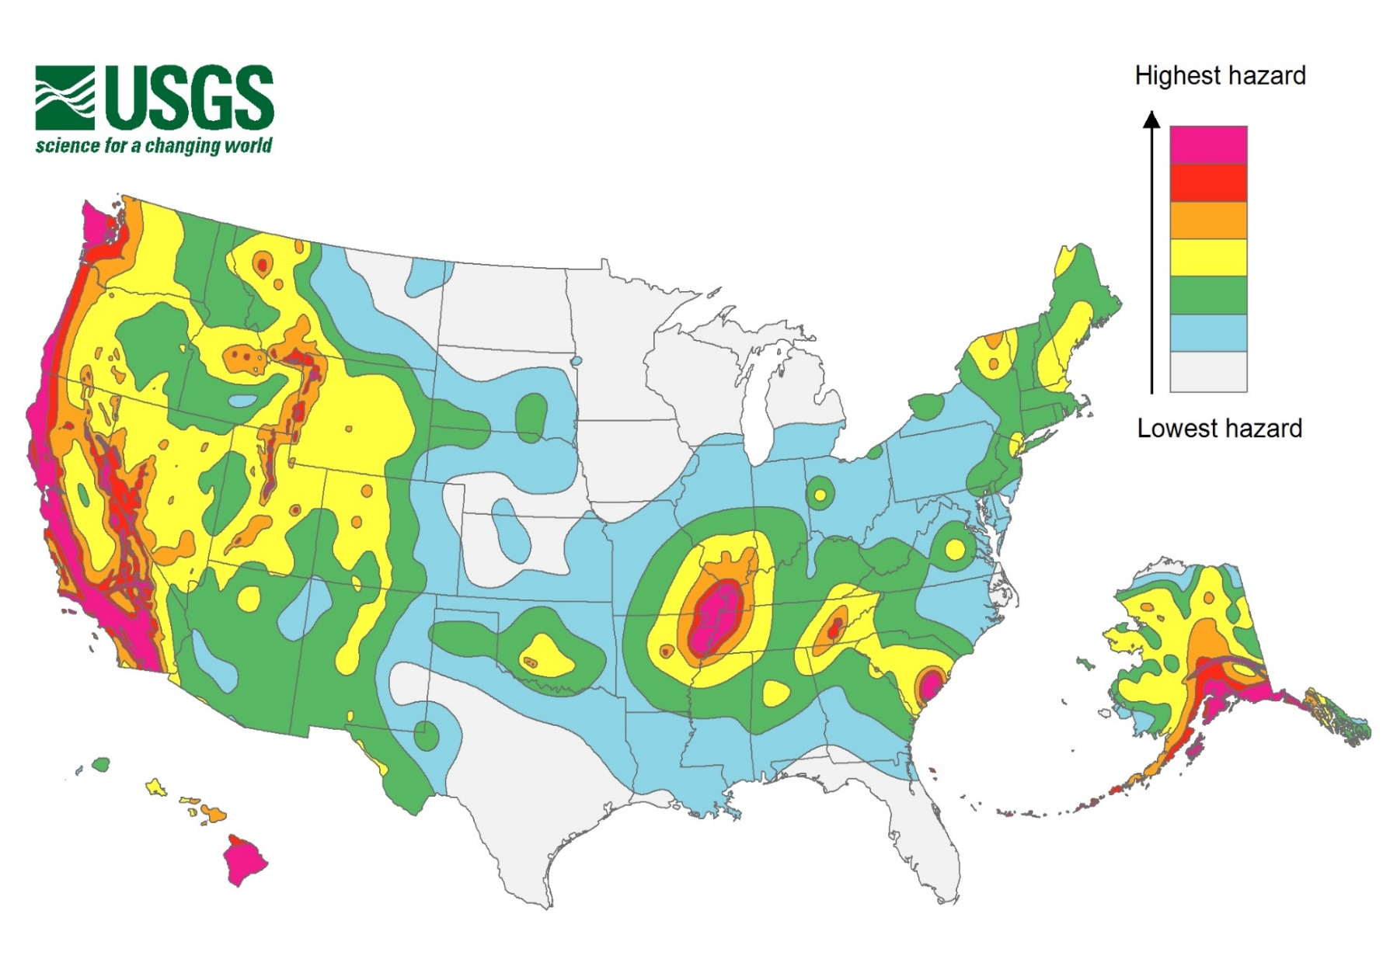
Earthquakes
2017 USGS National Seismic Hazard Map, displaying intensity of potential ground shaking from an earthquake in 50 years (which is the typical lifetime of a building).

Slide 6
Earthquake Hazards
After shocks
Unstable structures
Demolition
Electrical Hazards/Utilities
Heavy equipment
Chain Saws/Power Tools
Carbon Monoxide
Debris removal
Airborne smoke and dust: asbestos, silica, etc.
Hazardous materials
Bloodborne pathogens
Slips, trips, and falls
Lifting
Notes:
In the aftermath of an earthquake, workers may be involved in a variety of response and recovery operations. The following are hazards that workers may encounter in assessing and/or cleaning up the damage to a worksite.
After shocks
Work in earthquake-impacted areas presents safety and health hazards that should be properly identified, evaluated, and controlled in a systematic manner to reduce or eliminate occupational safety and health risks to recovery and cleanup site workers.
Collapsed structures are a common result of earthquakes.

Slide 7
Response Worker Precautions
Unstable Structures
Determine condition of framing, floors and walls, and to assess possibility of an unplanned collapse of any portion of the structure.
Brace or shore the walls and floors of structures which have been damaged and which employees must enter.
Notes:
Collapsed structures are a common result of earthquakes.
The following hazards should be considered in order to protect workers preparing to enter a collapsed structure:
Water system breaks that may flood basement areas
Exposure to pathogens from sanitary sewer system breaks
Exposed and energized electrical wiring
Exposure to airborne smoke and dust (asbestos, silica, etc.)
Exposure to bloodborne pathogens
Exposure to hazardous materials (ammonia, battery acid, leaking fuel, etc.)
Natural gas leaks creating flammable and toxic environments
Structural instability
Insufficient oxygen
Confined spaces
Slip, trip or fall hazards from holes, protruding rebar, etc.
Struck-by hazards from falling objects
Fire
Struck by heavy equipment such as cranes or excavators
Sharp objects such as glass and debris
Secondary collapse from aftershock, vibration and explosions
Unfamiliar surroundings
Adverse weather conditions
Noise from equipment (generators/heavy machines)
Workplace violence from robbing and looting

Slide 8
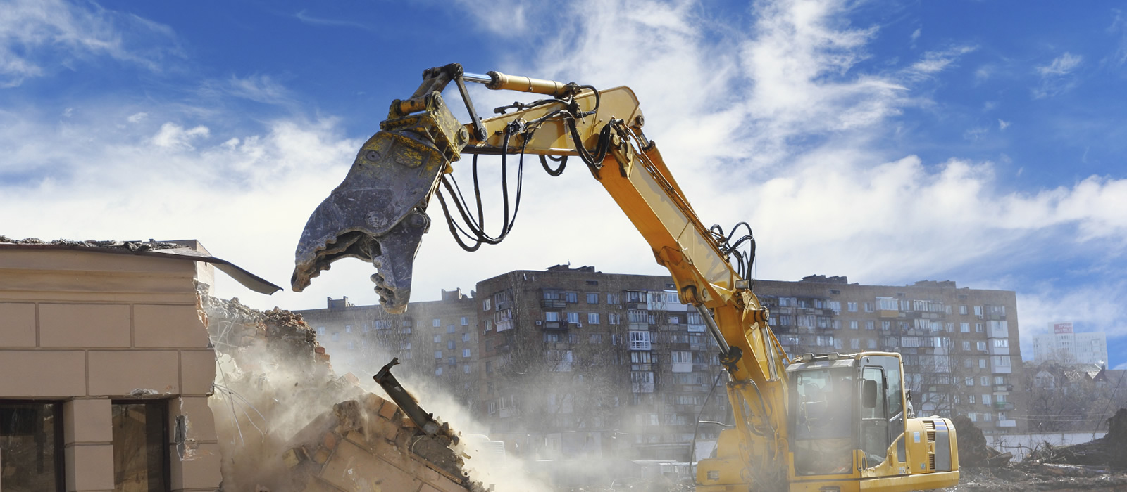
Response Worker Precautions
Demolition
A written engineering survey must be performed on each structure being considered for demolition to determine the condition of the framing, floors and walls, and to assess the possibility of an unplanned collapse of any portion of the structure.
Notes:
The following hazards should be considered in order to protect workers during demolition:
Water system breaks that may flood basement areas
Exposure to pathogens from sanitary sewer system breaks
Exposed and energized electrical wiring
Exposure to airborne smoke and dust (asbestos, silica, etc.)
Exposure to bloodborne pathogens
Exposure to hazardous materials (ammonia, battery acid, leaking fuel, etc.)
Natural gas leaks creating flammable and toxic environments
Structural instability
Insufficient oxygen
Confined spaces
Slip, trip or fall hazards from holes, protruding rebar, etc.
Struck-by hazards from falling objects
Fire
Struck by heavy equipment such as cranes or excavators
Sharp objects such as glass and debris
Secondary collapse from aftershock, vibration and explosions
Unfamiliar surroundings
Adverse weather conditions
Noise from equipment (generators/heavy machines)
Workplace violence from robbing and looting

Slide 9
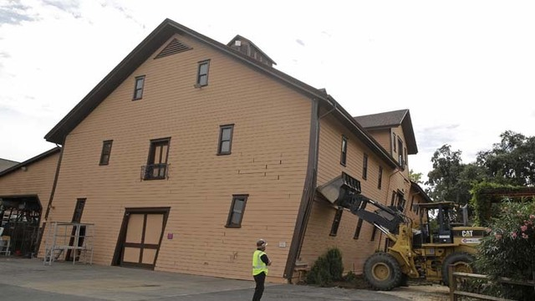
Response Worker Precautions
Electrical Hazards
Always consider all electrical equipment, lines and conductors to be energized.
Downed wires can energize other nearby objects, such as fences, water pipes, bushes and trees, buildings, and telephone/CATV/ fiber optic cables.
Even manhole castings and reinforcement bars (rebar) in pavement can become energized by downed wires.
Heavy Equipment
Maintain safe distance and coordination working around other site workers.

Slide 10
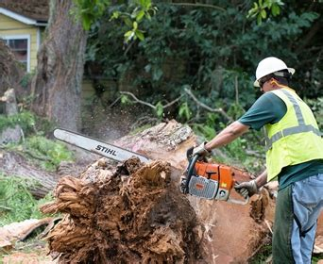
Response Worker Precautions
Chain Saws/Power Tools
Potential injuries can be minimized by using proper personal protective equipment and safe operating procedures.
Carbon Monoxide
Gasoline- or diesel-powered pumps, generators and pressure washers may be used during cleanup. These machines give off carbon monoxide

Slide 11
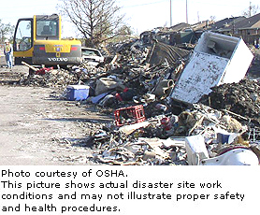
Response Worker Precautions
Debris Removal
Site workers are likely to be exposed to hazardous levels of noise, dust, and silica.
Sample results for these hazards show that individuals collecting and removing debris may be exposed above allowable levels (i.e., OSHA's PEL), particularly when operating machinery and heavy equipment.

Slide 12
Response Worker Precautions
Hazardous Materials
If hazardous chemical containers are found or leaking materials are detected, take self-protective measures such as moving to a safe distance upwind and contact hazardous material response personnel for evaluation of the risk and removal.
Bloodborne Pathogens
If it can be reasonably expected that a site worker could contact other potentially infected materials or contaminated surfaces or items, ensure workers wear gloves.

Slide 13
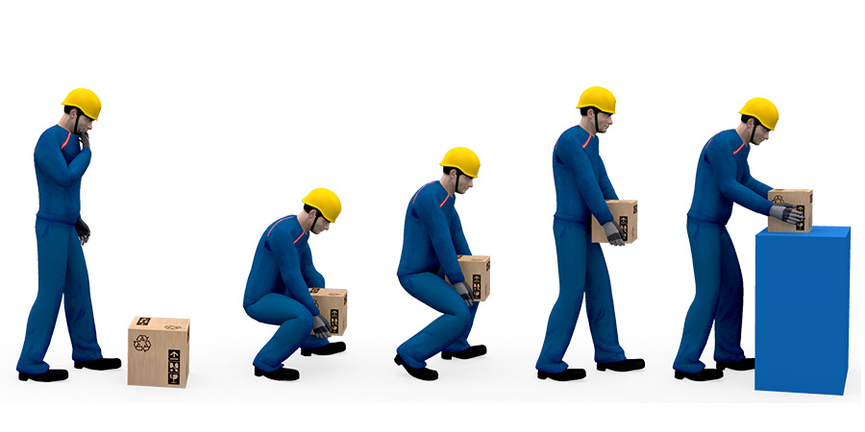
Response Worker Precautions
Slips, Trips, and Falls
Exercise care when stepping onto unstable or uneven surfaces, and onto surfaces where the hazard cannot be seen.
Lifting
Cleanup workers are at risk for developing stress, strain, and potential injuries to hands, back, knees and shoulders.
Avoid back injuries when lifting or moving objects by hand. Use teams of two or more to move bulky objects.

Slide 14
References
OSHA Earthquake Response & Recovery:
https://www.osha.gov/dts/earthquakes/response_recovery.html
NIOSH
https://www.cdc.gov/niosh/topics/emres/earthquake.html

Slide 15
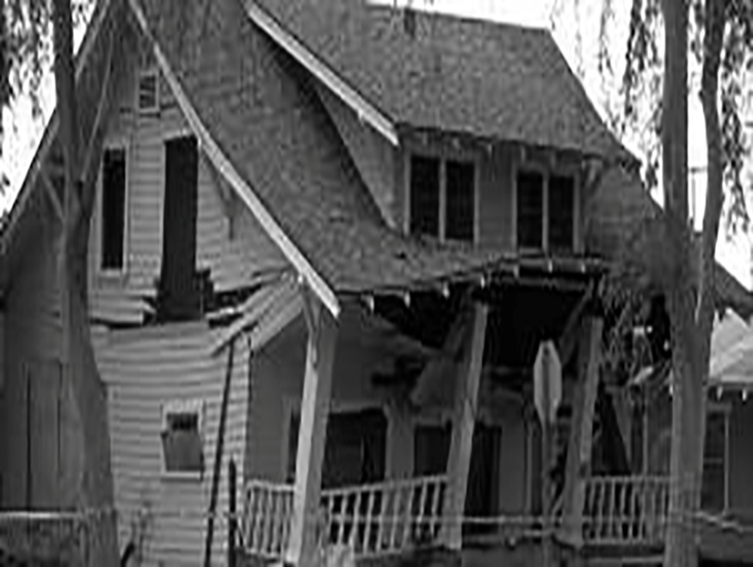
activity
List a minimum of FOUR hazards to site workers involved in cleanup following an earthquake?
After shocks
Unstable structures
Demolition
Electrical Hazards/Utilities
Heavy equipment
Chain Saws/Power Tools
Carbon Monoxide
Debris removal
Airborne smoke and dust: asbestos, silica, etc.
Hazardous materials
Bloodborne pathogens
Slips, trips, and falls
Lifting

Slide 16
activity
Use the Safety and Health Checklist to complete:
Hazard Recognition
Probability
Severity
Risk
Apply the Hierarchy of Health & Safety Controls

