Slide 1
Rigging Basics

Slide 2
Learning Objectives
Describe hazards and most common causes of rigging accidents
Recognize types of rigging equipment
Discuss training and qualifications for riggers
Understand how to choose the right rigging equipment for the job
Summarize OSHA standards/directives pertaining to rigging
Understand load capacities, limits and lifting principles
Understand hand signals

Slide 3
Common Rigging Hazards

Slide 4
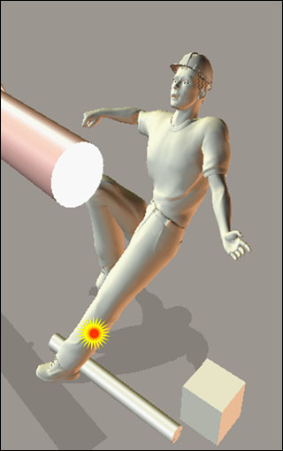
Fall Hazard Examples
Uneven working surfaces
Wet and slippery working surfaces
Working surfaces not cleared of obstructions
Improper use of portable ladder
Unprotected sides, floor openings and holes

Slide 5
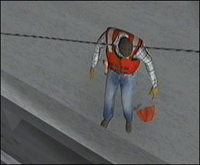
Struck-By & Crushing Hazard Examples
Gear and equipment not properly inspected
Defective gear and equipment
Moving parts and equipment
Loads not safely rigged before being hoisted
Improper use of tag line allowing hoisting material to swing out of control
Loads swung or suspended overhead
Hazardous locations between a swinging load and fixed object
*Workers can be injured by falling loads, falling booms overturning equipment being caught in moving machinery parts, and being struck by moving machinery or loads.

Slide 6
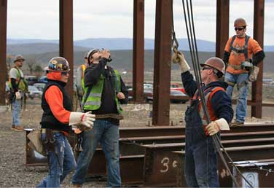
Electrical Hazard Examples
Use of hoisting and hauling equipment near energized lines
Tools and equipment not properly grounded
Defective electrical tools
Worn or frayed electric cables

Slide 7
Rigging Failure Examples

Slide 8
Crane Operator Crushed Between Two Steel Frames When Rigging Failed
The operator of an overhead crane was using a chain sling attached to the hook of the crane and was setting it up into a single choker hitch to pick up and turn over the steel frame that was lying horizontally on two sawhorses. The hook on the sling did not have a safety latch. The operator was standing between the load and another steel frame that was leaning vertically against the shop platform. The chain disconnected from the hook and the vertical steel frame fell towards him. He was crushed between the two steel frames.

Slide 9
Crane Operator Crushed Between Two Steel Frames When Rigging Failed
Possible ways to prevent this type of accident:
Ensure that workers do not place any part of their bodies into areas where they might become trapped when operating an overhead crane.
Ensure that the tools and equipment used are regularly inspected for defects and are replaced or repaired as needed.
Ensure that workers who use cranes are trained in rigging procedures.
Perform daily inspection of cranes using safety checklists to ensure that all equipment is working properly.
Ensure that the hook has a working safety latch, and if not, is moused.

Slide 10
Worker Killed When Struck by Falling Exhaust Stack
Workers were using a wheel-mounted crane to reposition two exhaust stacks that had been removed from a vessel. The exhaust stacks were being placed close to each other while they were being prepared for sandblasting and painting. The crane operator placed one exhaust stack on its side and leaned the second stack against it while preparing to move the second stack onto its side. The crane operator then slackened the line so that a rigger could reposition the wire rope. As the rigger approached the second stack, the 3-ton exhaust stack fell over and struck the rigger in the back of the head, killing him instantly.

Slide 11
Worker Killed When Struck by Falling Exhaust Stack
Possible ways to prevent this type of accident:
Fully understand the sequence of rigging events.
Understand the balance point of material.
Ensure the drop position is secure.
Ensure the lifted item is chocked, if possible.

Slide 12
OSHA Crane Standards
Construction – Cranes & Rigging
1926.1400-1442 – Cranes Subpart CC
1926.251 – Rigging equipment for material handling
Marine Terminals – Cargo Handling Gear and Equipment
1917.45 – Cranes and derricks (See also 1917.50).
1917.50 – Certification of marine terminal material handling devices
General Industry – 1910 Subpart N – Materials Handling And Storage
1910.179 – Overhead and gantry cranes
1910.180 – Crawler locomotive and truck cranes
1910.181 – Derricks
1910.183 – Helicopters
1910.184 – Slings

Slide 13
Wind Speed Incorporated by DOE Reference?
DOE STANDARD, HOISTING AND RIGGING
(Formerly Hoisting and Rigging Manual)
DOE-STD-1090-99
9.5.1 Conduct of Operator
v. In the absence of crane manufacturer’s instructions regarding maximum wind speeds for operation, operations undertaken at wind speeds in excess of 25 mph should be evaluated by a qualified person to determine if the size, shape and weight of the load can be safely lifted.
15.5.2 Mobile Cranes/Boom Trucks
7. In the absence of crane manufacturer’s instructions regarding maximum wind speeds for operation, operations undertaken at wind speeds in excess of 25 mph should be evaluated by a qualified person to determine if the size, shape and weight of the load can be safely lifted.
4.1 GENERAL
22. Personnel platforms should not be used in winds greater than 15 mph (25 km/h), electric storms, snow, ice, sleet, or other adverse weather conditions that could affect the safety of personnel.

Slide 14
OSHA Competent Person vs. Qualified Person
This is in response to your memorandum of January 28, on the above subject.
29 CFR 1926.32(f) states: "Competent person" means on who is capable of identifying existing and predictable hazards in the surroundings or working conditions, which are unsanitary, hazardous, or dangerous to employees, and who has authorization to take prompt corrective measures to eliminate them.
29 CFR 1926.32(l) states: "Qualified" means one who, by possession of a recognized degree, certificate, or profess- ional standing, or who by extensive knowledge, training and experience, has successfully demonstrated his ability to solve or resolve problems relating to the subject matter, the work, or the project.
These definitions provide that a competent person must have authority to take prompt measures to eliminate hazards at the work site and have the experience to be capable of identifying these hazards. This is the reason a competent person is required under inspection requirements in 29 CFR 1926.650 and 29 CFR 1926.651.
The definitions provide that a qualified person must have a recognized degree, certificate, etc., or extensive experience and ability to solve the subject problems, at the worksite. This is the reason why 29 CFR 1926.651(f) requires that supporting systems design shall be by a qualified person. There may be a requirement for more technical or engineering knowledge here.
Each excavation job as in any other case, must be evaluated as to the facts relating to the needs of a competent person, and qualified person.
The professional judgment of OSHA must come into play by using our construction regulations where they apply
Please advise if we can be of further assistance.

Slide 15
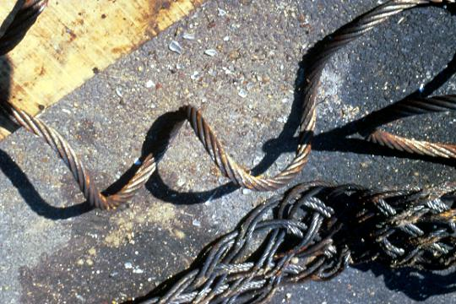
General Requirements
Rigging inspected prior to shift(s)
As necessary during use
Removed if defective
Remove rigging equipment when not in use
Notes:
Rigging equipment for material handling shall be inspected prior to use on each shift and as necessary during its use to ensure that it is safe. Defective rigging equipment shall be removed from service.
Rigging equipment shall not be loaded in excess of its recommended safe working load, as prescribed in Tables H-1 through H-20 in this subpart, following 1926.252(e) for the specific equipment.
Rigging equipment, when not in use, shall be removed from the immediate work area so as not to present a hazard to employees.

Slide 16
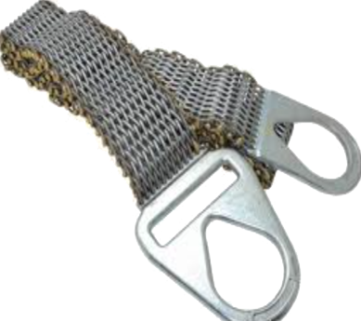
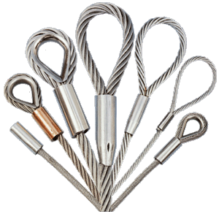
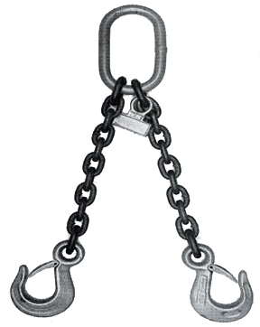
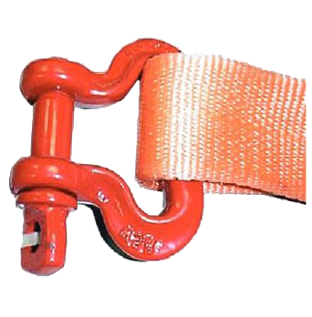
Material Handling Rigging Equipment
Metal Mesh
Wire Rope
Alloy Steel
Synthetic Fiber
Notes:
(5) "Scope." This section applies to slings used in conjunction with
other material handling equipment for the movement of material by
hoisting, in employment's covered by this part. The types of slings
covered are those made from alloy steel chain, wire rope, metal mesh, natural or synthetic fiber rope (conventional three strand construction), and synthetic web (nylon, polyester, and polypropylene).
1926.251(a)(6)
(6) "Inspections." Each day before being used, the sling and all
fastenings and attachments shall be inspected for damage or defects by a competent person designated by the employer. Additional inspections shall be performed during sling use, where service conditions warrant. Damaged or defective slings shall be immediately removed from service.

Slide 17
Sling Inspections
Each day before being used, the sling and all fastenings and attachments shall be inspected for damage or defects by a competent person designated by the employer. Additional inspections shall be performed during sling use, where service conditions warrant. Damaged or defective slings shall be immediately removed from service.

Slide 18
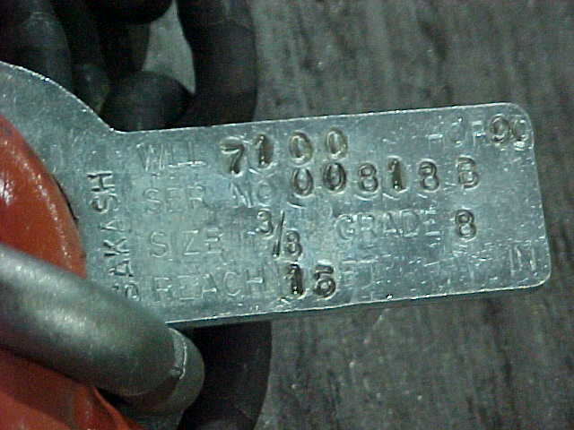
Alloy Steel Chain
Must have permanently affixed durable identification stating
Size
Grade
Rated capacity, and
Sling manufacturer
All attachments capacity at least equal to chain
Notes:
Welded alloy steel chain slings shall have permanently affixed durable identification stating size, grade, rated capacity, and sling manufacturer.
Hooks, rings, oblong links, pear-shaped links, welded or mechanical coupling links, or other attachments, when used with alloy steel chains, shall have a rated capacity at least equal to that of the chain.

Slide 19
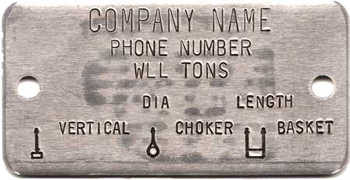
Wire Rope Slings
Sample Tag

Slide 20
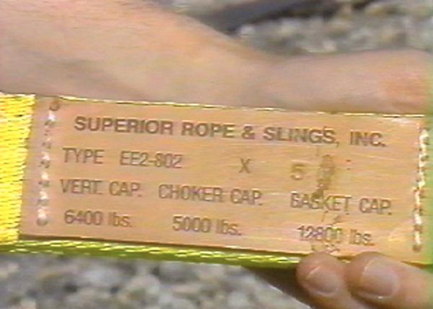
Synthetic Webbing Sling
Synthetic webbing (nylon, polyester, and polypropylene).
(1) Each synthetic web sling marked or coded to show:
(i) Name or trademark of manufacturer
(ii) Rated capacities for the type of hitch
(iii) Type of material
Notes:
(e) Synthetic webbing (nylon, polyester, and polypropylene).
(1) The employer shall have each synthetic web sling marked or coded to show:
(i) Name or trademark of manufacturer.
(ii) Rated capacities for the type of hitch.
(iii) Type of material.
(2) Rated capacity shall not be exceeded.
(3) "Webbing." Synthetic webbing shall be of uniform thickness and width and selvage edges shall not be split from the webbing's width.
(4) "Fittings." Fittings shall be:
(i) Of a minimum breaking strength equal to that of the sling; and
(ii) Free of all sharp edges that could in any way damage the webbing.

Slide 21
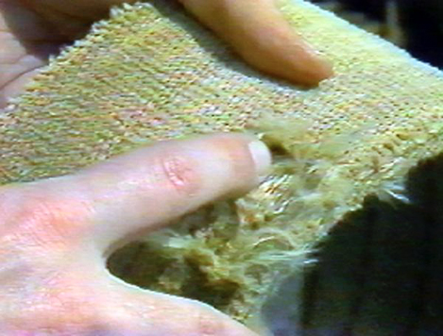
Synthetic Webbing Sling
Don’t use around acids or phenolics
Remove from service if:
Acid or caustic burns
Melting or charring of any part of the sling surface;
Snags, punctures, tears or cuts;
Broken or worn stitches; or
Distortion of fittings.
Notes:
Nylon web slings shall not be used where fumes, vapors, sprays, mists or liquids of acids or phenolics are present.
Polyester and polypropylene web slings shall not be used where fumes, vapors, sprays, mists or liquids of caustics are present.
Web slings with aluminum fittings shall not be used where fumes, vapors, sprays, mists or liquids of caustics are present.

Slide 22
Selecting the Right Hitch for Your Sling and Lift

Slide 23
Straight Hitch
Notes:
Not good for loose or long loads, or loads that can tip.

Slide 24
Choker Hitch
Is this bundle acceptable?
No, it must be bound together as one unit.
?

Slide 25
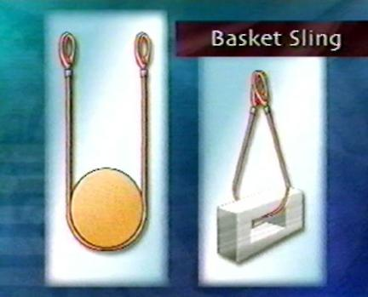
Basket Hitch

Slide 26
Qualified Rigger
Employers must use qualified riggers during hoisting activities for assembly and disassembly work.
Qualified riggers are also required whenever workers are within the fall zone and hooking, unhooking, or guiding a load, or doing the initial connection of a load to a component or structure.

Slide 27
Am I a Qualified Rigger?
A qualified rigger is a rigger who meets the criteria for a qualified person. Employers must determine whether a person is qualified to perform specific rigging tasks. Each qualified rigger may have different credentials or experience. A qualified rigger is a person that:
possesses a recognized degree, certificate, or professional standing, or has extensive knowledge, training, and experience, and
can successfully demonstrate the ability to solve problems related to rigging loads.

Slide 28
Am I a Qualified Rigger?
A qualified rigger must have the ability to properly rig the load for a particular lift. It does not mean that a rigger must be qualified to do every type of rigging job. Each load that requires rigging has unique properties that can range from the simple to the complex.
Example: A rigger may have extensive experience in rigging structural components and other equipment to support specific construction activities, but maybe not a particular piece of equipment or type of construction material.
A rigger’s experience may have been gained over many years. However, this experience does not automatically qualify the rigger to rig unstable, unusually heavy, or eccentric loads that may require a tandem lift, multiple-lifts, or use of custom rigging equipment. In essence, employers must make sure the person can do the rigging work needed for the exact types of loads and lifts for a particular job with the equipment and rigging that will be used for that job.

Slide 29
Certified/Qualified Operator vs. Rigger
A certified operator does not necessarily meet the requirements of a qualified rigger. Determining whether a person is a qualified rigger is based on the nature of the load, lift, and equipment used to hoist that load plus that person’s knowledge and experience. A certified/qualified operator may meet the requirements of a qualified rigger, depending on the operator’s knowledge and experience with rigging.

Slide 30
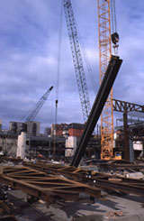
Working Under Loads
Routes for suspended loads must be preplanned to ensure that no employee is required to work directly below a suspended load, except for:
Employees engaged in the initial connection of the steel.
Employees necessary for the hooking or unhooking of the load.
When employees work under suspended loads, the following criteria must be met:
Materials being hoisted must be rigged to prevent unintentional displacement.
Hooks with self-closing safety latches or their equivalent must be used to prevent components from slipping out of the hook.
All loads must be rigged by a qualified rigger.

Slide 31
Communication is Key

Slide 32
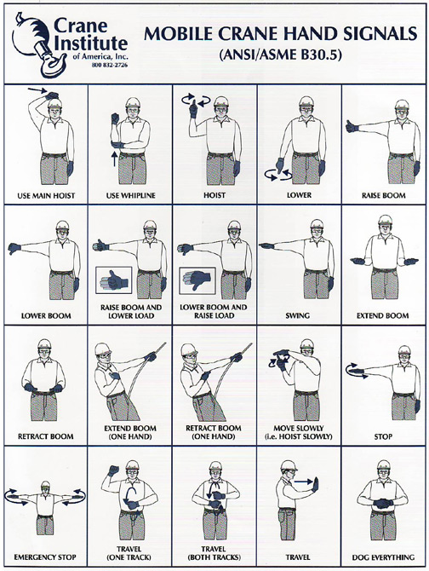
Hand Signals

Slide 33
Standard and Alternative Signals
Hand signal charts must be either posted on the equipment or conspicuously posted in the vicinity of the hoisting operations.
When using non-standard hand signals, the signal person, operator, and lift director (where there is one) must contact each other prior to the operation and agree on the non-standard hand signals that will be used.
Hand signal charts must be either posted on the equipment or conspicuously posted in the vicinity of the hoisting operation.

Slide 34
Review
What are some of the common hazards when rigging? Falls, Struck By, Crushed By, and Electrical.
Where can I find the safe lifting capacity for my rigging? On the tag attached to my sling.
MUST the rated capacity be noted on the rigging that I am using? Yes, because it is the only way I know what the safe working loads are.
Who determines if I am a qualified rigger? My employer.

