Slide 1
Confined Space Safety

Slide 2
Terminal Learning Objective
Upon the successful completion of this module, participants will have a greater understanding of confined spaces, their hazards, and the methods to control those hazards
Notes:
TRAINER SAYS:
The primary purpose for this training session is to make sure that you as a participant in this train the trainer class learn effective training and presentation techniques well enough to become an effective outreach trainer.
The objective is to show you some simple yet powerful presentation and training techniques.

Slide 3
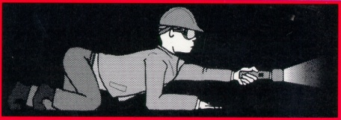
Enabling Learning Objectives
In this module, we will:
Describe the characteristics of confined spaces
Define Permit-Required Confined Spaces and Non-Permit-Required Confined Spaces and the hazards associated with these spaces

Slide 4
Enabling Learning Objectives
In this module, we will:
List the elements of the Entry Permit
Discuss how the hazards are managed, including atmospheric testing and ventilation

Slide 5
Enabling Learning Objectives
Describe the responsibilities of the entry supervisor, attendant, and entrant
and
Define and discuss the three types of rescue scenarios: self-rescue, non-entry rescue, and entry rescue

Slide 6
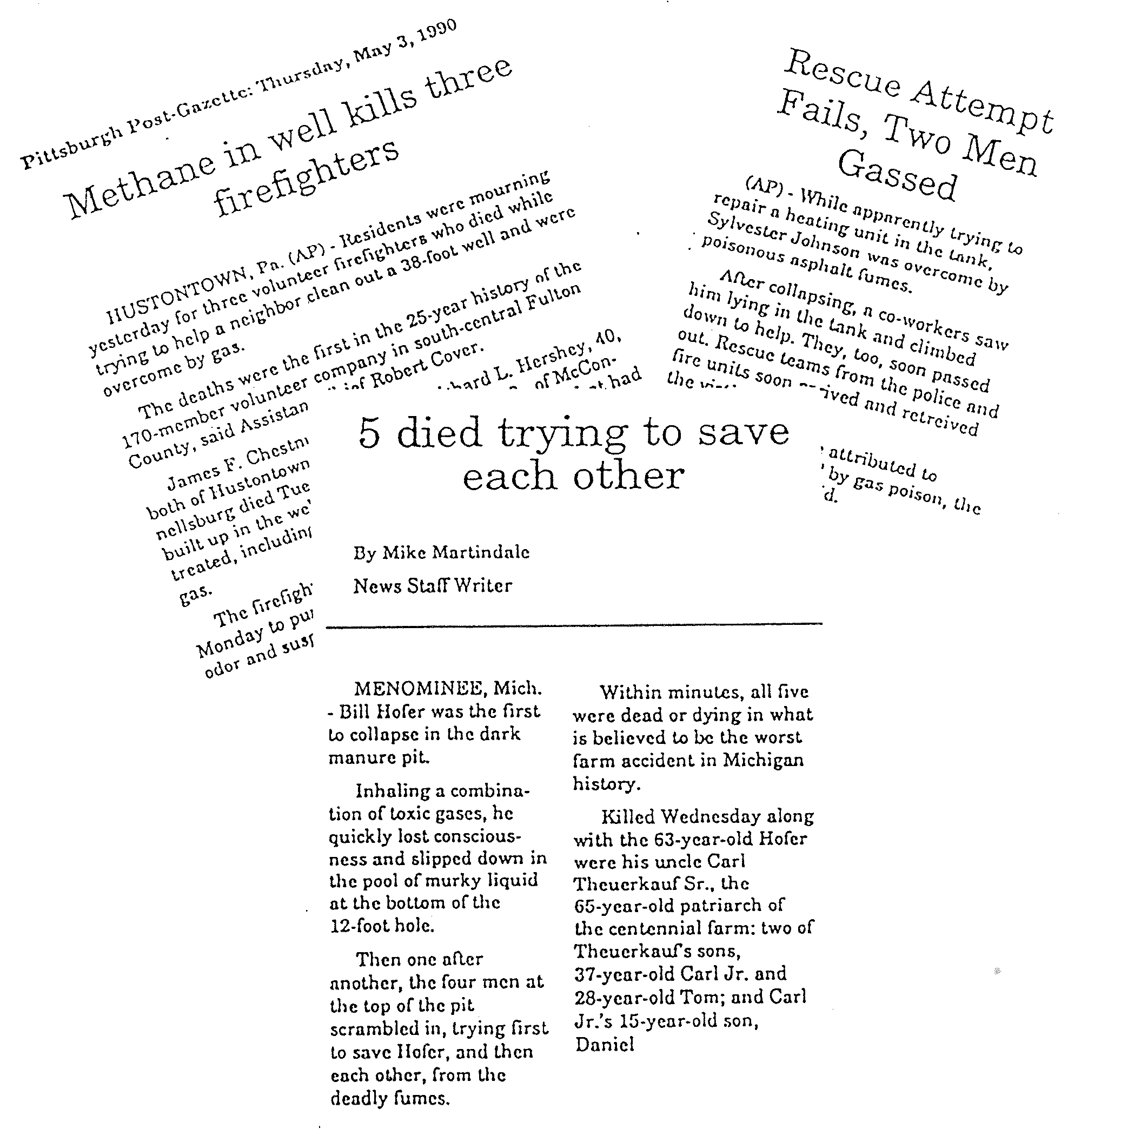
Accidents Within Confined Spaces
92 Fatalities
per Year

Slide 7
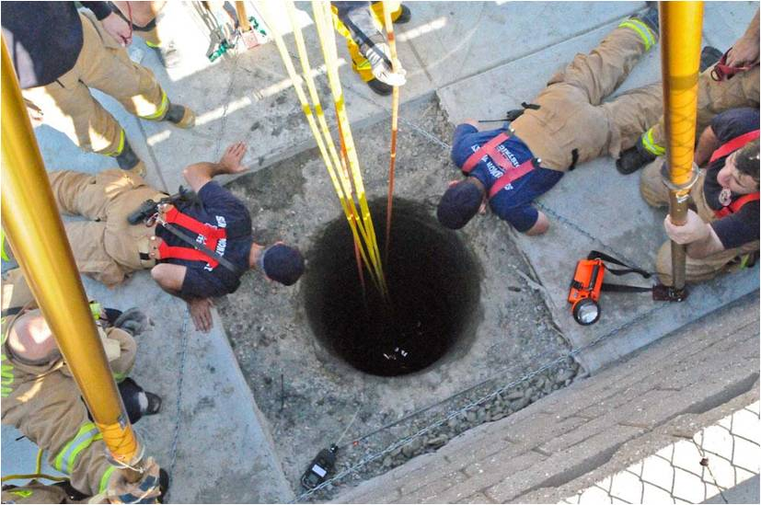
Accidents Within Confined Spaces
Following proper procedures will prevent 80 – 90% of these accidents.

Slide 8
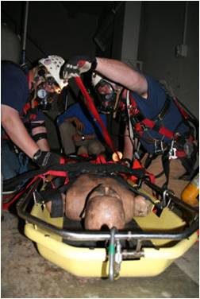
Predictable = Preventable
If we understand the hazards, every accident can be predicted.
Therefore, they can be prevented.

Slide 9
If we can keep one worker from getting into trouble in a confined space, we will be saving two or three.
65% of the people who die in these spaces are would-be rescuers — people who see someone passed out and in trouble, so they jump in to help the victim.

Slide 10
Confined Spaces and Permit Spaces
Confined Space Characteristics:
Large enough to enter
Limited entry & exit openings
Not designed for continuous occupancy

Slide 11
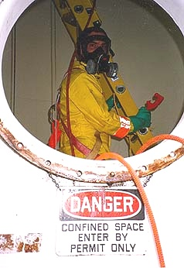
A Permit-Required Confined Space is . . .
A confined space with one or more of the following:
Hazardous atmosphere (or potential)
Engulfment potential
Entrapment potential
Other serious safety/health hazard

Slide 12
Hazards of Permit Spaces
Design and use-caused hazards
Hazardous atmosphere, engulfing material, sloping walls or floor
Work-caused hazards
Work activities can create serious hazards including hazardous atmospheres, noise and heat

Slide 13
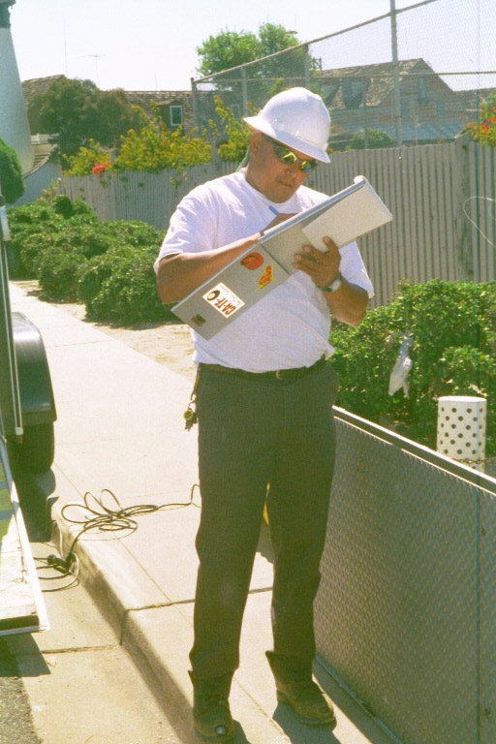
Permit Program Components
Identify confined & permit spaces
Assess the hazards
Determine how to manage/control hazards
Produce entry procedures
Develop entry permit

Slide 14
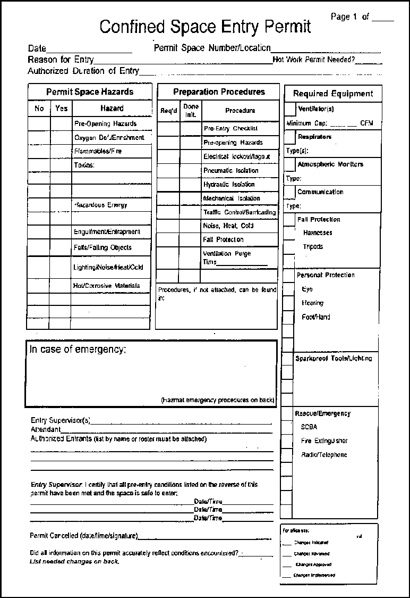
The Permit
Permit Space
Purpose of entry
Date & authorized duration of the permit
Authorized entrants
Attendants

Slide 15
The Permit
Entry Supervisor
Hazards of the space
Hazard control procedures
Emergency procedures
Equipment
Other information

Slide 16
The Permit (cont.)
Permits should be posted at the entrance of the confined space.


Slide 17
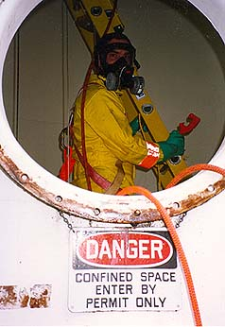
Entrant’s Responsibilities
Know all the hazards and signs of exposure
Use all confined space equipment
Keep in contact with attendant and alert if needed
Evacuate if needed

Slide 18
Entrant’s Responsibilities (cont.)
You become an entrant when any part of your body breaks the plane of the opening.

Slide 19
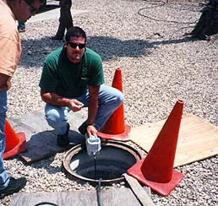
Attendant’s Responsibilities
Remain at the entrance to the space
Know hazards & signs of exposure
Track the entrants and only allow authorized entrants to enter
Keep constant communication

Slide 20
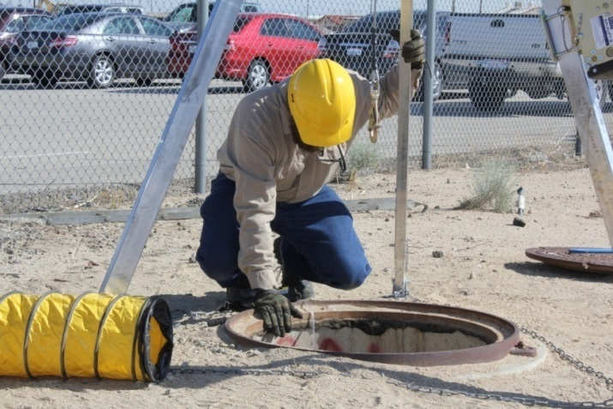
Attendant’s Responsibilities (cont.)
Protect entrants from external hazards
Monitor work activities and watch out for hazards
Contact the rescue team, if needed

Slide 21
Entry Supervisors
Know hazards and signs of exposure
Ensures all hazards are controlled
Ensures entry conditions are acceptable
Signs the permit to authorize entry & also cancels the entry permit

Slide 22
Module 1: Summary
Characteristics of confined spaces
Main hazards
Permit
Responsibilities of entrants and attendants

Slide 23
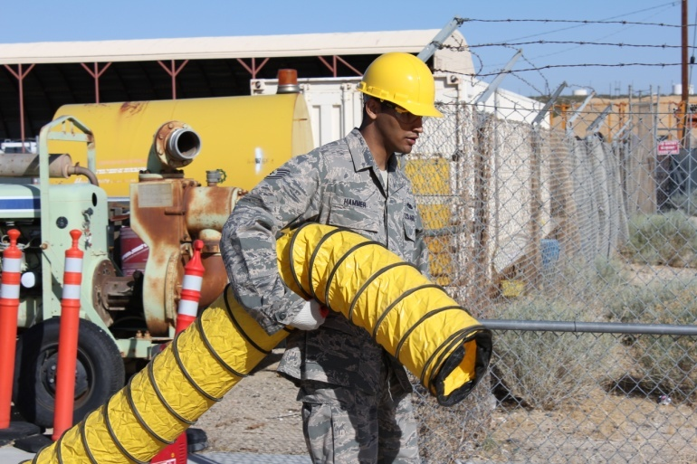
Module 2: Hazards
Isolating the permit space
Heat stress and noise hazards
Hazardous atmospheres

Slide 24
Isolation
Many permit space accidents occur when hazardous energy or material enter the space.

Slide 25
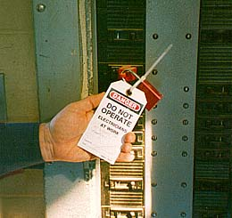
Isolation Methods
Double block & bleed
Lockout/tagout
Blanking and bleeding
Disconnecting mechanical linkages

Slide 26
Isolation (cont.)
The entry permit should specify which isolation measures must be taken to make the space safe to enter.


Slide 27
Heat Hazards
120
110
100
90
80
70
60
50
40
30
Heat Rash
Heat Cramps
Heat Exhaustion
Heat Stroke

Slide 28
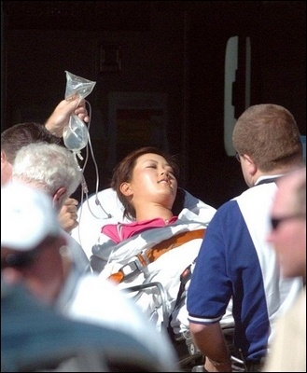
Heat stroke is a life-threatening condition. This is an emergency. The victim should be cooled down with running water, moist cloths, and fanning (apply ice to limited areas). Administer fluids if the victim is able to accept them. Do not give aspirin, medication, alcohol, or stimulants (caffeine/cigarettes).

Slide 29
Hazardous atmospheres cause many of the accidents in confined spaces.
Atmospheric Hazards
An atmosphere that seems safe near the entrance can be deadly just a few feet away.

Slide 30
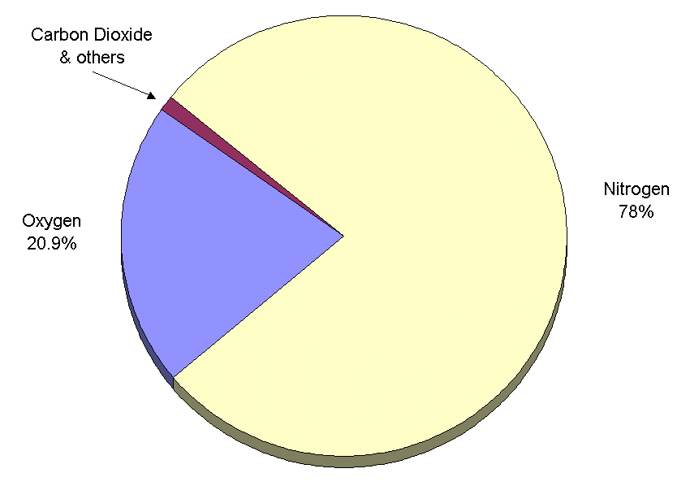
Atmospheric Hazards
Other Gases
1%
Oxygen
20.9%
Composition of
Normal Air
Nitrogen
78%

Slide 31
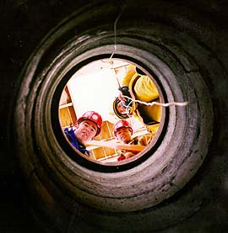
Types of Hazardous Atmospheres
Oxygen deficient: Less than 19.5 % O₂
Flammable: LEL over 10% or O₂ above 23.5 %
Toxic: Toxic gases, vapors, mists or dusts at or above exposure limits
It is possible to have any combination of these three hazards.

Slide 32
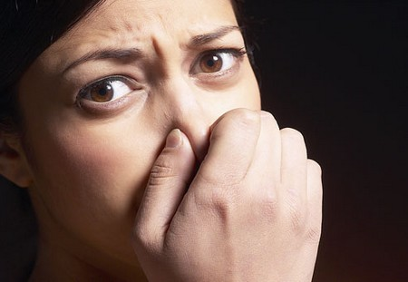
Hazardous Atmospheres
Human senses (sight, smell, taste) cannot protect you from hazardous atmospheres since some gases have no taste or odor.

Slide 33
Gas Behavior in Confined Spaces
Rises
Stratification
Pocketing
Vapor Densities
Pockets
Sinks

Slide 34
Gas Behavior in Confined Spaces
If the gas is heavier than air (V.D. > 1), the gas will sink.
If the gas is lighter than air (V.D. < 1), the gas will rise.
The possibility of layers or pockets is the reason to check/test all levels of the confined space.
Key Point: Remember to check the vapor densities of any contaminant you suspect may be present.

Slide 35
Oxygen Deficient Atmospheres
Common in spaces with little or no natural ventilation
OXYGEN
less than
Air with oxygen levels lower than 19.5% is HAZARDOUS.

Slide 36
Causes of Oxygen Deficiency
Displacement
Bacteria (decay/rot)
Oxidation (rust)
Combustion
Absorption
OXYGEN

Slide 37
Symptoms of O₂ Deficiency
Oxygen Level
Symptoms
19.5%
15 – 19%
12 – 14%
10 – 12%
8 – 10%
6 – 8%
0 – 6%
Minimum permissible level
Possibly impaired coordination
Respiratory/pulse increase, impaired judgment/coordination
Further increase in respiration, pulse
Fainting, nausea, vomiting, blue lips
4 – 5 minutes: Recovery with treatment
6 minutes: 50% mortality
8 minutes: 100% mortality
Coma in 40 seconds or less

Slide 38
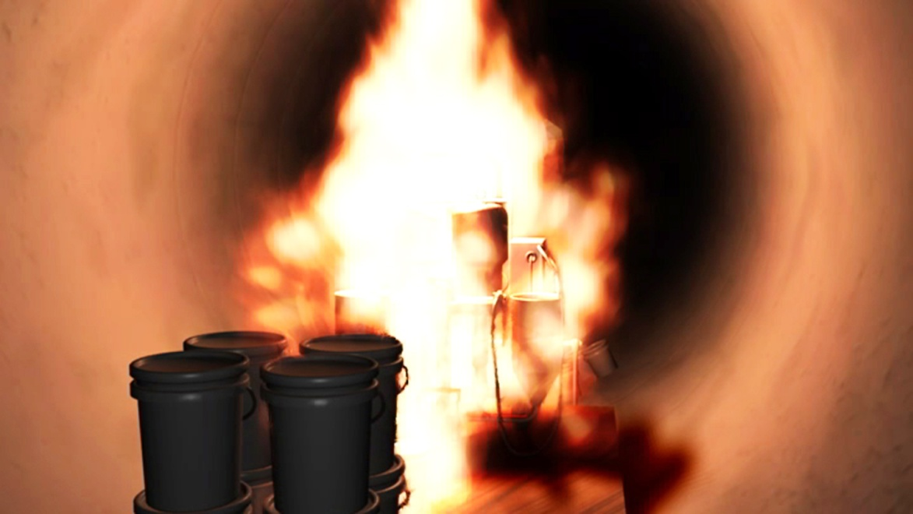
Oxygen Hazards
Never ventilate a space with pure oxygen because oxygen levels higher than 23.5 % increase the fire hazard in and around the space.

Slide 39
Combustible Atmospheres
Sufficient oxygen
Sufficient fuel
Ignition source (flame, spark, hot surface)
The Fire Triangle

Slide 40
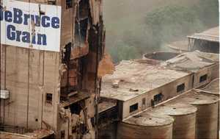
Combustible Particulate Atmospheres
If vision is obscured by combustible dusts or mists at a distance of five feet, a hazard exists.
Some particulates may pose a hazard at lower concentrations.
Examples include: coal dust, grain dust, saw (wood) dust, and sugar.

Slide 41
Flammable Range, UEL, LEL
Flammable (Explosive) Range.
The range of flammable vapor or gas-air mixture between the upper and lower flammable limits is known as the "flammable range", also often referred to as the "explosive range".

Slide 42
Flammable Range, UEL, LEL
Lower Explosive Limit (LEL)
-or Lower Flammable Limit (LFL)
The lower explosive limit (LEL) or lower flammable limit (LFL) of a combustible gas is defined as the smallest amount of the gas that will support a self-propagating flame when mixed with air (or oxygen) and ignited.
Below the LEL/LFL, the mixture is said to be too “lean” to burn.

Slide 43
Flammable Range, UEL, LEL
Upper Explosive Limit (LEL)
-or Upper Flammable Limit (LFL)
The upper explosive limit (LEL) or upper flammable limit (LFL) of a combustible gas is defined as the maximum amount of the gas that will support a self-propagating flame when mixed with air (or oxygen) and ignited.
Above the UEL/UFL, the mixture is said to be too “rich” to burn.

Slide 44
Toxic Atmospheres
Sources:
Bacteria
Toxins stored (or once stored) in the space
Substances brought into space
Work being done in or near space
Engine exhaust

Slide 45
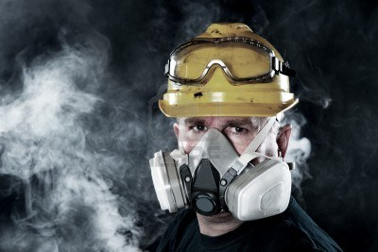
Toxic Atmospheres (cont.)
A toxic atmosphere is present whenever gases, dusts, mists, or vapors exist in concentrations that can cause illness or injury.

Slide 46
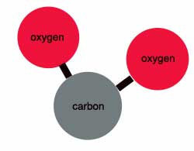
Carbon Dioxide (CO₂)
Odorless
Colorless
Component of normal air (which contains about 370 ppm of CO₂).
Heavier than air
Common as dry ice or compressed liquid
Product of organic decay
Byproduct of fermentation

Slide 47
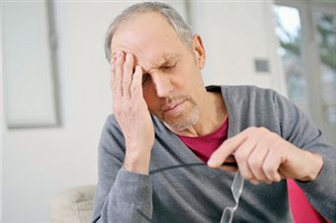
Carbon Dioxide: Symptoms of Overexposure
Headache and dizziness
Prickling or burning skin sensations
Breathing difficulty or painful breathing
Sweating and a sense of malaise

Slide 48
Carbon Monoxide (CO)
Component of engine exhaust; product of incomplete combustion
Odorless and colorless
Interferes with blood’s ability to transport oxygen

Slide 49
Carbon Monoxide: Symptoms of Overexposure
CO Level
Symptoms
Exposure Time
35
200
400 – 600
1000 – 2000
2000 - 5000
Permissible Exposure Level
Slight headache, other discomfort
Headache, discomfort, irritation
Confusion, headache, nausea, tendency to stagger, slight heart palpitations
Unconsciousness
8 hours
3 hours
1 – 2 hours
½ - 2 hours
Minutes

Slide 50
Hydrogen Sulfide (H₂S)
Associated with sewers, the oil and gas industry, and organic decay
Irritant of the mucous membranes
Highly toxic
Flammable (LEL = 4% by volume)
Heavier than air; rotten egg odor
Diminishes a person’s ability to smell

Slide 51
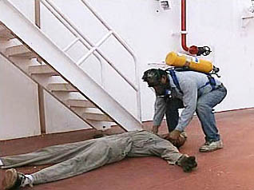
Hydrogen Sulfide:
Symptoms of Overexposure
Irritation of the eyes and respiratory tract
Temporary suspension of breathing (apnea)
Dizziness and headache
Fatigue

Slide 52
Hydrogen Sulfide Exposure
H₂S Level
Symptoms
Exposure Time
10
50 – 100
200 – 300
500 – 700
1000
Permissible Exposure Level
Mild eye and respiratory irritation
Marked eye and respiratory irritation
Unconsciousness, death
Unconsciousness, death
Ceiling Limit
1 hour
1 hour
½ - 1 hour
Minutes

Slide 53
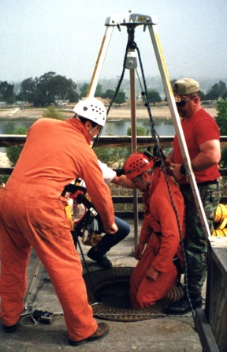
Module 3 – Making Safe Entries
Monitors
Ventilators and other equipment
Emergencies

Slide 54
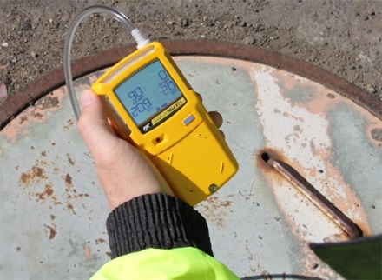
Atmospheric Monitors
Always test air before breathing it!
Atmospheric Monitors (gas detectors/indicators) contain sensors that react with the contaminant.
You should always calibrate and zero the monitor. You also should ensure that the alarms are working, and that you will be able to see and hear them.
An inaccurate monitor will not protect you.

Slide 55
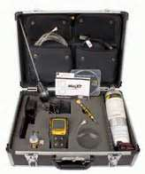
Calibration and Zeroing
Calibration means to expose the monitor to a sample gas with known concentrations.
Zeroing the instrument means to expose the monitor to a fresh-air atmosphere, free of contaminants, during initial set-up of the instrument.
Sensors wear out over time, and some substances reduce sensor accuracy.

Slide 56
Assessing Air Quality
Rise
If not using a multi-gas monitor:
TEST FOR O₂ FIRST
Test for combustibles
Test for toxins
Float
Sink
Be sure to test ALL levels

Slide 57
Most explosions and fires occur at the point of entry.

Slide 58
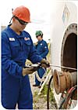
Atmospheric Monitors: Summary
Essential for entering most permit spaces
Calibrate and zero
Make sure alarms work and can be heard in the space
Test ALL levels

Slide 59
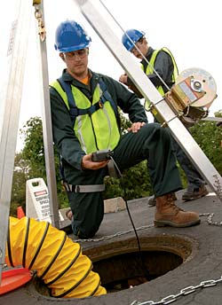
Communications
Attendant and entrant must remain in constant communication.
Attendant must be able to summon rescue team.
Can use hand or rope signals, radios, hard-wired systems.

Slide 60
Harnesses & Tripods
Provide fall protection
Attendant can rescue an entrant without assistance
Raise and lower entrant
Can cause entanglement problems

Slide 61
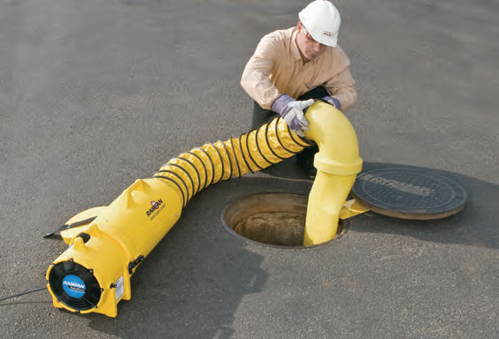
Ventilators/Blowers
Purge times are on the size of the space and atmospheric testing
Hang hose properly - 1 foot below ceiling, 2 feet above floor
Ensure blower supplies clean air

Slide 62
Space Ventilation
WIND
WIND
SHORT CIRCUITING
RECIRCULATING
Hose too short
Air turns to path of least resistance
Fan intake in downwind
Hazardous air is drawn into fan

Slide 63
Space Ventilation
WIND
WIND
POSITIVE PRESSURE
NEGATIVE PRESSURE
One opening
Lighter than air gases
One opening
Heavier than air gases

Slide 64
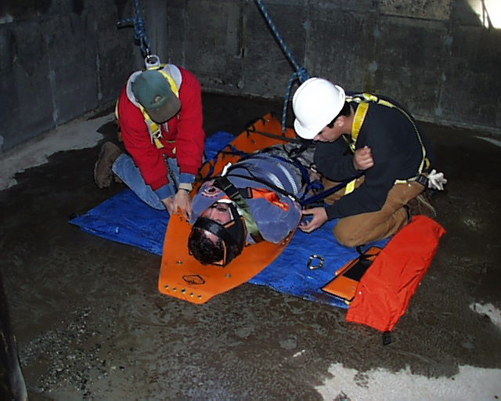
Emergency Procedures
The easiest emergency to deal with is one which never occurs . . .
. . .but accidents happen and you need to know what to do.

Slide 65
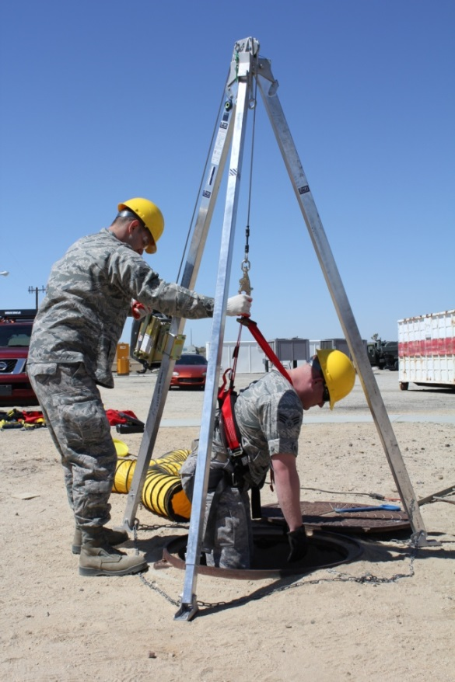
In an Emergency:
Contact rescue team
Attempt “non-entry” rescue/retrieval

Slide 66
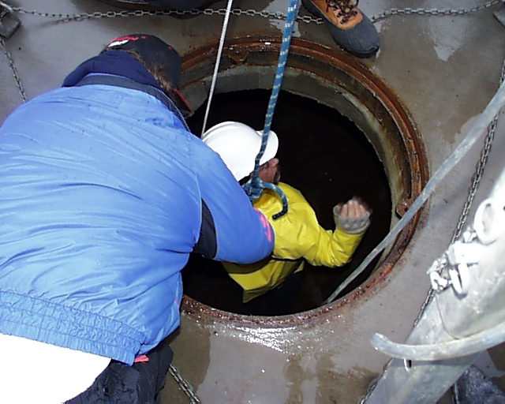
Evacuation Required When . . .
Alarm on any testing instrument goes off
O₂ drops to below 19.5% or rises above 23.5%
Combustibles rise above 10% of LEL/LFL
Toxins rise over exposure limits
Outside conditions pose a hazard
Entrant exhibits signs of exposure
Attendant must leave post

Slide 67
Initiating an Evacuation
Entry supervisor, entrant or attendant can order an evacuation.
All entrants must evacuate immediately.
The permit should list emergency procedures.

Slide 68
Attendant should stand by and brief rescuers when they arrive:
Number, location, identity, & condition of entrants
Cause of emergency
Conditions in permit space

Slide 69
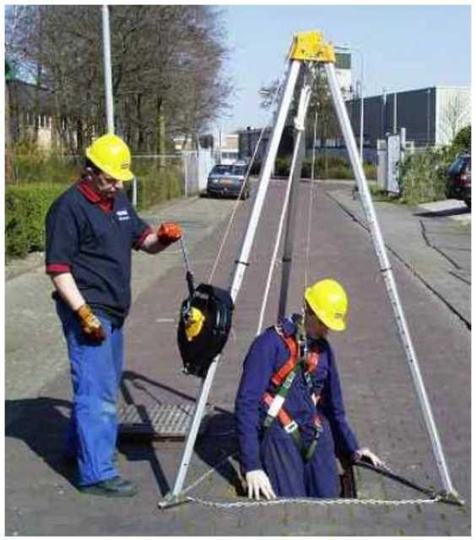
Rescue Equipment Components
Full-Body Harness
Lifeline
Mechanical Retrieval Device (winch, tripod)

Slide 70
Attendants should remember:
When in doubt,
get them OUT!

Slide 71
Module 3: Summary
Monitors
Ventilators and other equipment
Emergencies

Slide 72
Review
In this module, we:
Described the characteristics of confined spaces
Defined Permit-Required Confined Spaces and Non-Permit-Required Confined Spaces and the hazards associated with these spaces
Listed the elements of the Entry Permit

Slide 73
Review (cont’d)
Discussed how the hazards are managed, including atmospheric testing and ventilation
Described the responsibilities of the entry supervisor, attendant, and entrant
Defined and discussed the three types of rescue scenarios: self-rescue, non-entry rescue, and entry rescue

Slide 74
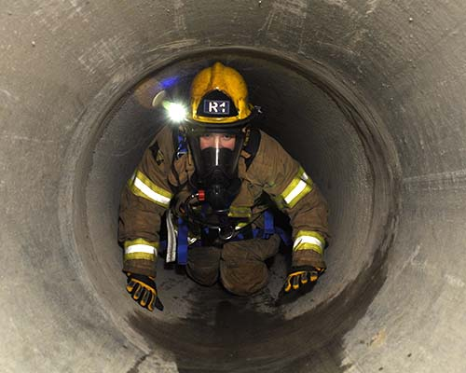
Questions?

