Slide 1

Top Ten Violations in Construction FY 2018
Fall Protection – General Requirements (1926.501)
Scaffolding (1926.451)
Ladders (1926.1053)
Fall Protection – Training (1926.503)
Eye and Face Protection (1926.102)
General Safety and Health Provisions (1926.20)
Head Protection (1926.100)
Aerial Lifts (1926.453)
Hazard Communication (1910.1200)
Fall Protection – Systems Criteria and Practices (1926.502)
Notes:
This is a list of the top 10 most frequently cited OSHA standards following inspections of construction worksites by federal OSHA. OSHA publishes this list to alert employers about these commonly cited standards so they can take steps to find and fix recognized hazards addressed in these and other standards before OSHA shows up.
The following slides show the top 5 sub-sections that OSHA cites for each of these standards.

Slide 2
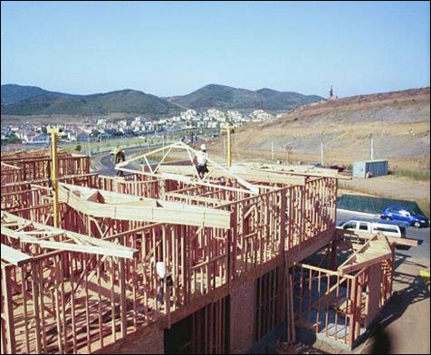
Top Ten Violations: FY 2018
(with top 5 sections cited)
1) 1926.501 - Fall Protection
1926.501(b)(13) (4,577 violations) – fall protection in residential construction
1926.501(b)(1) (1,126 violations) – unprotected sides and edges
1926.501(b)(10) (596 violations) – roofing work on low-slope roofs
1926.501(b)(11) (429 violations) – steep roofs
1926.501(b)(4)(i) (117 violations) – protection from falling through holes, including skylights

Slide 3
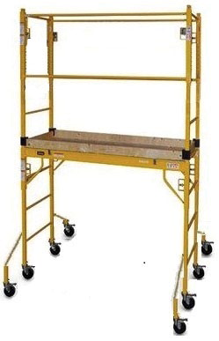
Top Ten Violations: FY 2018
(with top 5 sections cited)
2) 1926.451 - Scaffolding
1926.451(g)(1) (553 violations) – fall protection
1926.451(e)(1) (413 violations) – providing access
1926.451(b)(1) (333 violations) – platform construction
1926.451(g)(1)(vii) (253 violations) – use of personal fall arrest or guardrail systems
1926.451(c)(2) (147 violations) – foundation for supported scaffold poles, legs, posts, frames, and uprights

Slide 4
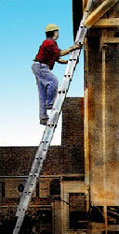
Top Ten Violations: FY 2018
(with top 5 sections cited)
3) 1926.1053 - Ladders
1926.1053(b)(1) (1,605 violations) – extending portable ladder side rails at least 3 feet above upper landing surface
1926.1053(b)(4) (373 violations) – using ladders only for purpose for which they were designed
1926.1053(b)(13) (261 violations) – not using the top or top step of a stepladder as a step
1926.1053(b)(16) (120 violations) – marking or tagging portable ladders with structural defects and removing them from service
1926.1053(b)(6) (74 violations) – using ladders only on stable and level surfaces unless secured

Slide 5
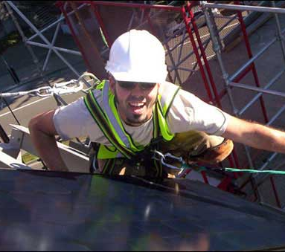
Top Ten Violations: FY 2018
(with top 5 sections cited)
4) 1926.503 – Fall Protection, Training
1926.503(a)(1) (1,286 violations) – training program for each employee who might be exposed to fall hazards
1926.503(b)(1) (368 violations) – written training certification
1926.503(c)(3) (113 violations) – retraining required when inadequacies in employee’s knowledge or use of fall protection systems or equipment indicate that the employee has not retained the requisite understanding or skill
1926.503(a)(2) (85 violations) – training by a competent person qualified in specified areas
1926.503(a)(2)(iii) (46 violations) – training by a competent person on fall protection to be used, including guardrail, personal fall arrest, safety net, warning line, and safety monitoring systems, and controlled access zones

Slide 6


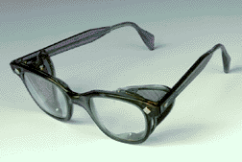
www.osha.gov
We Can Help
Top Ten Violations: FY 2018
(with top 5 sections cited)
5) 1926.102 – Eye and Face Protection
1926.102(a)(1) (1,475 violations) – ensuring that each affected employee uses appropriate eye or face protection when exposed to eye or face hazards
1926.102(a)(2) (48 violations) – ensuring that each affected employee uses eye protection that provides side protection when there is a hazard from flying objects
1926.102(a)(3) (4 violations) – employees that wear prescription lenses
1926.102(b)(1) (2 violations) – protective eye and face protection devices must comply with any of the specified consensus standards
Notes:
Only 4 sub-sections of this standard were cited in FY 2018.

Slide 7
www.osha.gov
We Can Help
Top Ten Violations: FY 2018
(with top 5 sections cited)
6) 1926.20 – General Safety and Health Provisions
1926.20(b)(2) (510 violations) – inspections of job sites, materials, and equipment by competent persons
1926.20(b)(1) (447 violations) – accident prevention programs
1926.20(b)(4) (15 violations) – only employees qualified by training or experience can operate equipment and machinery
1926.20(b)(3) (6 violations) – tagging/locking controls of unsafe machinery, tools, materials, or equipment, or removing from place of operation
1926.20(a)(1) (2 violations) – contractor requirements

Slide 8
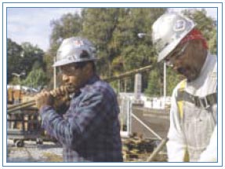
www.osha.gov
We Can Help
Top Ten Violations: FY 2018
(with top 5 sections cited)
7) 1926.100 – Head Protection
1926.100(a) (956 violations) – employees must wear protective helmets when working in areas with possible danger of head injury from impact, falling or flying objects, or electrical shocks and burns.
Note that this was the only sub-section of 1926.100 with violations.

Slide 9
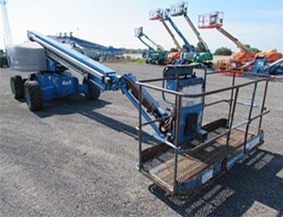
www.osha.gov
We Can Help
Top Ten Violations: FY 2018
(with top 5 sections cited)
8) 1926.453 – Aerial Lifts
1926.453(b)(2)(v) (769 violations) – body belts and lanyards
1926.453(b)(2)(iv) (92 violations) – prohibition on sitting or climbing on edge of basket or using planks or ladders for a work position
1926.453(b)(2)(vi) (16 violations) – boom and basket load limits
1926.453(b)(2)(i) (6 violations) – daily testing of lift controls prior to use
1926.453(a)(2) (4 violations) – field modification of aerial lifts

Slide 10

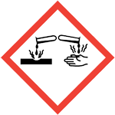
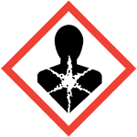
www.osha.gov
We Can Help
Top Ten Violations: FY 2018
(with top 5 sections cited)
9) 1910.1200 - Hazard Communication
1910.1200(e)(1) (1,510 violations) – written hazard communication program
1910.1200(h)(1) (1,170 violations) – employee information and training
1910.1200(g)(8) (496 violations) – maintaining copies of Safety Data Sheets in the workplace and ensuring that they are readily available to employees
1910.1200(g)(1) (331 violations) – having Safety Data Sheets in the workplace for each hazardous chemical
1910.1200(f)(6)(ii) (196 violations) – labeling containers of hazardous chemicals with product identifier and words, pictures, symbols, or combination thereof

Slide 11
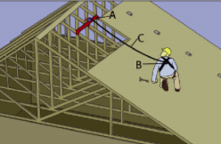
www.osha.gov
We Can Help
Top Ten Violations: FY 2018
(with top 5 sections cited)
10) 1926.502 – Fall Protection, Systems Criteria and Practices
1926.502(d)(16)(iii) (94 violations) – rigging of personal fall arrest systems to prevent free fall more than 6 feet or contact with a lower level
1926.502(d)(15) (92 violations) – anchorages for personal fall arrest systems
1926.502(d)(17) (57 violations) – attachment points of body belt and harness
1926.502(i)(4) (46 violations) – color coding or marking of covers
1926.502(i)(3) (45 violations) – securing covers to prevent accidental displacement by wind, equipment, or employees

