Slide 1


www.osha.gov
We Can Help
1. Fall Protection – General Requirements (1926.501)
2. Hazard Communication (1910.1200)
3. Scaffolding (1926.451)
4. Respiratory Protection (1910.134)
5. Lockout/Tagout (1910.147)
6. Ladders (1926.1053)
7. Powered Industrial Trucks (1910.178)
8. Fall Protection – Training Requirements (1926.503)
9. Machine Guarding (1910.212)
10. Eye and Face Protection (1926.102)
Top Ten
Violations
Most frequently cited OSHA standards
during FY 2018 inspections
Notes:
This is a list of the top 10 most frequently cited standards following inspections of worksites by federal OSHA. OSHA publishes this list to alert employers about these commonly cited standards so they can take steps to find and fix recognized hazards addressed in these and other standards before OSHA shows up.
The following slides show the top 5 sub-sections that OSHA cites for each of these standards.

Slide 2
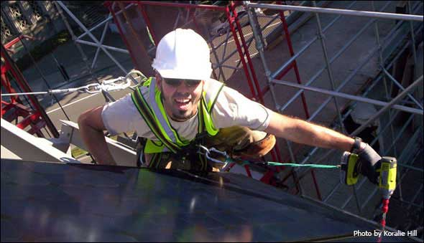
www.osha.gov
We Can Help
Top Ten Violations: FY 2018
(with top 5 sections cited)
1) 1926.501 - Fall Protection
1926.501(b)(13) (4,577 violations) – fall protection in residential construction
1926.501(b)(1) (1,126 violations) – unprotected sides and edges
1926.501(b)(10) (596 violations) – roofing work on low-slope roofs
1926.501(b)(11) (429 violations) – steep roofs
1926.501(b)(4)(i) (117 violations) – protection from falling through holes, including skylights

Slide 3


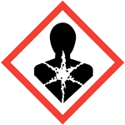
www.osha.gov
We Can Help
Top Ten Violations: FY 2018
(with top 5 sections cited)
2) 1910.1200 - Hazard Communication
1910.1200(e)(1) (1,510 violations) – written hazard communication program
1910.1200(h)(1) (1,170 violations) – employee information and training
1910.1200(g)(8) (496 violations) – maintaining copies of Safety Data Sheets in the workplace and ensuring that they are readily available to employees
1910.1200(g)(1) (331 violations) – having Safety Data Sheets in the workplace for each hazardous chemical
1910.1200(f)(6)(ii) (196 violations) – labeling containers of hazardous chemicals with product identifier and words, pictures, symbols, or combination thereof

Slide 4
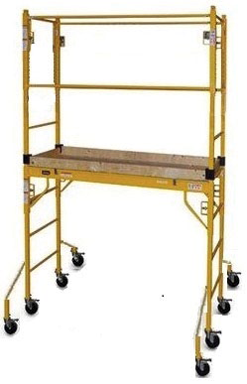
www.osha.gov
We Can Help
Top Ten Violations: FY 2018
(with top 5 sections cited)
3) 1926.451 - Scaffolding
1926.451(g)(1) (553 violations) – fall protection
1926.451(e)(1) (413 violations) – providing access
1926.451(b)(1) (333 violations) – platform construction
1926.451(g)(1)(vii) (253 violations) – use of personal fall arrest or guardrail systems
1926.451(c)(2) (147 violations) – foundation for supported scaffold poles, legs, posts, frames, and uprights

Slide 5

www.osha.gov
We Can Help
Top Ten Violations: FY 2018
(with top 5 sections cited)
4) 1910.134 – Respiratory Protection
1910.134(e)(1) (583 violations) – medical evaluation to determine employee’s ability to use a respirator
1910.134(c)(1) (450 violations) – written respiratory protection program
1910.134(f)(2) (276 violations) – fit testing for employees using a tight-fitting facepiece respirator: testing frequency
1910.134(c)(2)(i) (208 violations) – providing respirators at request of employees or permitting employees to use their own respirators
1910.134(f)(1) (202 violations) – fit testing for employees using a tight-fitting facepiece respirator: qualitative fit test or quantitative fit test

Slide 6
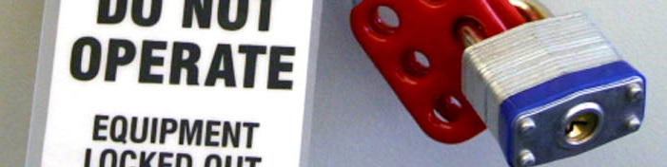
www.osha.gov
We Can Help
Top Ten Violations: FY 2018
(with top 5 sections cited)
5) 1910.147 – Lockout/Tagout
1910.147(c)(4)(i) (587 violations) – developing, documenting, and utilizing energy control procedures
1910.147(c)(6)(i) (342 violations) – periodic inspection of energy control procedure at least annually
1910.147(c)(1) (332 violations) – establishing an energy control program
1910.147(c)(7)(i) (263 violations) – training on the energy control program
1910.147(d) (180 violations) – elements of lockout/tagout procedures

Slide 7
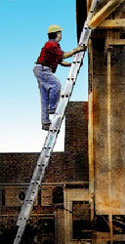
www.osha.gov
We Can Help
Top Ten Violations: FY 2018
(with top 5 sections cited)
6) 1926.1053 - Ladders
1926.1053(b)(1) (1,605 violations) – extending portable ladder side rails at least 3 feet above upper landing surface
1926.1053(b)(4) (373 violations) – using ladders only for purpose for which they were designed
1926.1053(b)(13) (261 violations) – not using the top or top step of a stepladder as a step
1926.1053(b)(16) (120 violations) – marking or tagging portable ladders with structural defects and removing them from service
1926.1053(b)(6) (74 violations) – using ladders only on stable and level surfaces unless secured

Slide 8
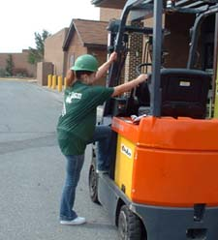
www.osha.gov
We Can Help
Top Ten Violations: FY 2018
(with top 5 sections cited)
7) 1910.178 – Powered Industrial Trucks
1910.178(l)(1)(i) (418 violations) – operator training: ensuring that operators are competent to safely operate a powered industrial truck as demonstrated by completion of training and evaluation
1910.178(l)(4)(iii) (263 violations) – refresher training and evaluation: evaluation of operator’s performance must be conducted at least once every three years
1910.178(l)(6) (258 violations) – certification of operator training and evaluation
1910.178(p)(1) (188 violations) – taking powered industrial trucks out of service when in need of repair, defective, or unsafe
1910.178(l)(1)(ii) (173 violations) – operator training: ensuring completion of training prior to permitting employee to operate powered industrial truck

Slide 9
www.osha.gov
We Can Help
Top Ten Violations: FY 2018
(with top 5 sections cited)
8) 1926.503 – Fall Protection, Training
1926.503(a)(1) (1,286 violations) – training program for each employee who might be exposed to fall hazards
1926.503(b)(1) (368 violations) – written training certification
1926.503(c)(3) (113 violations) – retraining required when inadequacies in employee’s knowledge or use of fall protection systems or equipment indicate that the employee has not retained the requisite understanding or skill
1926.503(a)(2) (85 violations) – training by a competent person qualified in specified areas
1926.503(a)(2)(iii) (46 violations) – training by a competent person on fall protection to be used, including guardrail, personal fall arrest, safety net, warning line, and safety monitoring systems, and controlled access zones

Slide 10
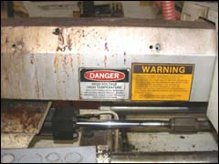
www.osha.gov
We Can Help
Top Ten Violations: FY 2018
(with top 5 sections cited)
9) 1910.212 – Machine Guarding
1910.212(a)(1) (1,289 violations) – providing one or more methods of machine guarding
1910.212(a)(3)(ii) (475 violations) – point of operation guarding: guarding device
1910.212(b) (76 violations) – anchoring fixed machinery
1910.212(a)(2) (46 violations) – affixing guards to the machine
1910.212(a)(3)(iii) (28 violations) – point of operation guarding: special handtools for placing and removing material

Slide 11
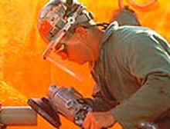
www.osha.gov
We Can Help
Top Ten Violations: FY 2018
(with top 5 sections cited)
10) 1926.102 – Eye and Face Protection
1926.102(a)(1) (1,475 violations) – ensuring that each affected employee uses appropriate eye or face protection when exposed to eye or face hazards
1926.102(a)(2) (48 violations) – ensuring that each affected employee uses eye protection that provides side protection when there is a hazard from flying objects
1926.102(a)(3) (4 violations) – employees that wear prescription lenses
1926.102(b)(1) (2 violations) – protective eye and face protection devices must comply with any of the specified consensus standards
Notes:
Only 4 sub-sections of this standard were cited in FY 2018.

Slide 12

Top Ten Violations in Construction FY 2018
Fall Protection, Duty to Have (1926.501)
Scaffolding (1926.451)
Ladders (1926.1053)
Fall Protection, Training (1926.503)
Eye and Face Protection (1926.102)
General Safety and Health Provisions (1926.20)
Head Protection (1926.100)
Aerial Lifts (1926.453)
Hazard Communication (1910.1200)
Fall Protection, Systems Criteria and Practices (1926.502)
Notes:
This is a list of the top 10 most frequently cited OSHA standards during inspections of construction worksites.

