Slide 1
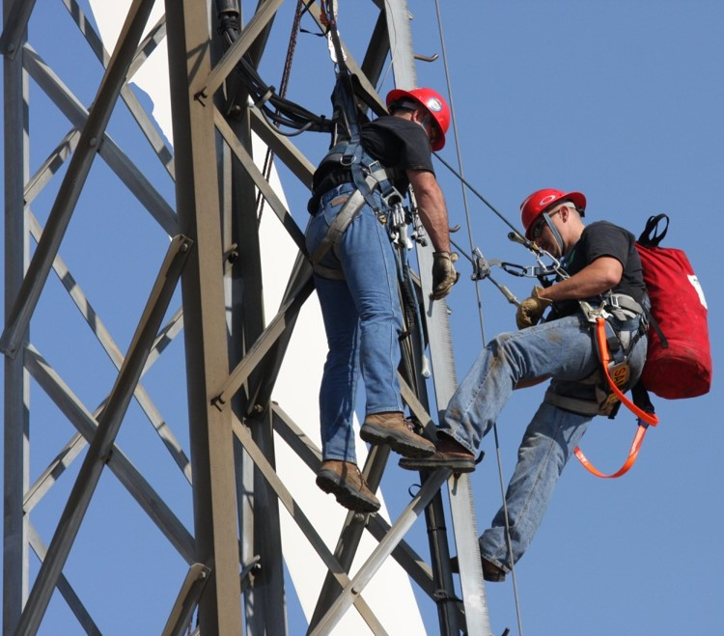
Fall Protection Safety

Slide 2
Objectives
The purpose of this class is to provide an overall awareness pertaining to fall hazards and methods of fall prevention and fall arrest.
Upon completion of this course, students will be able to:
Identify fall hazards and when fall protection is needed.
Identify methods of fall prevention as well as types of fall protection and their basic components.
Recognize and discuss good work practices based on OSHA guidelines and describe the primary components of an OSHA compliant fall protection program.

Slide 3
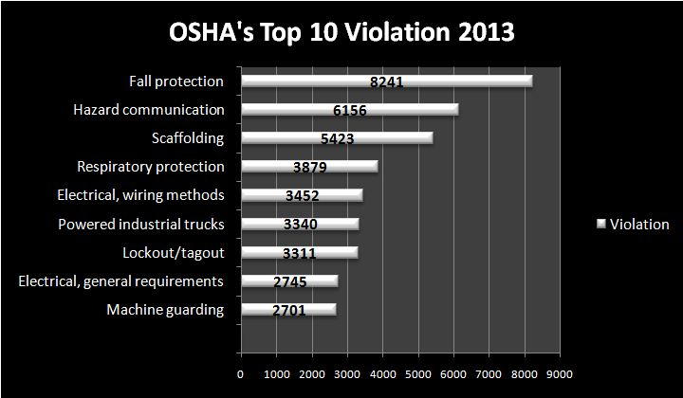
Fall Statistics
Falls Are The Leading Cause Of Deaths In The Construction Industry
Construction's “Fatal Four” CY 2013
*Fatal Four, AKA Focus Four, are the 4 greatest hazards in construction that lead to injuries and fatalities.

Slide 4
Top 10 Most Frequently Cited Standards For Fiscal 2014 (Oct. 1, 2013, To Sept. 30, 2014)
1926.501 - Fall Protection 1910.1200 - Hazard Communication 1926.451 - Scaffolding 1910.134 - Respiratory Protection 1910.178 - Powered Industrial Trucks | 1910.147 - Lockout/Tagout 1926.1053 - Ladders 1910.305 - Electrical, Wiring Methods 1910.212 - Machine Guarding 1910.303 - Electrical, General Requirements
*As of 10/28/14

Slide 5
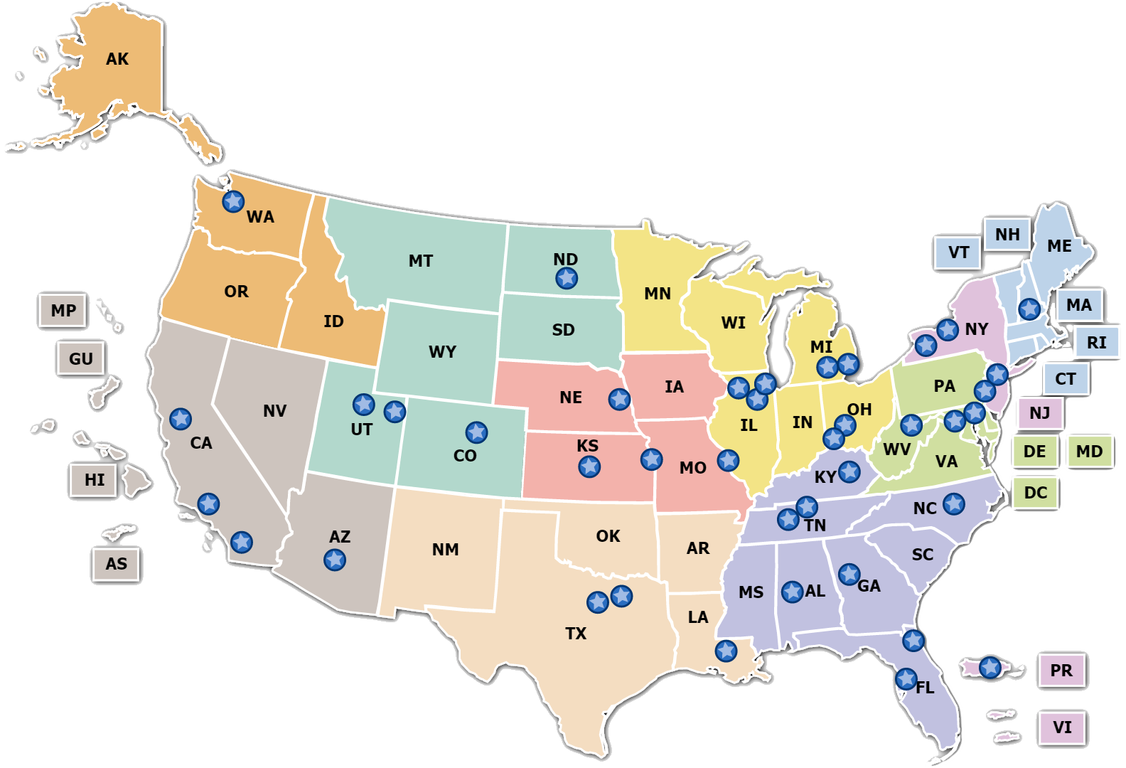
Region VI In The News
Department of Labor, OSHA Region VI
Texas, Louisiana, Arkansas,
New Mexico and Oklahoma

Slide 6
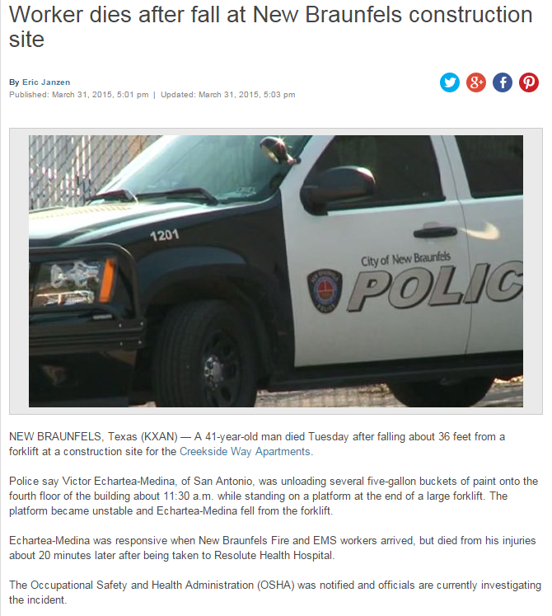
TEXAS

Slide 7
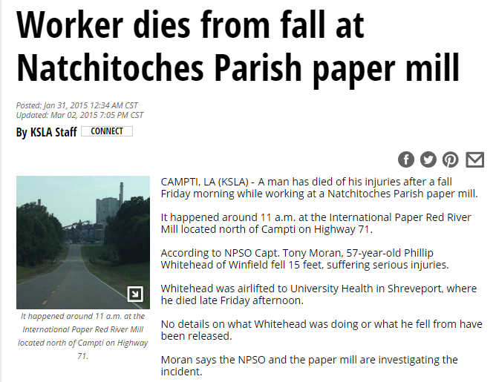
LOUISIANA

Slide 8
ARKANSAS

Slide 9
Have you ever fallen or
known someone who fell?

Slide 10
Fall Protection Standards
Fall protection is addressed in OSHA's standards for the construction industry. This section highlights some of the OSHA standards, Federal Registers (rules, proposed rules, and notices) preambles to final rules (background to final rules), directives (instructions for compliance officers), standard interpretations (official letters of interpretation of the standards), example cases, and national consensus standards related to fall protection.
OSHA Fall Protection Standards can be found in 29 CFR:
General Industry 1910
Construction 1926
Maritime 1915, 1917, 1918

Slide 11
OSHA Construction Standards (29 CFR 1926)
1926.451, General requirements (Scaffolding) [related topic page]
1926.452, Additional requirements applicable to specific types of scaffolds
1926.454, Training requirements (Scaffolding)
1926.501, Duty to have fall protection
1926.502, Fall protection systems criteria and practices
1926.503, Training requirements (Fall protection)
1926.760, Steel erection (Fall protection)
1926.800, Underground construction
1926.1051, General requirements (Stairways and ladders)
1926.1052, Stairways
1926.1053, Ladders
1926.1060, Training requirements (Stairways and ladders)
1926.1423, Cranes and derricks in construction (Fall protection)

Slide 12
Fall protection, for activities not in the construction industry, is addressed in specific standards for the general industry, shipyard employment, marine terminals and longshoring industry. This section highlights OSHA standards, Federal Registers (rules, proposed rules, and notices), the Regulatory Agenda (a list of actions being taken with regard to OSHA standards), preambles to final rules (background to final rules), directives (instructions for compliance officers), standard interpretations (official letters of interpretation of the standards), example cases, and national consensus standards related to fall protection.
Standards & Policy For
Non-Construction Work

Slide 13
General Industry (29 CFR 1910)
1910.23, Guarding floor and wall openings and holes
1910.25, Portable wood ladders
1910.26, Portable metal ladders
1910.27, Fixed ladders
1910.28, Safety requirements for scaffolding
1910.66, Powered platforms for building maintenance
Appendix A, Guidelines (Advisory)
Appendix C, Personal fall arrest system (Section I - Mandatory; sections II and III - Non-mandatory)
1910.67, Vehicle-mounted elevating and rotating work platforms [Aerial lifts]
1910.68, Manlifts
1910.132, General requirements (Personal Protective Equipment) [related topic page]
1910.268, Telecommunications
1910.269, Electric power generation, transmission, and distribution [related topic page]

Slide 14
Shipyard Employment (29 CFR 1915)
1915.71, Scaffolds or staging
1915.72, Ladders
1915.73, Guarding of deck openings and edges
1915.74, Access to vessels
1915.75, Access to and guarding of dry docks and marine realiways
1915.76, Access to cargo spaces and confined spaces
1915.77, Working surfaces
1915.158, Lifesaving equipment (life rings and PFDs)
1915.159, Personal fall arrest systems (PFAS)
1915.160, Positioning device systems
Subpart I Appendix B, General testing conditions and additional guidelines for personal fall protection systems (Non-mandatory)

Slide 15
Marine Terminals (29 CFR 1917)
1917.12, Slippery conditions
1917.26, First aid and lifesaving facilities (life-rings)
1917.95, Other protective measures (Personal flotation devices)
1917.112, Guarding of edges
1917.115, Platforms and skids
1917.116, Elevators and escalators
1917.117, Manlifts
1917.118, Fixed ladders
1917.119, Portable ladders
1917.120, Fixed stairways
1917.121, Spiral stairways
1917.124, Dockboards (car and bridge plates)
1917.125, Guarding temporary hazards

Slide 16
Longshoring (29 CFR 1918)
1918.22, Gangways
1918.23, Jacob's ladders
1918.24, Fixed and portable ladders
1918.25, Bridge plates and ramps
1918.26, Access to barges and river boats
1918.31, Hatch coverings
1918.32, Stowed cargo and temporary landing surfaces
1918.33, Deck loads
1918.34, Other decks
1918.35, Open hatches
1918.36, Weather deck rails
1918.37, Barges
1918.85, Containerized cargo operations; includes requirements for fall protection
1918.87, Ship's cargo elevators
1918.97, First aid and lifesaving facilities (life-rings)
1918.105, Other protective measures (personal flotation devices)

Slide 17
WHAT IS A FALL HAZARD?
Fall hazards are present at most worksites and many workers are exposed to these hazards on a daily basis. A fall hazard is anything at your worksite that could cause you to lose your balance or lose bodily support and result in a fall. Any walking or working surface can be a potential fall hazard.
Any time you are working at a height of four feet or more, you are at risk. OSHA generally requires that fall protection be provided at four feet in general industry, five feet in maritime and six feet in construction. However, regardless of the fall distance, fall protection must be provided when working over dangerous equipment and machinery. The importance of fall protection cannot be stressed

Slide 18
Examples of Fall Hazards
Unprotected sides, edges and floor holes & openings
Improperly constructed walking/working surfaces
Improper use of access equipment
Failure to properly use PFAs
Slips, trips & falls and poor housekeeping
Falls from as little as 4 to 6 feet can cause serious lost-time injuries and sometimes death.
Open-sided floors and platforms must be guarded.
Construction: 6 feet or more in height
Maritime: 5 feet or more in height
General Industry: 4 feet or more in height

Slide 19
Fall Hazards Can Be Prevented Using Fall Prevention, Fall Restraint & Fall Arrest

Slide 20
What's the difference between different types of fall protection?
 | Fall Prevention | Fall Restraint | Fall Arrest
How does it protect? | Prevents people from reaching the fall hazard by creating a barrier between the person and the fall hazard. | Prevents people from reaching a fall hazard through a tie off system. | Stops a fall that is in progress through a tie off system.
Equipment Needed | No individual equipment | Custom fitted equipment | Custom fitted equipment
Training Needed | None | Yes, extensive and ongoing | Yes, extensive and ongoing
Inspection | After Install and Annually | Every Use by the Individual | Every use by the individual
Maintenance | Annually | Must be inspected and cared before and after every use. | Must be inspected and cared before and after every use.
Potential for Injury | None | Mild | High
Costs | Higher up front costs. | Lower initial costs but hidden costs might be: training, equipment maintenance, and setup time. | Lower initial costs but hidden costs might be: training, equipment replacement, and setup time.
Burden to Laborer | Little to none. | Must inspect and properly wear their equipment. | Must inspect and properly wear their equipment.
OSHA Preference | Preferred because there is the least risk. | Better than fall arrest.
Example Products | Guardrails and Skylight Screens | A harness and lanyard tied off at a set length from a weighted tie off point. | A harness and retractable tied off to an anchor point.

Slide 21
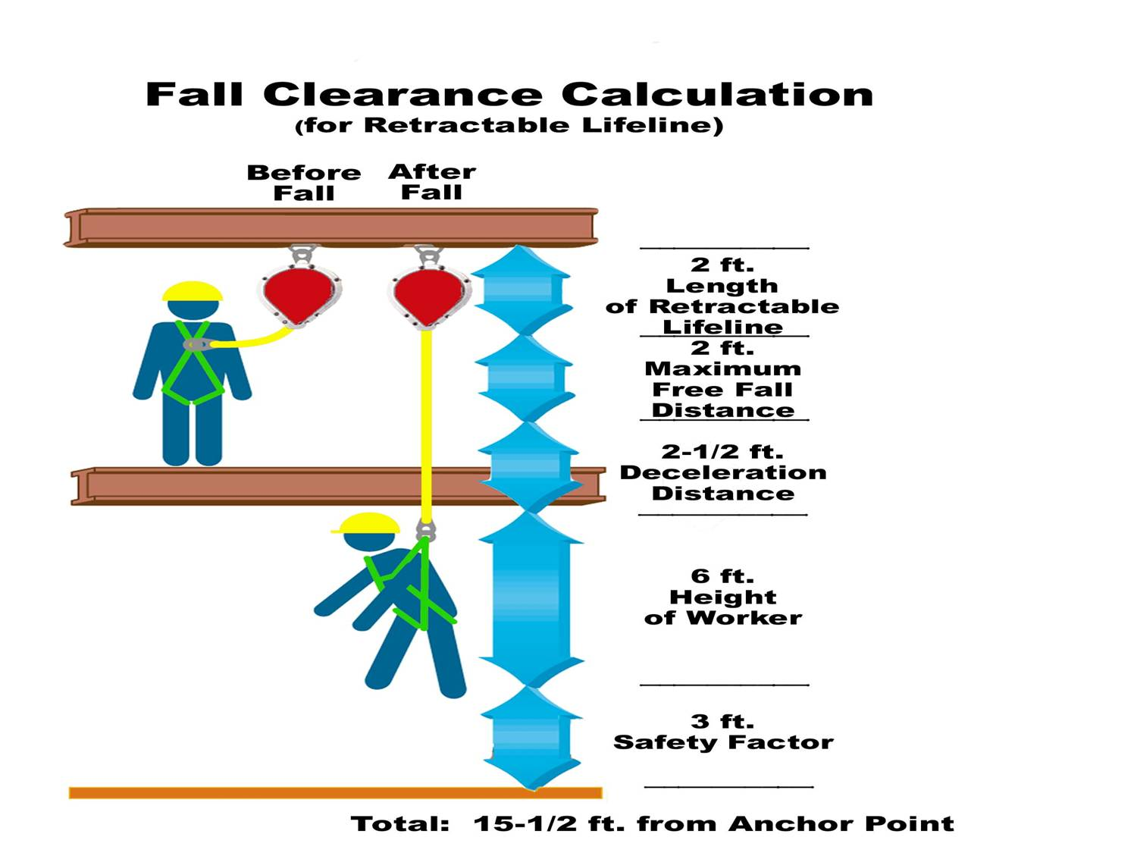
Fall Distance
6 Foot Lanyard with Decelarator
AKA: Shock Absorber
Retractable Lifeline aka YoYo with Decelarator AKA: Shock Absorber

Slide 22
Anatomy of a Fall How fast can you fall? You may think that you can catch yourself before falling too far and too much damage is done.

Slide 23
ELAPSED FREE FALL SPEED
TIME (SEC) DISTANCE FT/SEC HUMAN RESPONSE
0.1 2” 3.3 Unaware
0.2 8” 7.0 Aware
0.3 18” (1.5’) 10.0 Aware
0.4 31” 13.0 Reflex
0.5 48” (4’) 16.0 Start to move
0.6 70” 19.3 Start to move
0.61 72” (6’) 19.6 Slight movement
0.7 95” 23.0 Slight movement
0.8 124” 26.0 Movement
0.9 156” 29.0 Movement
1.0 193” (16’) 32.0 Movement
2.0 773” (64’) 64.0 Movement
Note: “Start to move” and “Slight movement” do NOT equate to reaching out and grabbing something. By the time you have conscience, controlled movement 8/10ths (or more) of a second have passed and you have already fallen roughly 10.3’ (124”)!
Notes:
Not like in the movies! Majority of people who fall, cant react fast enough to make any type of movement in order to secure their own resue

Slide 24
Two Factors Influence Falls
Body Weight (W)
Free Fall Distance (D)
Forces = W x D
A 215 pound worker with 6 pounds of tools who falls 6 feet can generate fall forces of 1,290 pounds across a person’s body
Without adequate deceleration or shock absorbers this could cause serious injuries.
Notes:
Discuss the factors which are involved in a fall give possible examples and detail information.

Slide 25
Fall Hazards Examples
Roofs
Wall Openings
Excavations
Rebar Hazards
Floor Holes and Openings

Slide 26
Roofs

Slide 27
Notes:
Discuss the hazards here, and possible protective systems that can be used.

Slide 28
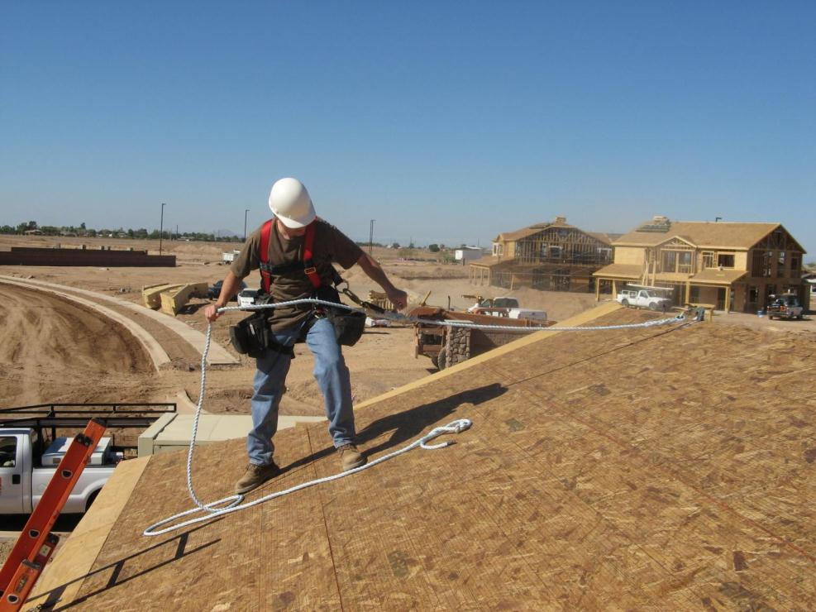
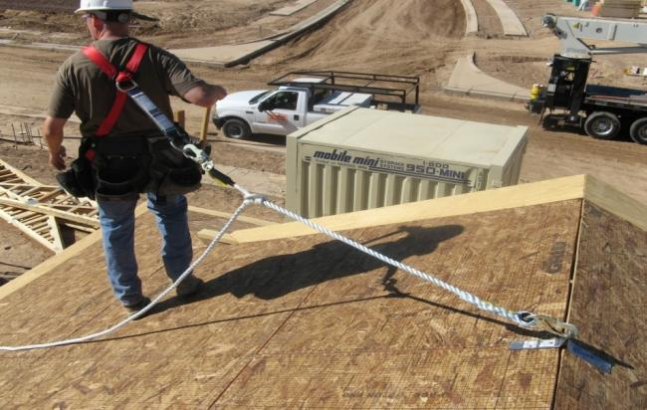
Shock Absorbing Lanyard
Full Body Harness
Rope Grab
Lifeline
Anchor Point
Notes:
This picture shows a rope grab system on roof to protect a worker in the event of a fall.

Slide 29
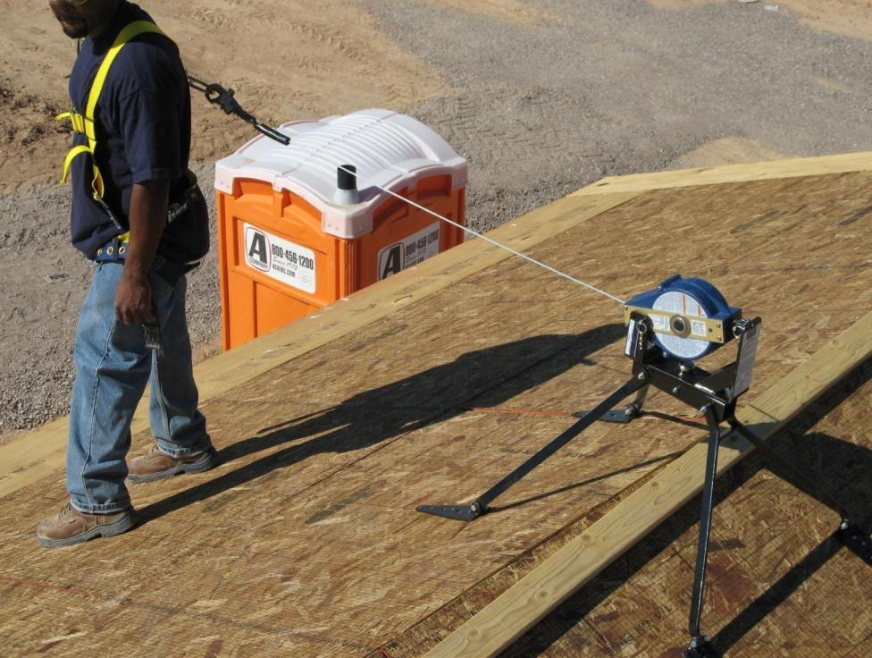
Notes:
Explain that this is a self-retracting lifeline attached to a full body harness

Slide 30
Wall Openings

Slide 31
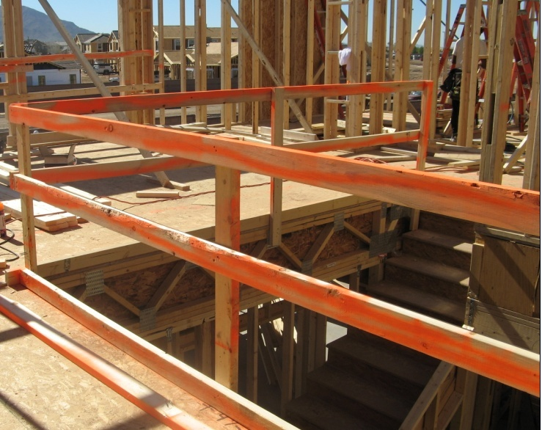
Top-rail at 42”
Mid-rail at 21”
Toeboard min. 3-1/2”
Notes:
This photo shows a properly installed guardrail system around a stairwell opening.
Top-rail = 42in.
Mid-rail = 21in.
Toeboard = 3 ½ in. (4in. Nominal)

Slide 32
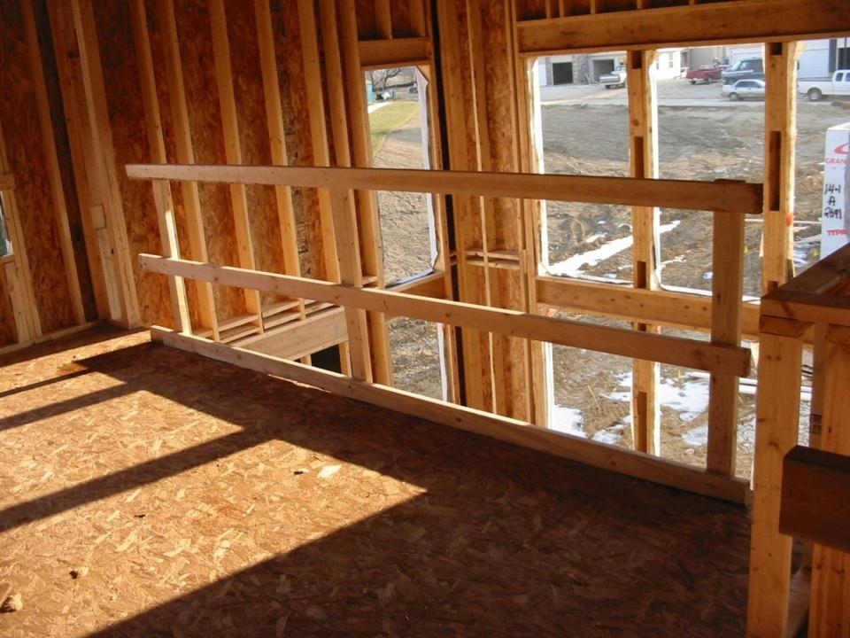
Wall openings greater than 18” need to be protected
Notes:
This photo shows guardrails used to protect workers from falling through a wall opening greater than 18’’.

Slide 33
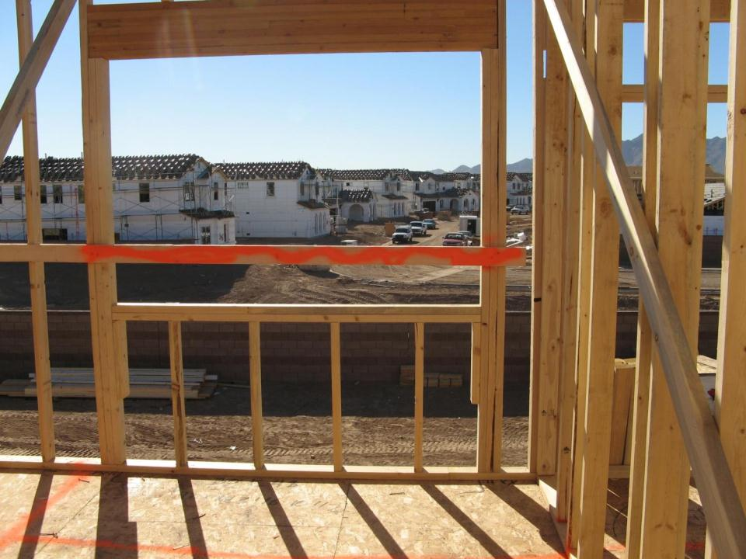
Notes:
This guardrail is painted orange on both sides to alert personnel that guardrails are installed and are visible from a distance.

Slide 34
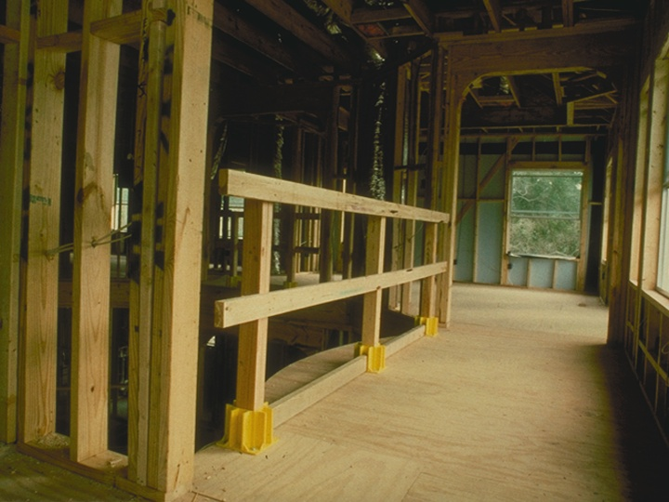
Notes:
Discuss how utilizing a boot system guardrail will allow drywall to be installed while still protecting workers from an unprotected edge.

Slide 35
Rebar Hazards

Slide 36
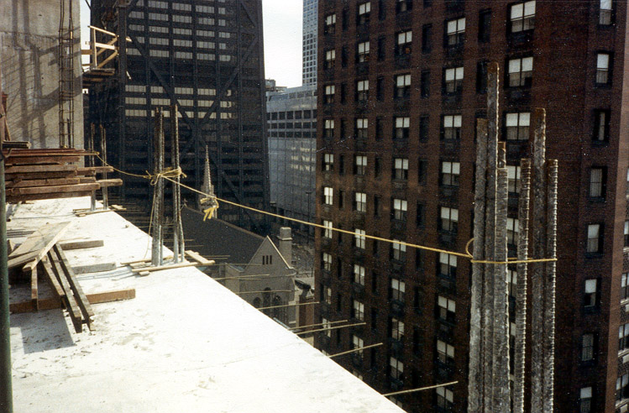
Falling on exposed rebar

Slide 37
Falling on exposed rebar

Slide 38
Floor Holes

Slide 39
Unguarded Floor Openings
Notes:
Discuss ways to protect workers from unguarded floor openings, i.e. guardrails or floor covers.

Slide 40
Unguarded Stair Opening
Notes:
Discuss ways to protect workers from unguarded floor openings, i.e. guardrails or floor covers.

Slide 41
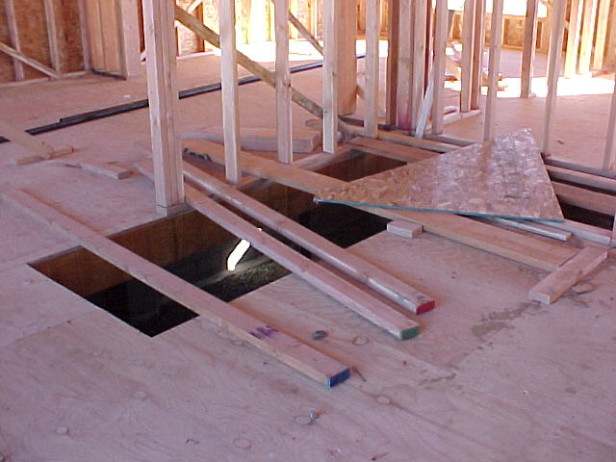
Notes:
Discuss ways to protect workers from unguarded floor openings, i.e. guardrails or floor covers.

Slide 42
Holes
Must be covered
By material that leaves no openings more than 1 inch wide. The cover shall be securely held in place to prevent tools or material from falling through.
Guardrails
May be used in accordance with applicable standards

Slide 43
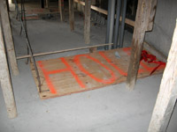
Notes:
Discuss briefly why each holes must be covered and not be able to be easily displaced

Slide 44
Alternate Work Methods
Employers have the option of having workers work from scaffolds (in compliance with Subpart L), ladders (in compliance with Subpart X) or aerial lifts (in compliance with 29 CFR 1926.453) instead of complying with 1926.501(b)(13).
Notes:
Now we all know the first principle of mishap prevention is to “eliminate” the hazard whenever possible. If you can’t eliminate it, you then have to minimize its effect. We cannot eliminate working at heights in construction, but using ladders, scaffolds and aerial lifts can help employers eliminate some falls from six feet or higher.

Slide 45
Scaffolds
Climbing the structural cross-braces of a scaffold is a hazard, and forbidden by OSHA. Safe access options include: portable ladders, hook-on ladders, attachable ladders, stair towers, stairway-type ladders, ramps, walkways, or built-in ladders.

Slide 46
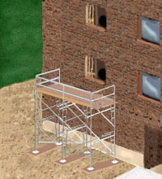
Direct Access
Direct access to or from another surface shall only be used when the scaffold is not more than 14 inches horizontally and 24 inches vertically from the other surface.

Slide 47
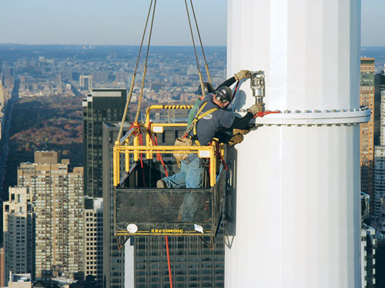
Scaffold Types
Supported
Fabricated Frame
Tube & Coupler
Wall Brackets
Form Brackets
Ladder Jacks
Pump Jacks
Suspended
Swings
Multi-point
Catenary
Boatswain Chair
Aerial Lifts
Extensible Boom Platforms
Aerial Ladders
Articulating Boom Platforms
Vertical Tower
Combination

Slide 48
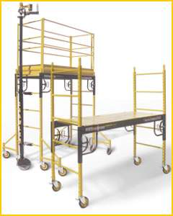
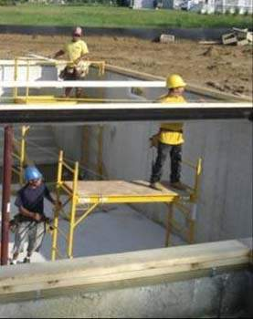
Supported Scaffolds
Bakers / Perry Scaffolds
Notes:
These scaffold systems are primarily used on the interior of buildings and can provide stable work platforms while framing, hanging board, and rolling trusses.

Slide 49
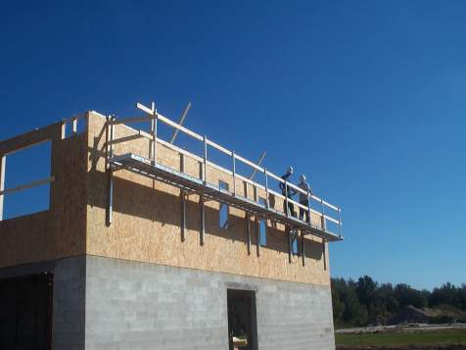
Other Work Methods
Here is an example of a wall bracket, or top plate, scaffold system. Some contractors are using these systems for rolling trusses, cutting rafter tails and hanging fascia.
Notes:
Here are examples of wall bracket, or top plate scaffold systems. (pause)

Slide 50
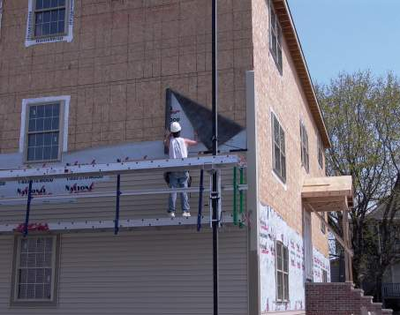
Other Work Methods
Pump-jack Scaffold
Notes:
Pump jacks are a popular system used by many contractors to install building wrap and siding. Some contractors have used different variations of the pump jack that allow them to jack it up to just under the fascia and be used as catch platforms. There the system can be used as perimeter protection while sheathing and roofing operations are performed.

Slide 51
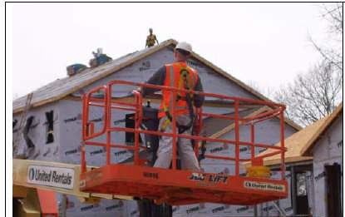
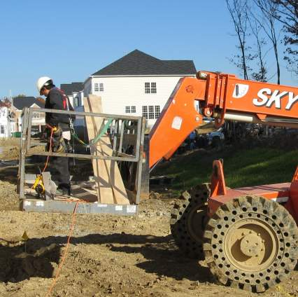
Other Work Methods
Extensible Boom Aerial Lift
All-terrain forklift with
basket attachment
Notes:
An Aerial lift is a good alternative for reaching heights if properly used. They can also be used to install and remove guardrail and safety net systems.

Slide 52
Other Work Methods
Extensible Boom Aerial Lift
Alternative for reaching heights if properly used
PFAS or fall restraint must be worn and lanyard attached to boom or basket when working from an aerial lift - 1926.453(b)(2)(v)
Notes:
PFAS or fall restraint must be worn and lanyard attached to the boom or basket when working from an aerial lift.

Slide 53
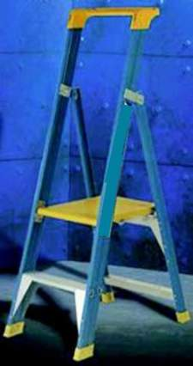
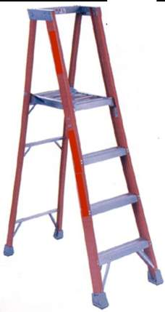
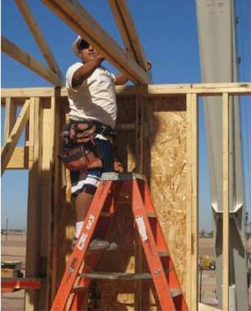
Other Work Methods - Ladders
Step Ladder
Platform Ladders
Notes:
Platform ladders are becoming more and more prevalent in the industry. These industry best practices, provide workers with a stable work base and allows more flexibility while maneuvering and positioning things like floor joists and trusses.

Slide 54
The ABC’s of Personal Fall Arrest Systems (PFAS)
Notes:
The ABCs of Fall Protection

Slide 55
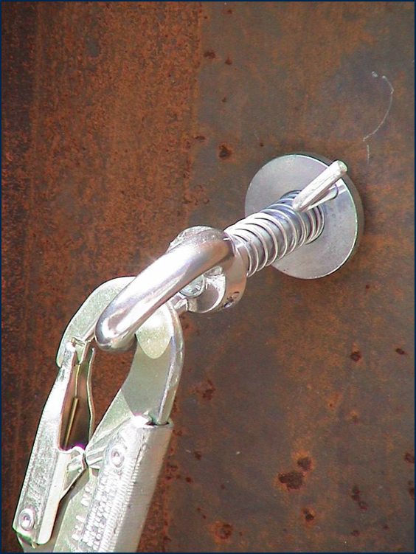
The A
Notes:
The Anchor system, discuss some the different systems used in the industry

Slide 56
The Anchor
Anchorages used for attachment of personal fall arrest equipment must be independent of any anchorage being used to support or suspend platforms, and capable of supporting at least 5,000 pounds per employee attached, or must be designed and used as follows:
As part of a complete personal fall arrest system which maintains a safety factor of at least two.
Under the supervision of a qualified person.

Slide 57
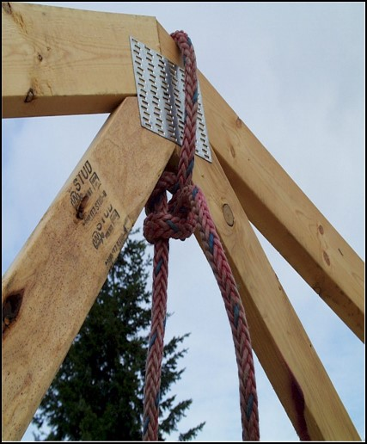
Improper Anchor Points
Standard Guardrails
Standard Railings
Ladder/Rungs
Scaffolding
Light fixtures
Conduit or Plumbing
Ductwork or Pipe Vents
Pipe Hangers
C-Clamps
Cable Trays
Another lanyard
Roofstacks, vents
Joists, girders (unless qualified person allows same)

Slide 58
The B = Body Harness
Notes:
The B= the body harness

Slide 59
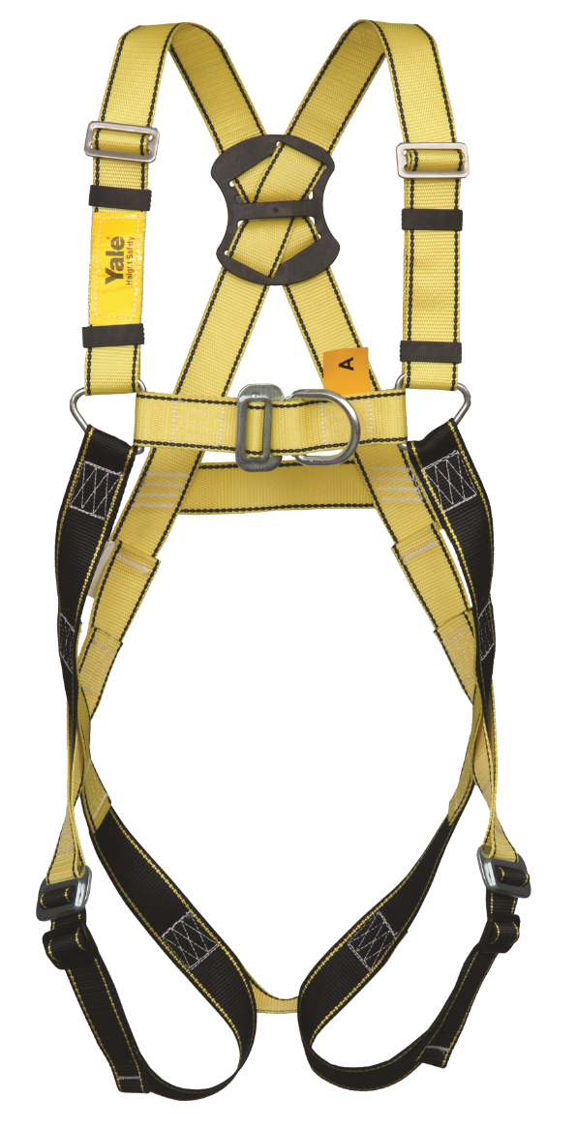
The Body Harness
Body harnesses are designed to minimize stress forces on an employee's body in the event of a fall, while providing sufficient freedom of movement to allow work to be performed.
Do not use body harnesses to hoist materials.
As of January 1, 1998, body belts are not acceptable as part of a personal fall arrest system, because they impose a danger of internal injuries when stopping a fall.

Slide 60
The Body Harness
Need to be inspected frequently
Daily before use by the worker 502(d)(21)
Recommend monthly inspections by Competent Person
Should never be modified
Should be taken out of service immediately if defective or exposed to an impact 502 (d)(9)

Slide 61
Proper Adjustment is Key
Be able to reach your D-Ring with your thumb
Maximum four (flat) fingers of slack at the legs, straps as high as comfortably possible
Ensure chest strap is across the chest/breastbone
Have a buddy double check for twist…etc.
Notes:
Demostrate with an actual harness to students. Have one try one on and see if they know how to properly put it on. Explain what is a proper fit, explain where the D ring should be and how tight all the belts and straps should be . What is the difference between the $35 harness to the $135 and above?

Slide 62
Adequate Anchorages are Crucial
29 CFR 1926 Subpart M Appendix C (h): OSHA’s stance on importance of anchorage points
Planning by employer is VITAL
No planning – employees tend to find their own anchorage or don’t use any
Must support 5000 pounds per employee attached

Slide 63
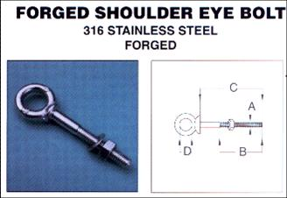
Use of Eye Bolts
Rated for loading parallel to the bolt axis
If wall mounted, the rating perpendicular to the axis must be good for 5,000lbs per employee.
Notes:
Use to anchor life lines? Only one person on horizontal line if rated only for 5,000lbs. Should be approved by qualified person.

Slide 64
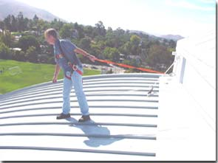
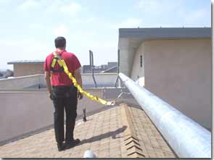
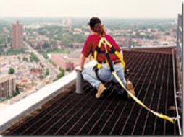
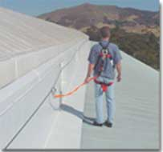
Notes:
Different types of anchor points and horizontal life line.

Slide 65
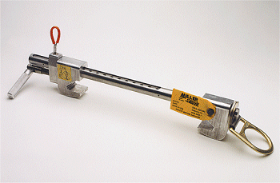
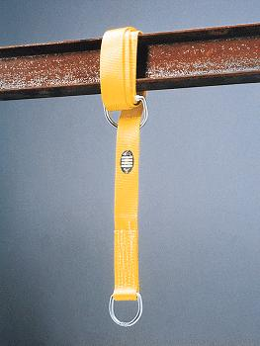
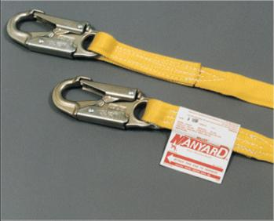
The C
Notes:
The C= the Connectors

Slide 66
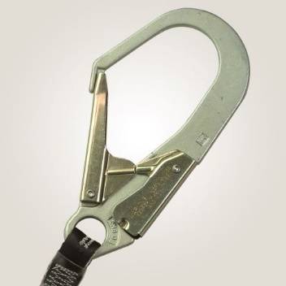
The Connectors
Connectors, including D-rings and snaphooks, must be made from drop-forged, pressed or formed steel, or equivalent materials. They must have a corrosion-resistant finish, with smooth surfaces and edges to prevent damage to connecting parts of the system.
Notes:
Discuss the difference kinds of connectors, demostrate each one and pass same via the audience let them touch and feel same, show them how it works and how to prevent roll out.

Slide 67
Connector (Lanyards)
Should be inspected before each use
Should not be tied back to themselves
Should be worn with timpact absorber/shock pack at the D-ring
Should have the appropriate clip for the intended anchorage points

Slide 68
Retractable Lifelines
Very effective for vertical applications
Will normally lock up in 1 to 2 feet, minimizing total fall distance and impact forces on the employee’s body
Notes:
Show and tell, demo a SRL, what is the difference of same from a normal landyard.

Slide 69
SRL and Deceleration Devices
Self retracting lifelines which limit free fall to 2’ or < must capable of sustaining minimum tensile load of 3000lbs to device is fully extended position
SRL which don’t limit fall to 2’ or < ripstich lanyards and tearing type lanyards must maintain min tensile load of 5,000lbs to lifeline/lanyard in fully extended position

Slide 70
Do Not Hook Lanyards to Retractables
This can cause hook failures and affect the locking capability of the retractable
The retractable should be attached directly to the D-ring
No plan for SWING factor in the event of a fall.
Notes:
You should never hook two difference FPS to each other because they might not work properly.

Slide 71
Review
What are the 4 greatest hazards in construction?
At what height must we have fall prevention or fall protection in:
Construction
Maritime
General Industry
Name 3 alternate work methods to help eliminate or reduce the risk of falls.
What are the A, B, C of a personal fall arrest system?

Slide 72
Review
What are the 4 greatest hazards in construction? Falls, Struck By, Caught By/In, Electrical
At what height must we have fall prevention or fall protection in:
Construction 6ft
Maritime 5ft
General Industry 4ft
Name 3 alternate work methods to help eliminate or reduce the risk of falls?
Scaffolds, Aerial Lifts, & Ladders
What are the A, B, C of a personal fall arrest system? Anchor Point, Body Harness, Connectors

