Slide 1
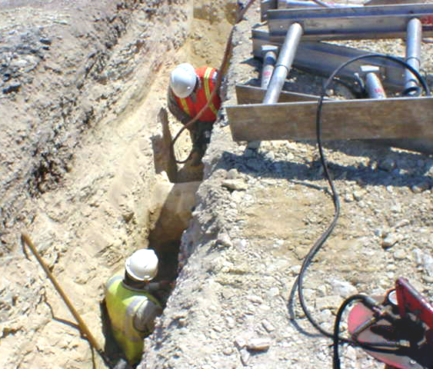
Excavation
Notes:
This slide gives the name of the course: Excavation Safety Competent Person Training Program. This slide is animated - - showing the light getting larger.

Slide 2
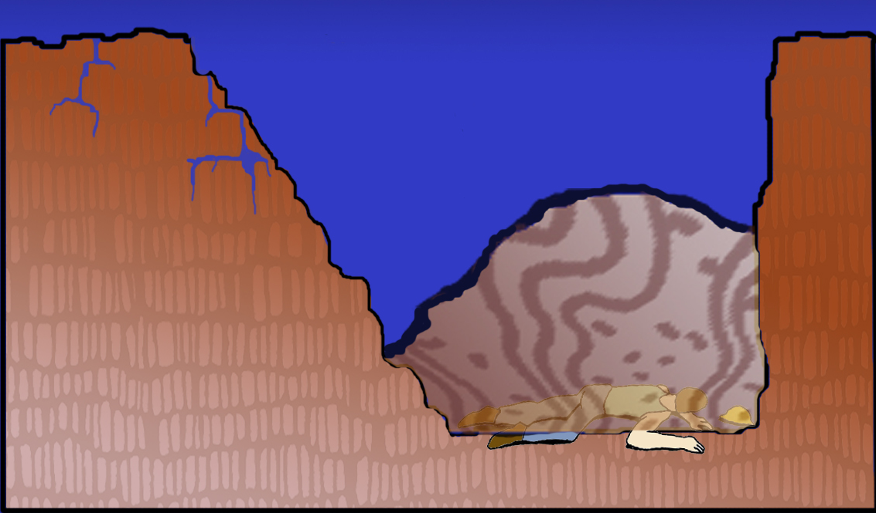
The fatality rate for cave-ins is fifteen times greater than for other construction accidents.
5’
8’
Unstable wedge weighs 16,000 lbs.
Notes:
The fatality rate for cave-ins is fifteen times greater than for other construction accidents.

Slide 3
OSHA Review of Cave-In Fatalities for 2003
Protective Measures in the Fatalities
24%
24%
Improperly used
64%
12%
Available but not in use
Not available

Slide 4
OSHA Standard 29 CFR 1926.650-652
Subpart P
OSHA is the Occupational Safety and Health Administration, which is an agency within the Federal Department of Labor. They are charged with promulgating and enforcing workplace safety regulations, which are found in Title 29 of the Code of Federal Regulations, which is the Labor title. Part 1926 contains the regulations for the Construction Industry. Sections 650-652 contain the Excavation regulations, which are also known as Subpart P.
Scope and Application
This standard applies to all open excavations made in the earth’s surface. Excavations are defined to include trenches.

Slide 5
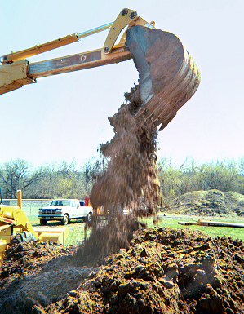
Excavation
Any man-made cut cavity, trench, or depression in an earth surface, formed by earth removal.
Trench Excavation
Narrow excavation (in relation to its length): In general, the depth is greater than the width, but the width of a trench (measured at its bottom) is not greater than 15 feet.

Slide 6
Competent Person
Means “…one who is capable of identifying existing and predictable hazards in the surroundings or working conditions which are unsanitary, hazardous, or dangerous to the employees and who has authorization to take prompt corrective measures to eliminate them.”
Targeted Competent Persons: Supervisors & Equipment Operators

Slide 7
Training Requirements for the Competent Person
In the preamble to the Standard, OSHA says that, “…for the purposes of this standard, one must have had specific training in and be knowledgeable about soils analysis, the use of protective systems, and the requirements of the standard. One who does not have such training or knowledge cannot possibly be capable of recognizing existing and predictable hazards in excavation work or taking prompt corrective measures.”

Slide 8
Specific Responsibilities of the Competent Person
Implement an adequate protective system for excavations 5+ feet deep.
Conduct tests for soil classification.
Understand standards and any data provided.
Determine proper protective system.
Recognize and reclassify soil after changes in conditions.

Slide 9
Specific Responsibilities of the Competent Person (cont.)
Determine whether damage to excavation safety equipment renders it unusable.
Design of structural ramps.
Location of underground installations/utilities.
Monitor water removal equipment and operation.
Perform daily inspections.
Determine the necessity for a protective system if less than 5 feet deep.

Slide 10
OSHA Review of
Cave-In Fatalities for 2003
14%
Was the competent person on-site at the time of the fatality?
86%
Yes
No

Slide 11
Options of the Competent Person
1. Use the OSHA Standard for guidance with:
Sloping
Shoring with timber or aluminum hydraulic shoring
Shielding
2. Use a Registered Professional Engineer to provide:
Tabulated data
Manufacturers tabulated data
A site specific design*
(*must be registered in the state where the work is being done.)

Slide 12
Registered Professional Engineers must be used if:
The excavation is deeper than 20 feet.
An “alternate system” (such as sheet piling) that the Standard does not provide guidance for is used.
If the excavator is at “variance” with the Standard (i.e. doing less than the Standard requires).
Note: OSHA expects that the engineer will be registered in a related area such as a civil, mechanical, geotechnical, or architectural engineer.

Slide 13
It’s a
Show-Me-In-Writing
Standard
Excavation protection solutions must either come from the OSHA Standard or a Registered Professional Engineer.

Slide 14
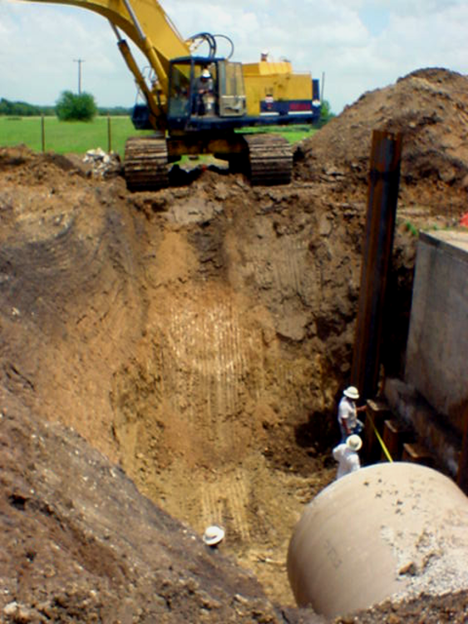
Right
Or
Wrong?

Slide 15
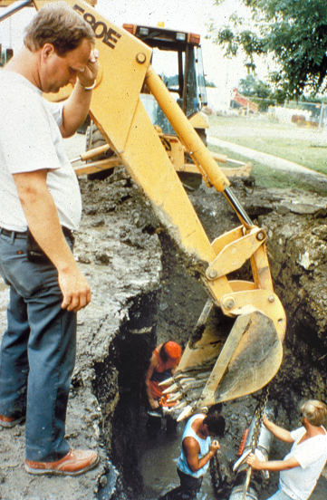
All four men are at exposure.

Slide 16
OSHA Soil Classification System
Soil Types
Stable Rock
Type A
Type B
Type C
STABILITY
Stable Rock Means
Natural solid mineral matter that can be excavated with vertical sides and remain intact while exposed.

Slide 17
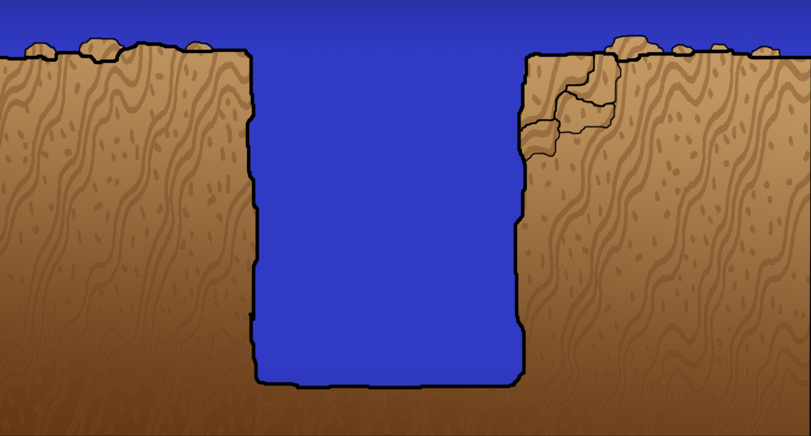
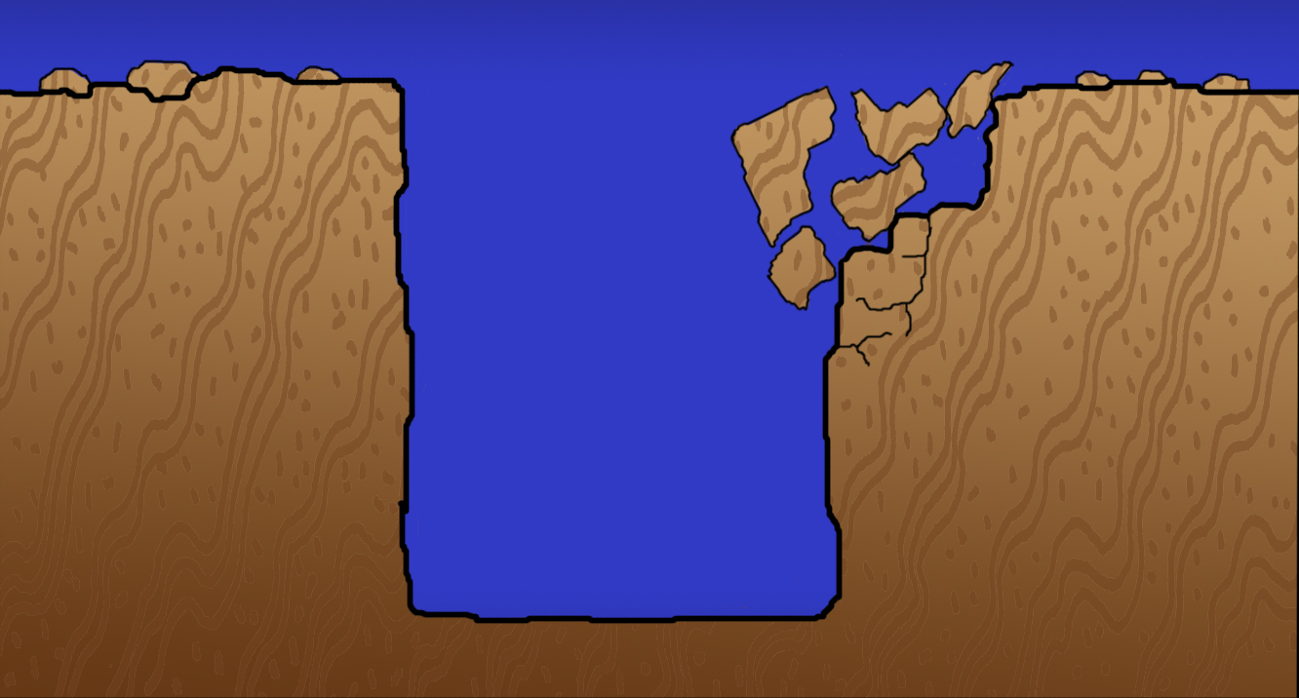
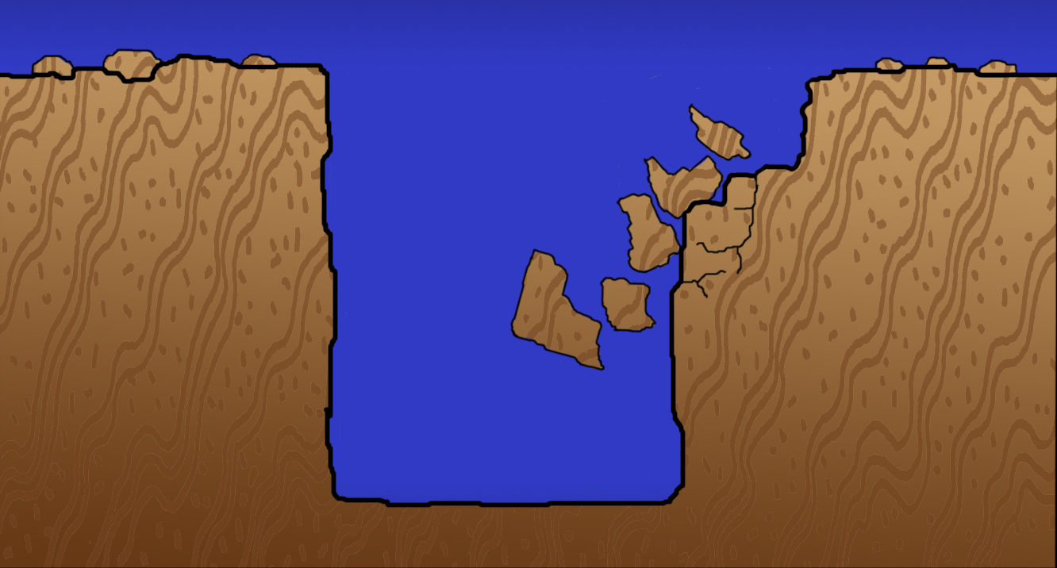
“Fallout” Effect of Fractured Rock
Fracture planes
may cause rocks
to slide
into excavation…

Slide 18
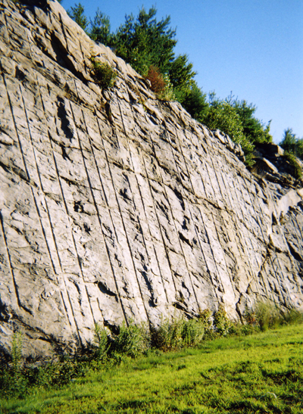
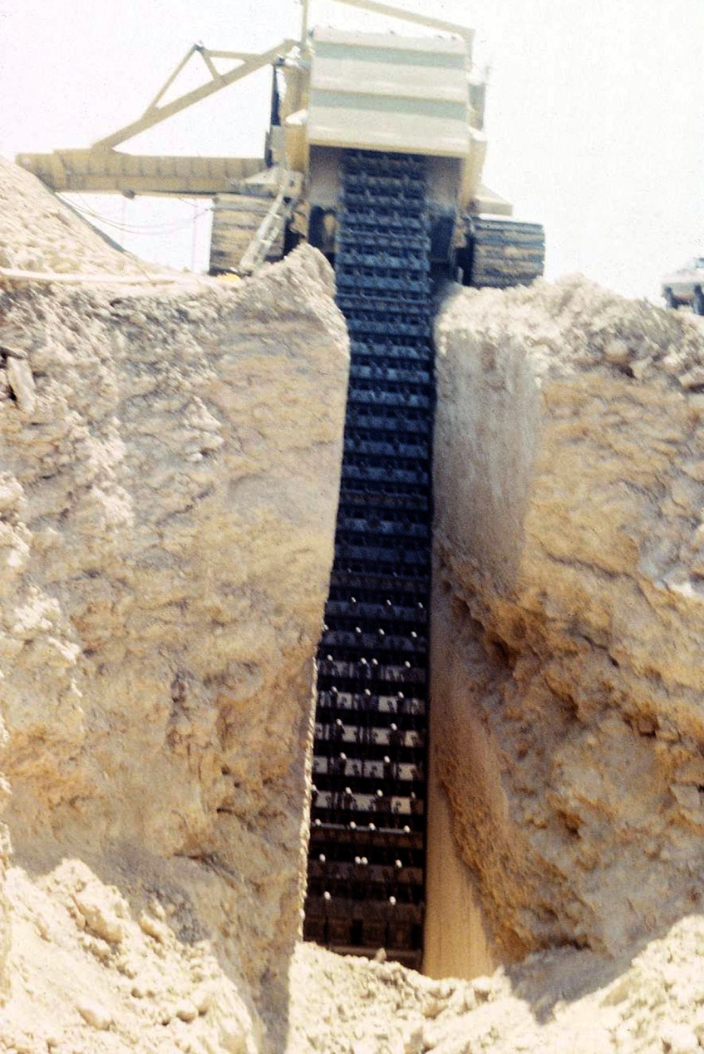
Drilling and blasting further fractures rock.
Rock sawing further fractures rock.

Slide 19
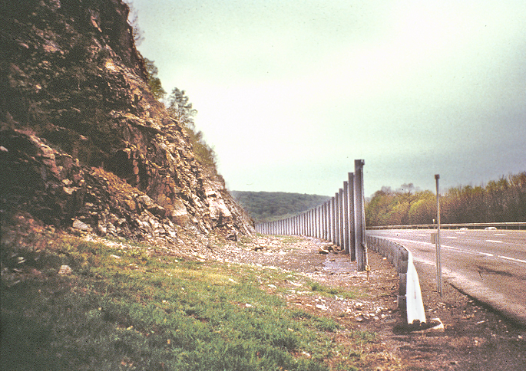
Fence used as
“shield” system

Slide 20
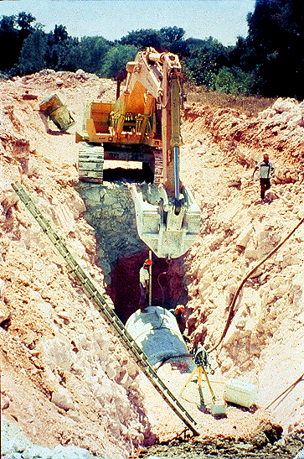
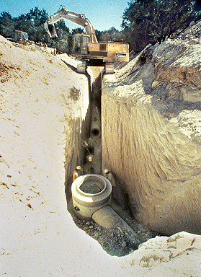
Rock fractured by blasting
will fail during excavation.

Slide 21
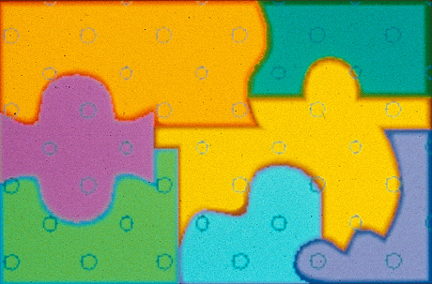
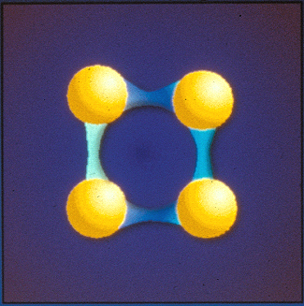
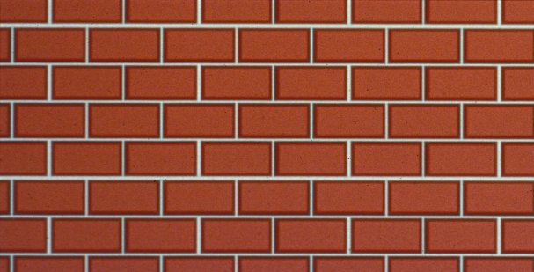
Type A Soil
Cohesive soil with an unconfined compressive strength of 1.5 ton per square foot (TSF) (144kPa) or greater.
Cohesion
Cementation
Chemical Bonding
Friction
Liquid Bonding

Slide 22
Examples of Cohesive Soils
Clay
Silty Clay
Sandy Clay
Clay Loam
Silty Clay Loam (in some cases)
Sandy Clay Loam (in some cases)
Cemented Soils Such as Caliche and Hard Pan are also Considered Type A

Slide 23
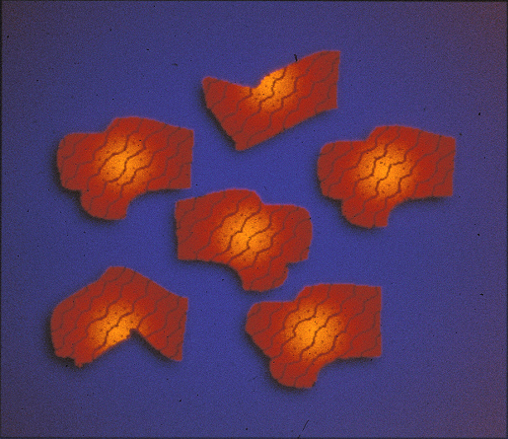
Type B Soil
Cohesive soil with an unconfined compressive strength greater than .5 TSF, but less than 1.5 TSF
Granular cohesionless soils including angular gravel

Slide 24
Type B (cont.)
Previously disturbed soils except those that would be classified as Type C soil.
Soil that meets the unconfined compressive strength or cementation requirements of Type A, but is fissured or subject to vibration.
Dry rock that is not stable.
Material that is part of a sloped, layered system where the layers dip into the excavation on a slope less steep than four horizontal to one vertical (4H:1V), but only if the material would otherwise be classified as Type B.

Slide 25
Type C Soil
Cohesive soil with an unconfined compressive strength of .5 TSF (48kPa) or less
Granular soils including gravel, sand, and loamy sand
Submerged soil or soil from which water is freely seeping
Submerged rock that is not stable
Material in a sloped, layered system where the layers dip into the excavation on a slope of four horizontal to one vertical (4H:1V) or steeper

Slide 26
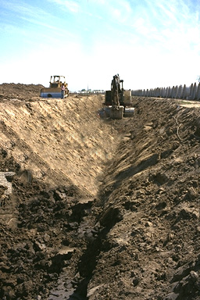
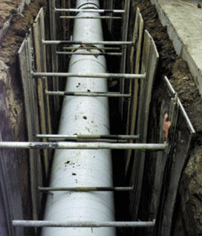
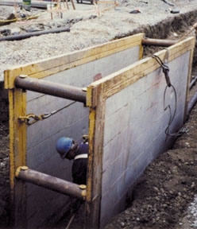
Protective Systems
Sloping
Shoring
Shielding

Slide 27
Sloping
Sloping Options
Sloping sides 1½ h to 1 v (34⁰) -- as though it were Type C soil.
Use Appendix A to classify the soil and Appendix B to determine the correct slope.
OR
Have a registered professional engineer provide:
Tabulated data for sloping or
A site-specific sloping profile

Slide 28
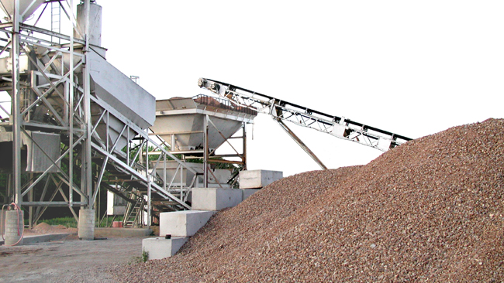
Terms Currently Used by OSHA
The term “angle of repose”
which comes from stockpiling
is no longer used by OSHA.
Safe angle
Maximum allowable slope
Actual slope

Slide 29
o
0 = 45
Type B
o
0 = 45
o
0 = 45

Slide 30
Excavation in Type C Soil
Simple Slope
20’ max.
1
1½
All simple-slope excavations 20 feet or less in depth shall have a maximum allowable slope of 1½:1.

Slide 31
o
Right
0 = 34
o
0 = 90
Wrong
Benching is not allowed in Type C Soil.

Slide 32
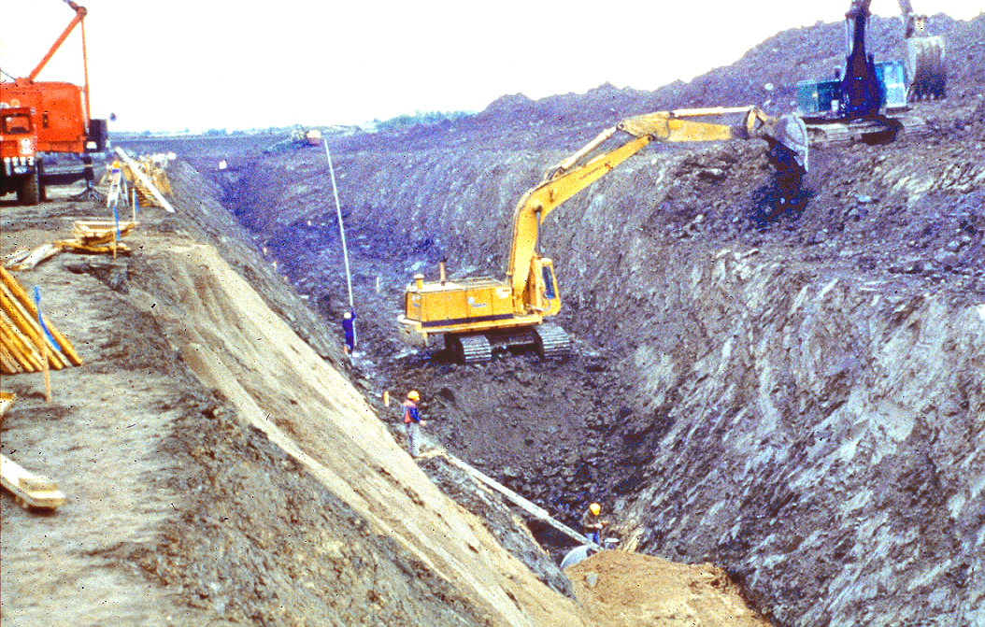
Simple Sloping

Slide 33
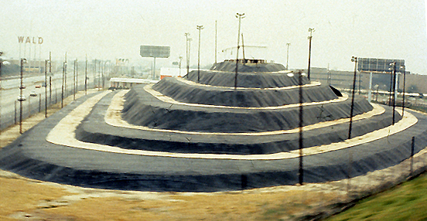
Sloping and Benching

Slide 34
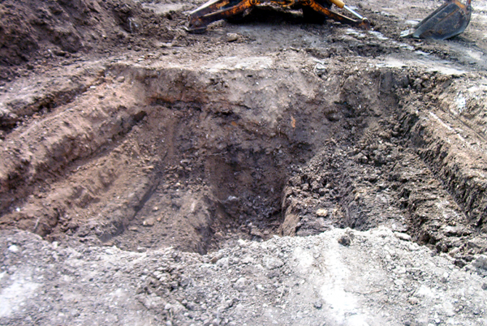
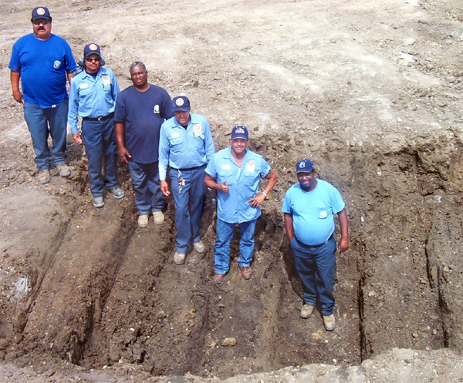
Benching
Do not put people or materials on steps above working level.

Slide 35
Shoring
Shoring Options
Use the timber or aluminum hydraulic shoring charts from the OSHA standard
- - or - -
have a registered professional engineer provide:
Tabulated data
Manufacturer’s tabulated data
Site-specific design
Shoring braces the unstable wedges so that they cannot fail.

Slide 36
Overloading
Do not exceed allowable surcharge loads.

Slide 37
OSHA: Surcharge Load Limit
1
1
1
1
20,000 lbs. of equipment -- if OSHA’s Timber or Hydraulic Shoring charts are used.
Spoil pile height, 2 ft. max -- if OSHA’s Timber charts are used.

Slide 38
Upright
Wale
Cleat
Mud Sill
Cross Brace
Soil
Timber Shoring

Slide 39
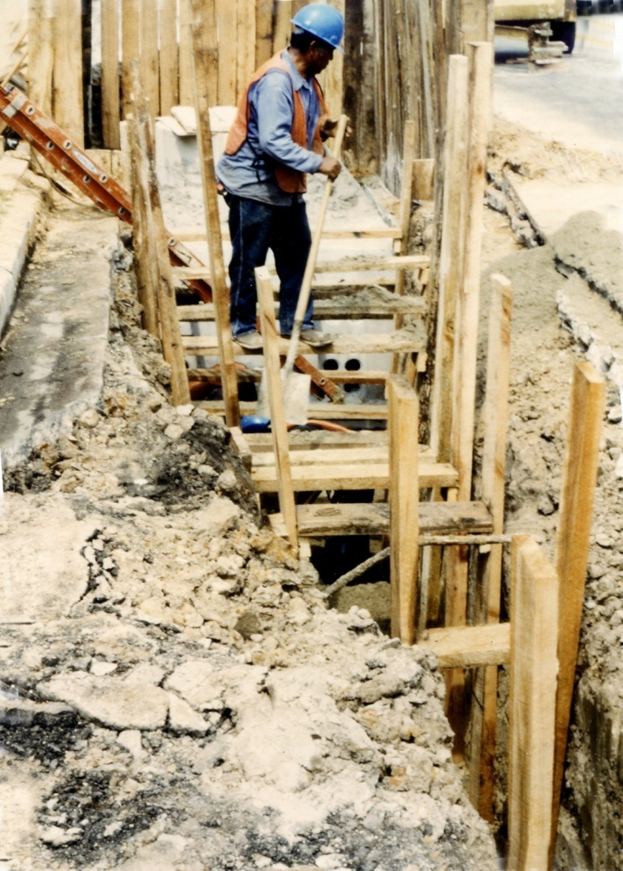
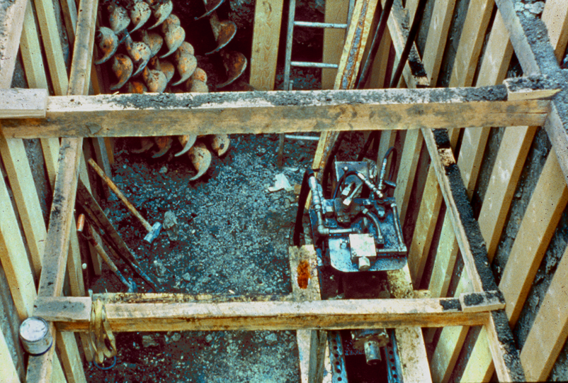
Inadequate shoring constructed from 2” x 6” pine from the local lumber yard.

Slide 40
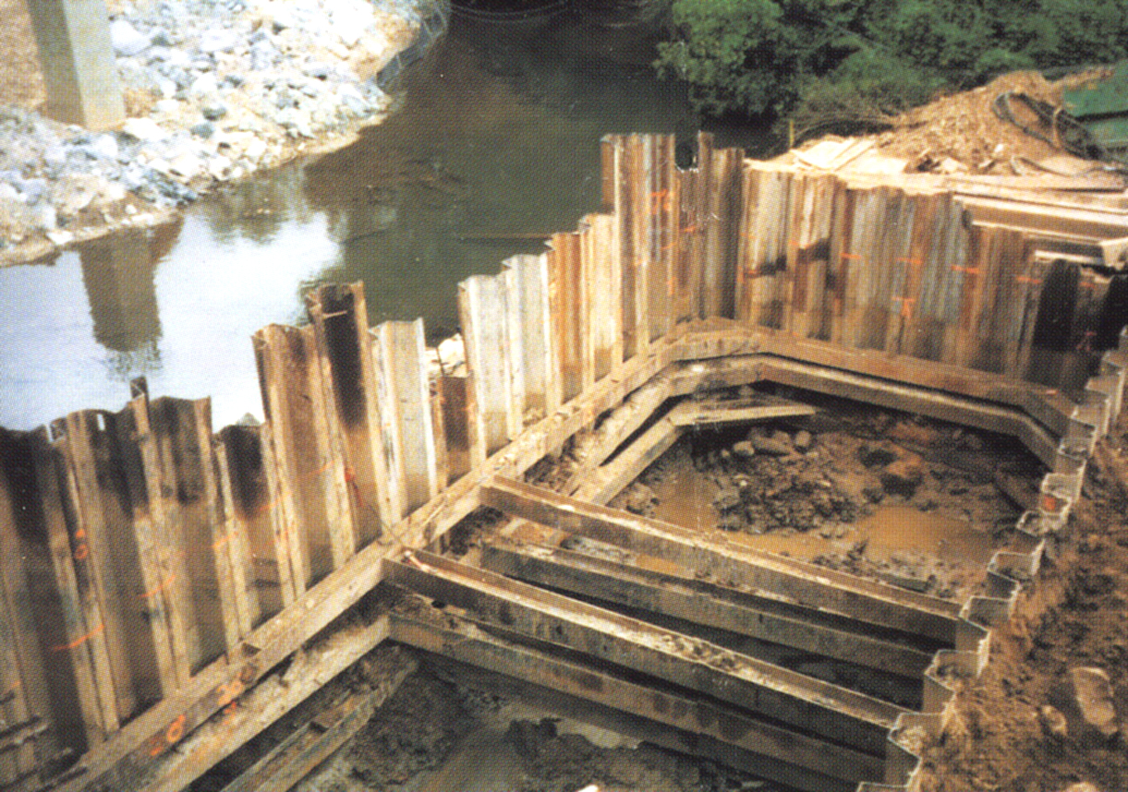
Steel sheet piling in “tight sheeting” application.

Slide 41
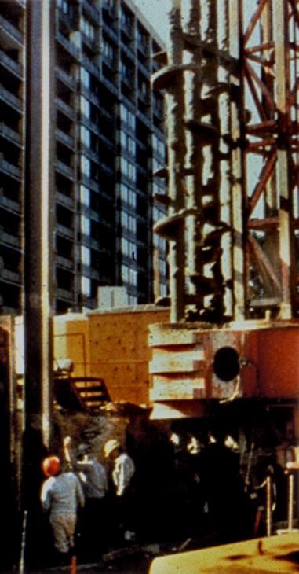
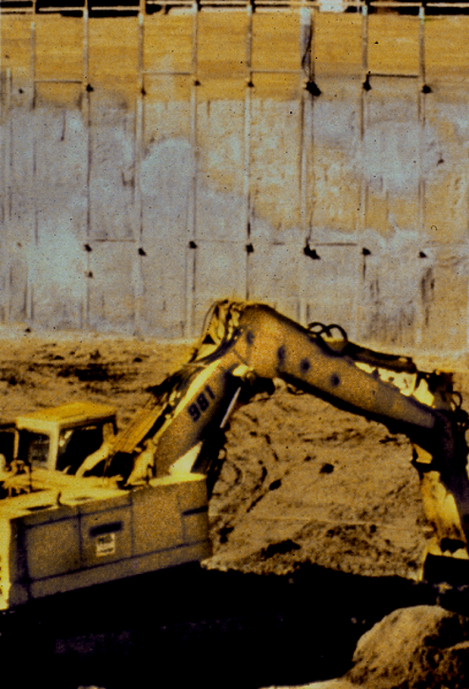
Soldier Piling

Slide 42
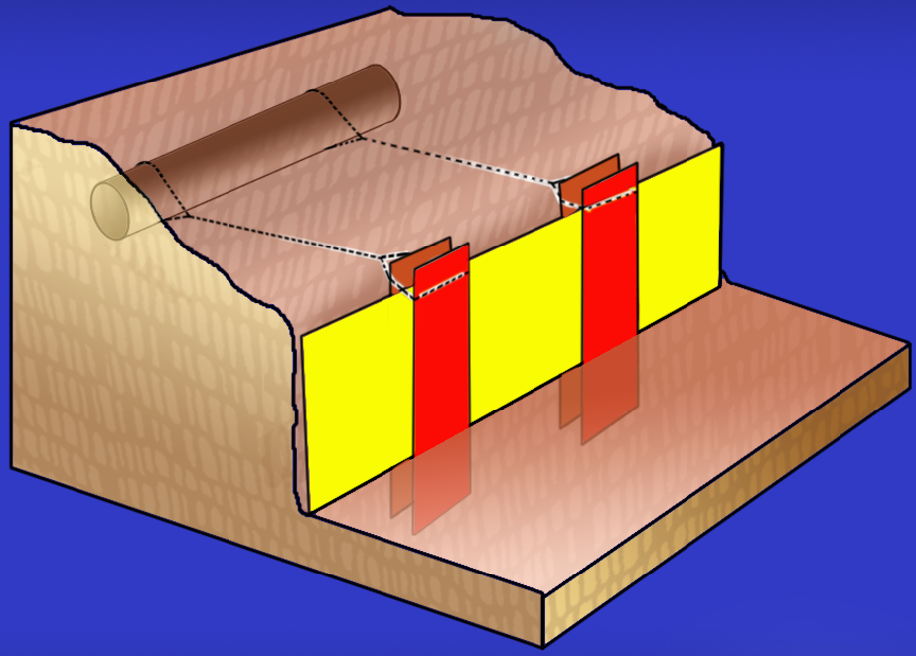
Tieback System
Buried Pipe
A Tieback System is often used with Soldier Piling or Plate & Beam Systems.

Slide 43
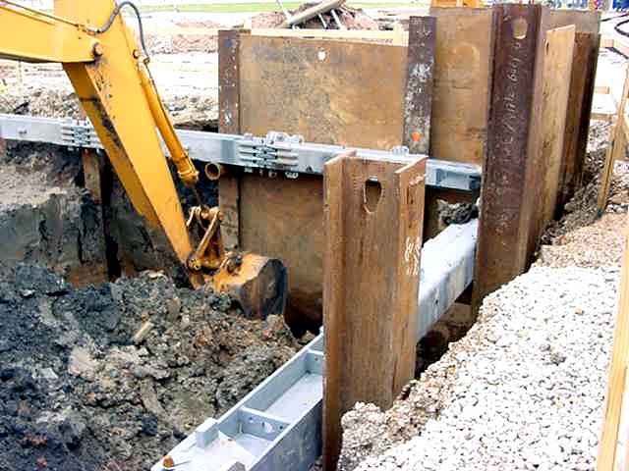
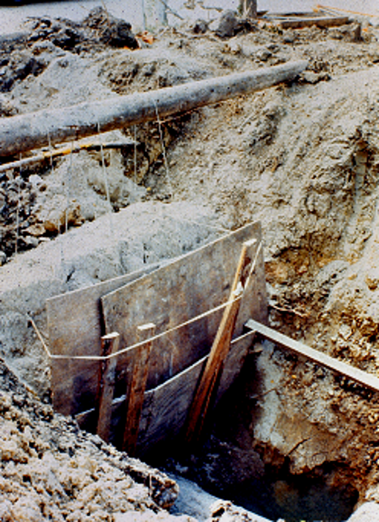
“Joe Pickup” Tieback System AKA, the fly swatter.
Plate & Beam System

Slide 44
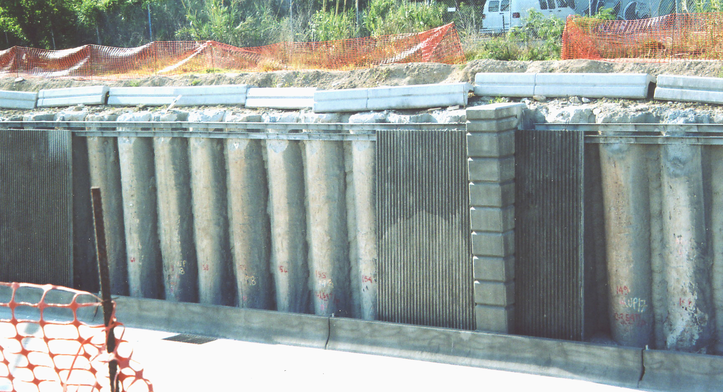
Soldier Piers

Slide 45
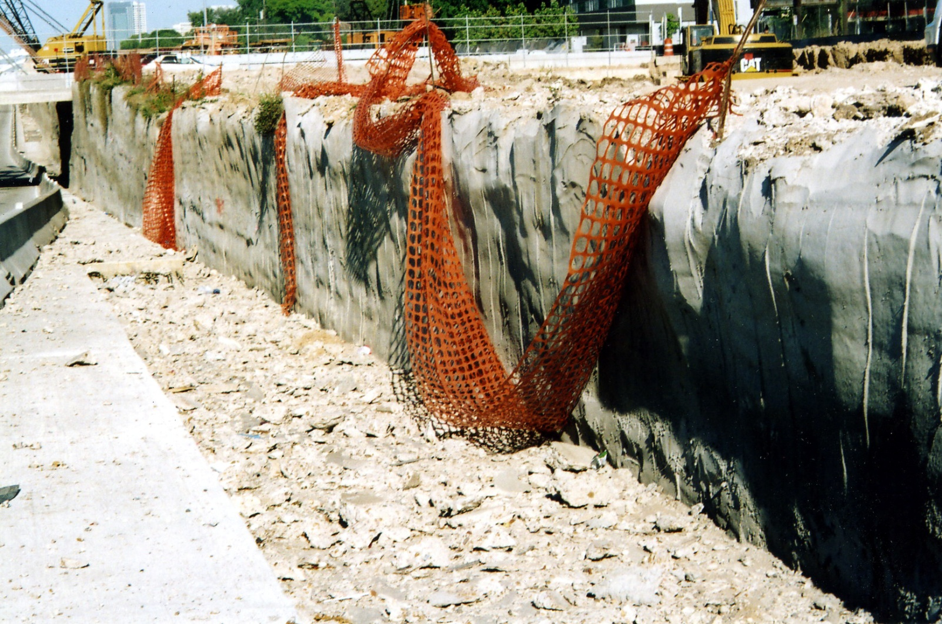
Soil Nailing

Slide 46
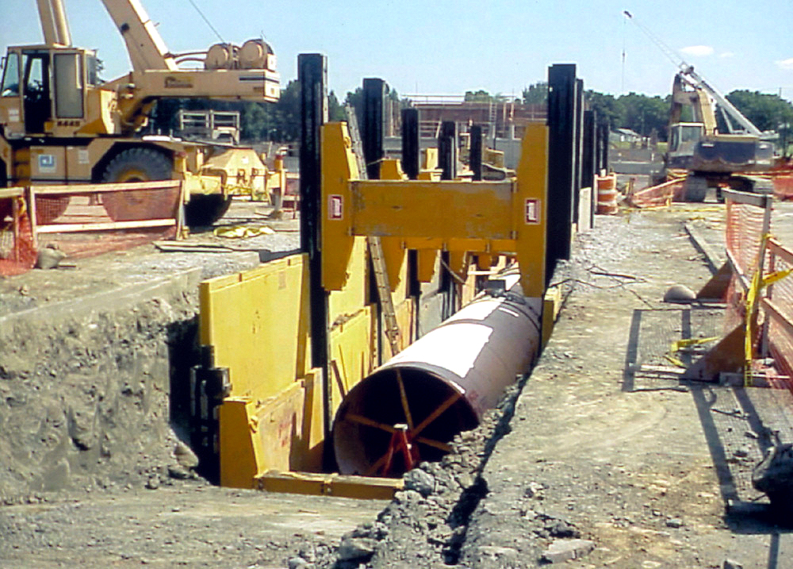
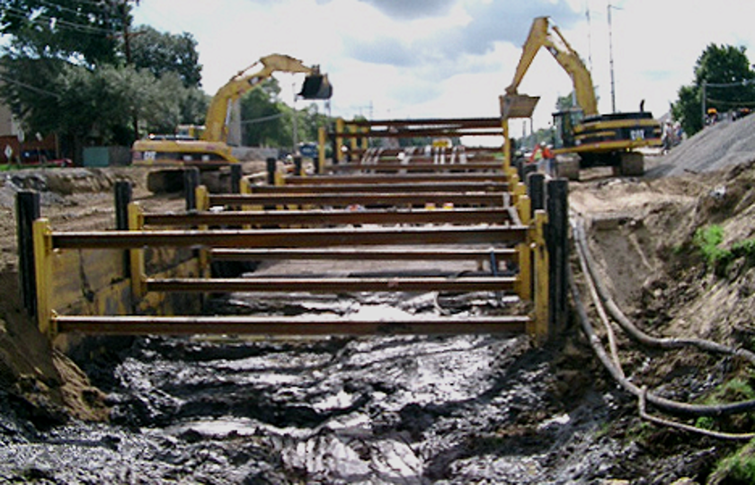
Slide Rail System

Slide 47
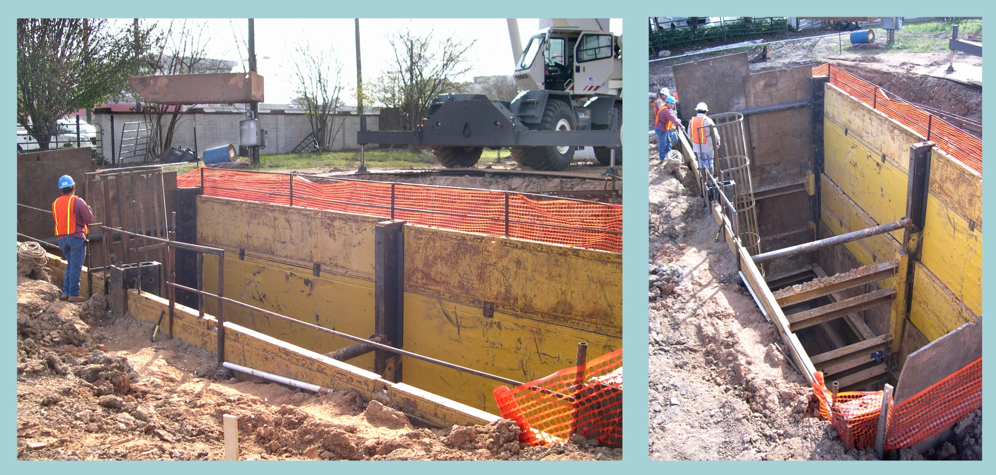
Slide Rail & Steel Plate

Slide 48
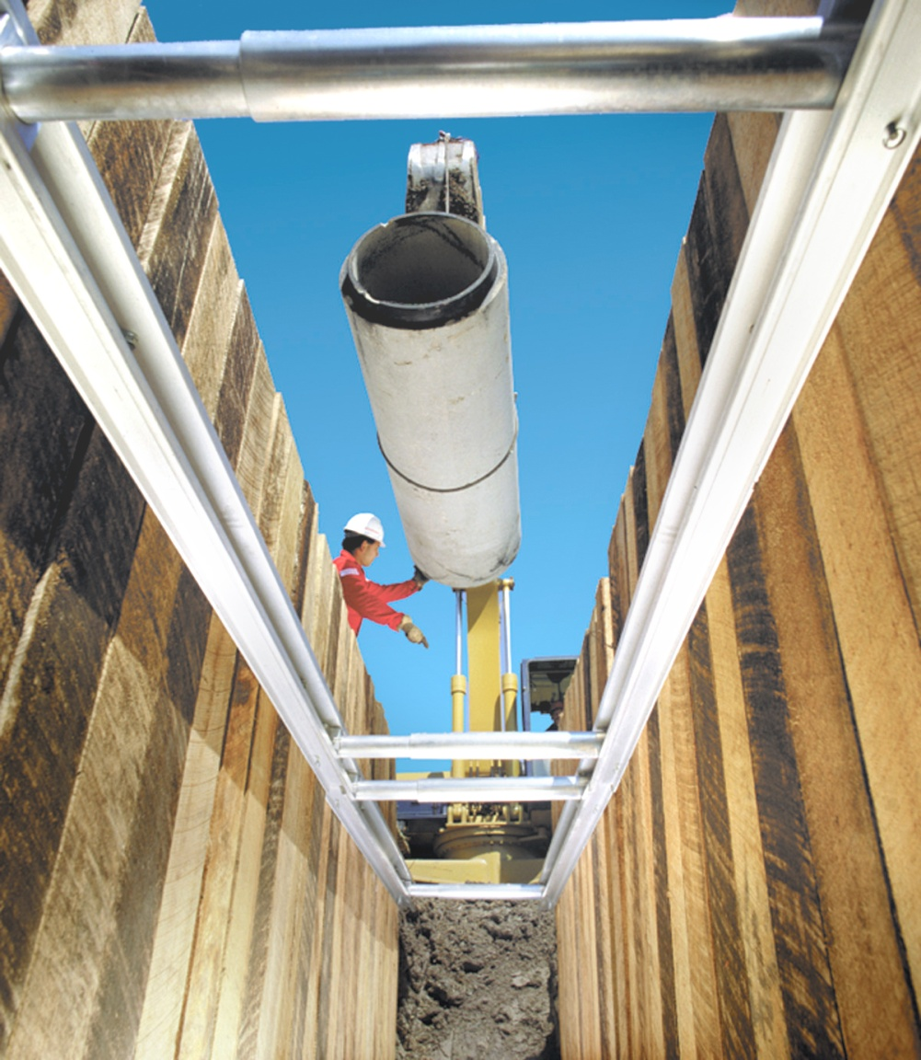
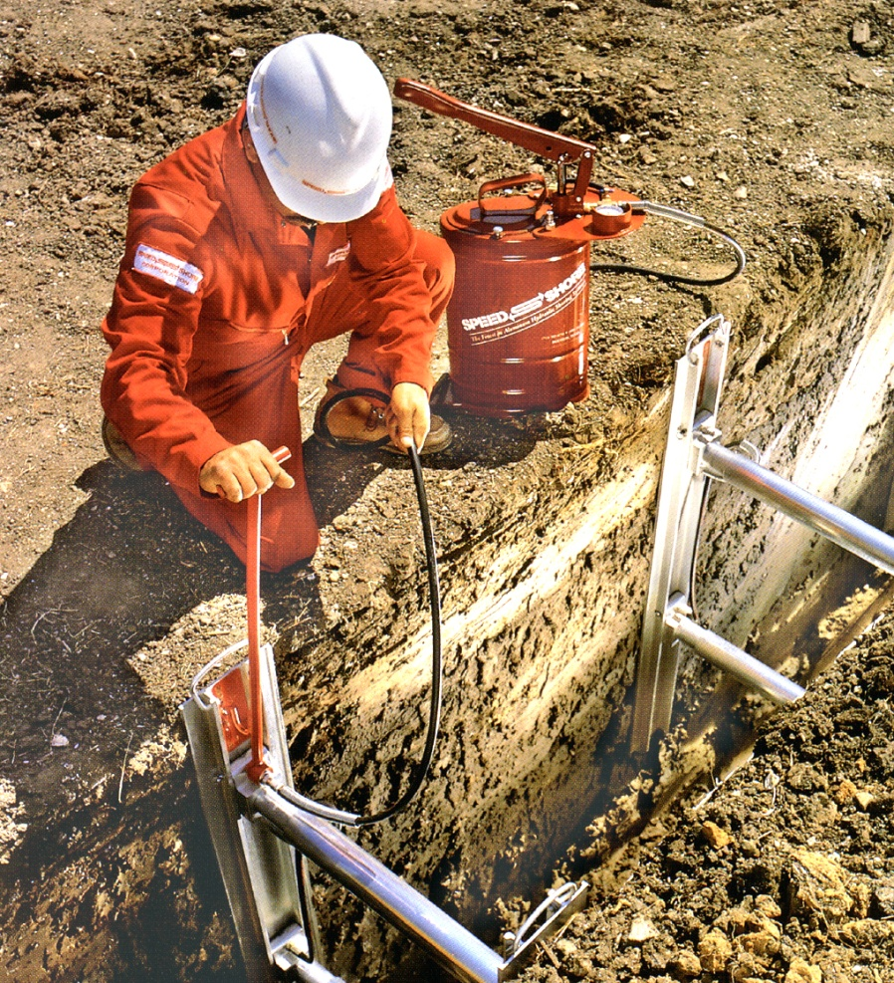
Aluminum Hydraulic Shoring
Vertical Shores
Waler Systems

Slide 49
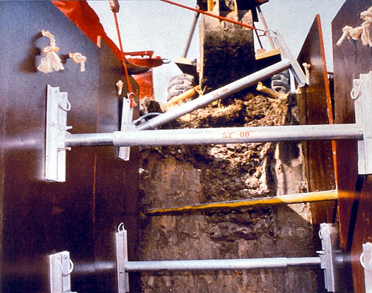
Single Shore

Slide 50
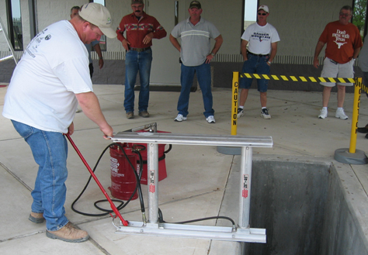
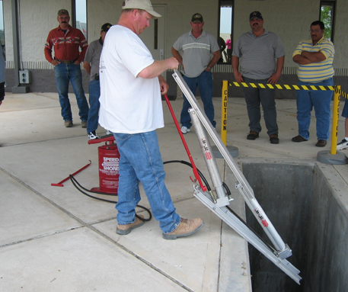
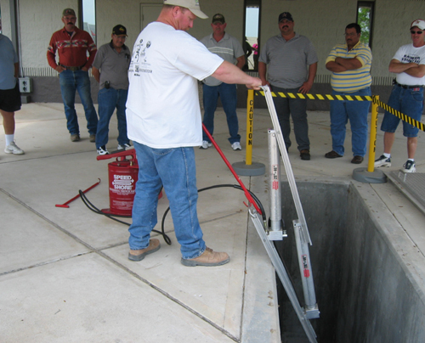
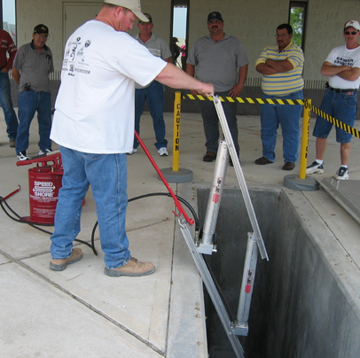
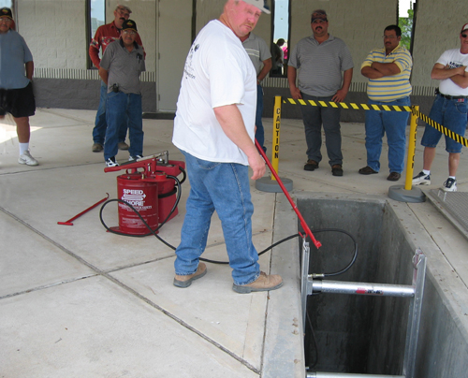
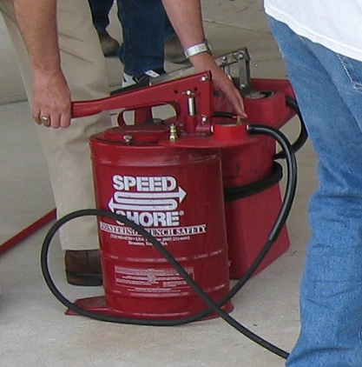
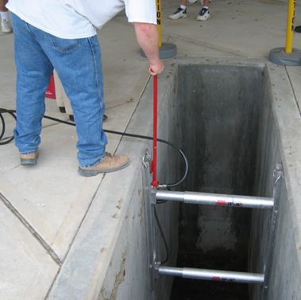
Installation of a Vertical Shore

Slide 51
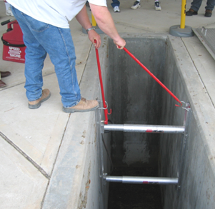
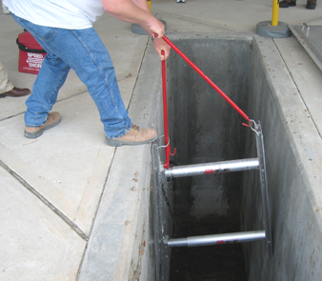
Removing a
Vertical Shore

Slide 52
Hydraulic Shoring is an Active Shoring System
Gauge:
750-1000 psi
Equal Pressure

Slide 53
Soil Arching

Slide 57
Arches transfer the load to the legs.

Slide 58
Soil arching at work.

Slide 59
Soil arching does not extend past the last shore.

Slide 60
Vertical spacing of vertical shore.
OSHA = 18” max. (manufacturer = 24”)
4’ max.
PLYWOOD
1 1/8” CDX or 3/4” Fin Form
4’ max.
2’ max.
2’ max.

Slide 62
What about Vertical Shores in Type C Soil?

Slide 64
PCF
A
B
C
25
45
60
80
Equivalent Fluid Pressure
or
Equivalent Weight Effect

Slide 66
Engineered Shoring Plan

Slide 67
Waler Systems

Slide 68
Type C Soils

Slide 69
4-Way Manhole Brace
With Steel Plate

Slide 70
Shield Systems

Slide 71
Utility Installation

Slide 72
Utility Repair

Slide 73
Shield Systems
Employees may remain inside the shield when it is moved forward, but they may not be in the excavation when the shield is installed, removed, or raised vertically.
Shields do not prevent cave-ins. They protect you when the cave-in occurs.

Slide 74
Employees are exposed to unsupported walls.

Slide 75
Shields must be certified.
Do not jury-rig or “field fabricate” your own.

Slide 76
Shield Certification

Slide 77
Beware of Limitations to Shield Use
** PSF rating and depths are based on short term exposure with excavation open a period of time equal to 24 hours or less.
Type B not exceeding 45 PSF per foot of depth, and Type C nor exceeding 60 PSF per foot in depth.

Slide 78
You may not exceed the rated capacity of any shield.

Slide 79
Steel Plate
Do not use steel plates behind shields – it can cause the shield to be overloaded...

Slide 80
...with predictable results.

Slide 81
You cannot make any additions to, any subtractions from, or any alterations to any shield without written consent from the manufacturers or a registered professional engineer.

Slide 82
Use arched or high clearance spreaders instead.
Do not remove braces to clear pipe.

Slide 83
Adequate Sizing
2’ to 4’
At least 1’
Allow 2 to 4 feet past the end of the pipe, and at least 1 foot alongside it for employee work space.

Slide 84
What if the trench is deeper than the box is tall?

Slide 85
If the trench is deeper than the box is tall, the upper portion of
the trench wall can collapse and bury employees inside the shield.

Slide 86
2’ min.
Spoil Pile
18” min.
Max allowable slope from table B-1
V
H
Support or shield system must be certified for the full depth of the excavation.

Slide 87
Use end plate to prevent exposure at end of trench shield.

Slide 88
“Stacker” assemblies consisting of two or more shields, attached per manufacturers’ specifications, may be used.

Slide 89
No Lateral Shift
Prevent lateral shift by digging the trench with a minimum gap (4” – 6”) between the shield and the trench wall and backfilling half to two-thirds the height of the shield.

Slide 90
Lateral shift can result in an employee being crushed against the pipe.

Slide 91
Check the Clearance!

Slide 92
Check the Clearance!

Slide 93
A shield or support system may ride 2’ off the bottom if:
2’ max.
it is certified for the full depth.
no soil is caving under or behind it.

Slide 94
Unless he’s a munchkin, the shield is too high off the bottom.

Slide 95
Incompetent Person

