Slide 1
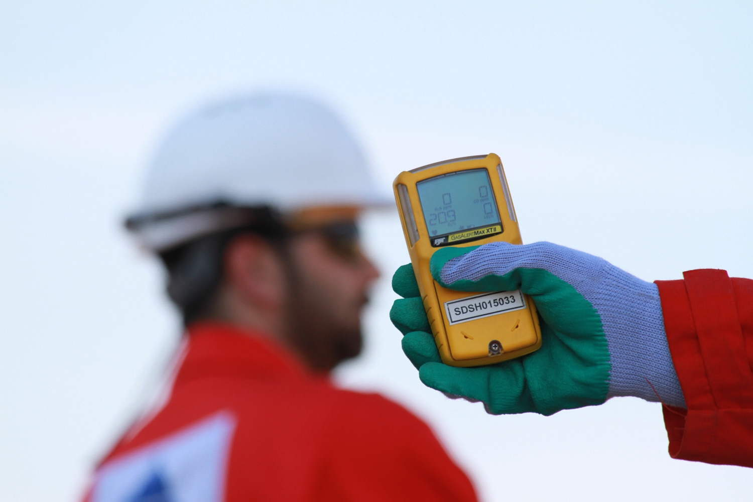
Hydrogen Sulfide (H₂S) Safety Practices and
Methods of Detection
H₂S
Notes:
References:
ANSI Z390.1-2017
API 49 and 55
Texas Statewide Rule 36, Hydrogen Sulfide Safety
Instructor:
This course is designed to meet the requirements of ANSI Z390.1, including:
Hazards
Protection
Requirements of the ANSI Standard.
What the Instructor should do:
Introduce the Course
What Participant/s should do: Actively participate in the learning, including structured discussions.
Reference Material Used:
Class Props: Respiratory Protection, Personal H2S Monitors

Slide 2
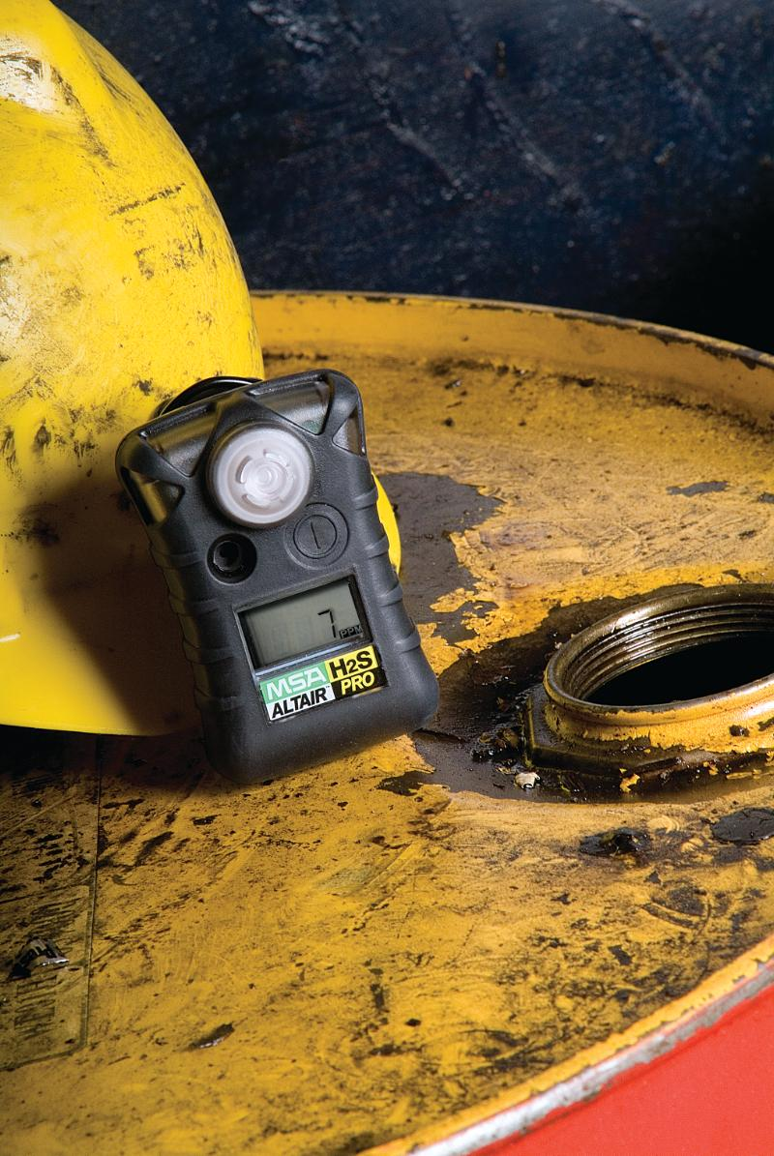
Objectives:
Introduce safety practices related to H₂S
Discuss methos of detection for H₂S
Notes:
Appendix C of ANSI/ASSE Z390.1 requires you to cover the safety practices to eliminate or reduce the hazards and methods to detect and warn workers about unsafe environments.

Slide 3
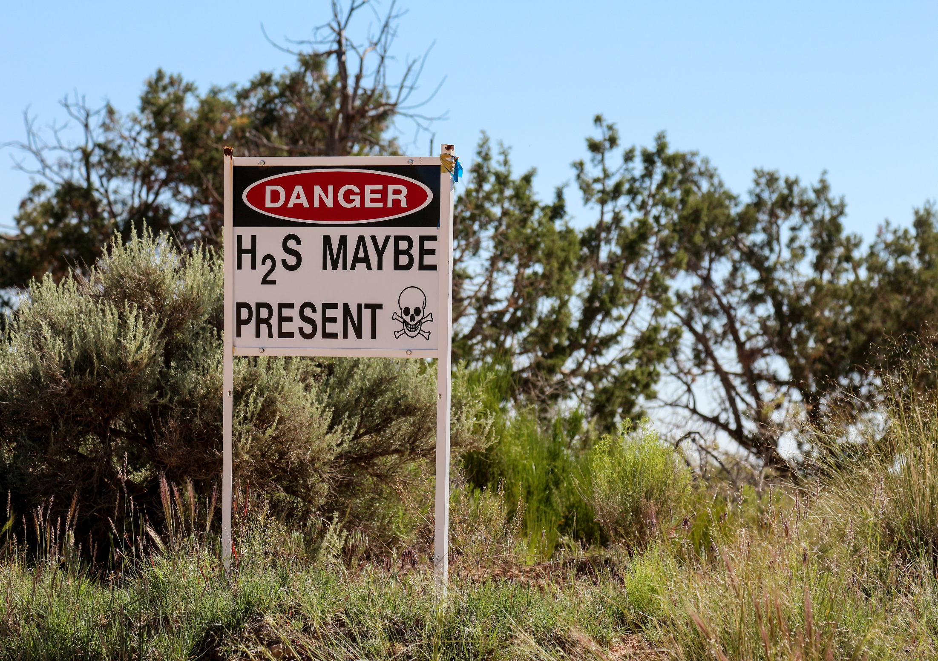
General Safety
Even though H₂S has very strong odor, it’s warning properties are poor.
Often times, employees think that just because they can’t smell H₂S that it’s not present.
If odor is detected, leave area until source is identified, controlled, and area made safe.

Slide 4
Notes:
When leaving area with H₂S, go upwind or across wind.
Never with wind.
Go to higher elevation such as a hill.
Do not return until area is made safe.

Slide 5
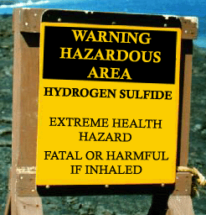
General Safety
If you don’t have proper respiratory protection, STAY OUT!
Use warning signs to alert personnel.
Use fencing to keep unauthorized personnel out.

Slide 6
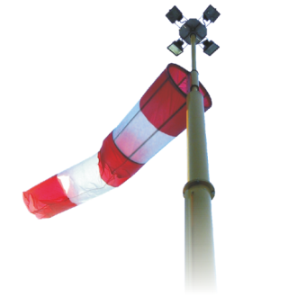
General Safety – Wind Direction Indicators
Post wind direction indicators in areas where H₂S is present or has potential to be present.
Wind direction indicators give visual cue as to presence and direction of wind.

Slide 7
General Safety
Use wind direction indicators, such as…
Windsocks
Flags
Banners
Streamers
Use H₂S monitors and detectors

Slide 8
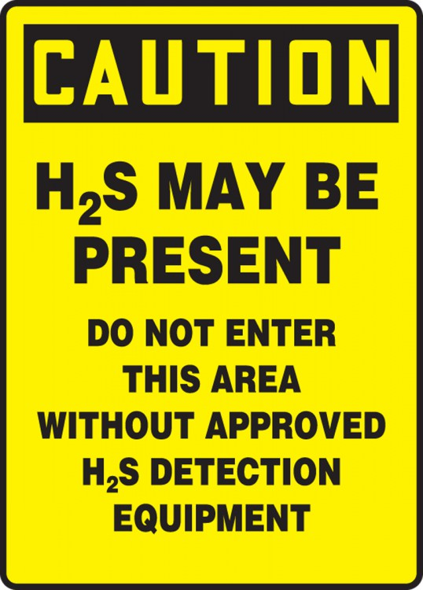
General Safety - Signs
Signs to indicate the potential for or the presence of H₂S
Signs to prohibit smoking
Signs to prohibit ignition sources
Other signs as needed
Notes:
Remember, the ignition temperature of H2S is 500 degrees. A cigarette is 1400 degrees and an oxy-acetylene torch is 1200 degrees.

Slide 9
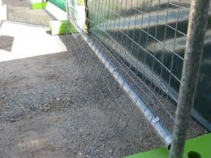
General Safety - Fences
Fence off dangerous areas, including:
Tanks,
Open pits,
Wellheads
Install fences far enough away
Post signs on fences

Slide 10
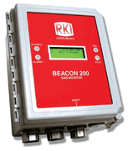
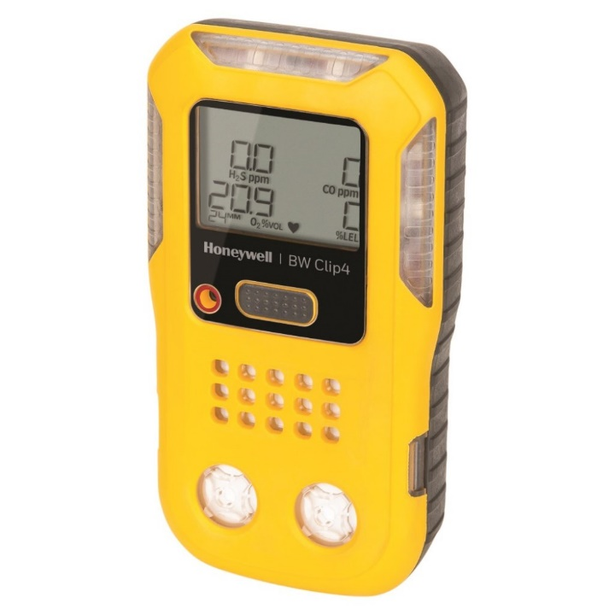
Monitoring Equipment
Two basic types of monitoring equipment:
Fixed
Portable

Slide 11
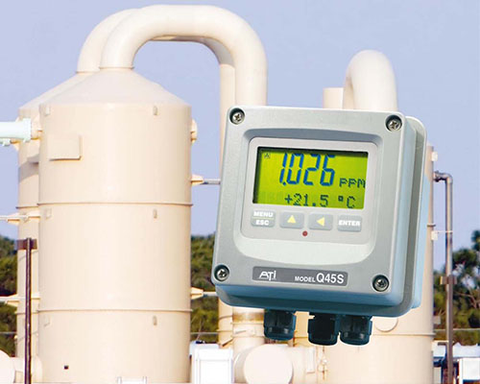

Slide 12
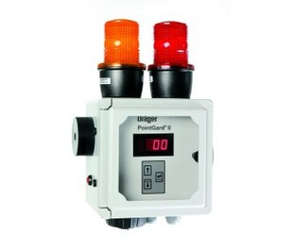
Monitoring Equipment - Fixed
Used in permanent locations
Can detect single or multiple gases
Have reset alarm level
Have audio and visual alarms

Slide 13
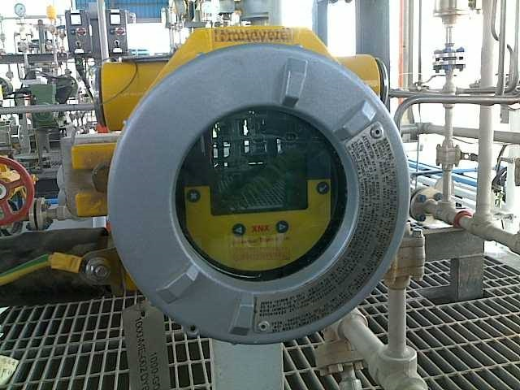

Slide 14
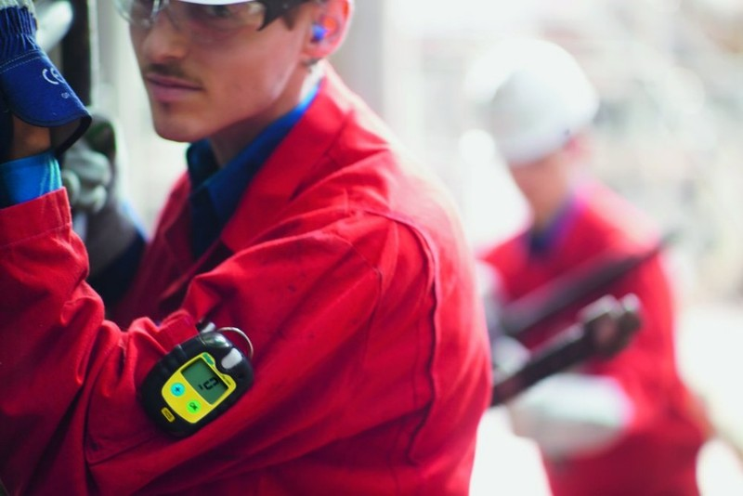
Monitoring Equipment - Portable
Two basic types of portable monitoring equipment:
Electronic
Non-electronic

Slide 15
Portable Electronic Monitors
Can be single gas or multi-gas
Usually handheld, clipped to belt, or carried in shirt pocket (should be in the breathing zone)
Some have LCD
Some alarm only
Notes:
Portable Electronic Monitors
Can be single gas or multi-gas
Usually handheld, clipped to belt, or carried in shirt pocket (should be in the breathing zone)
Some have LCD
Some alarm only

Slide 16
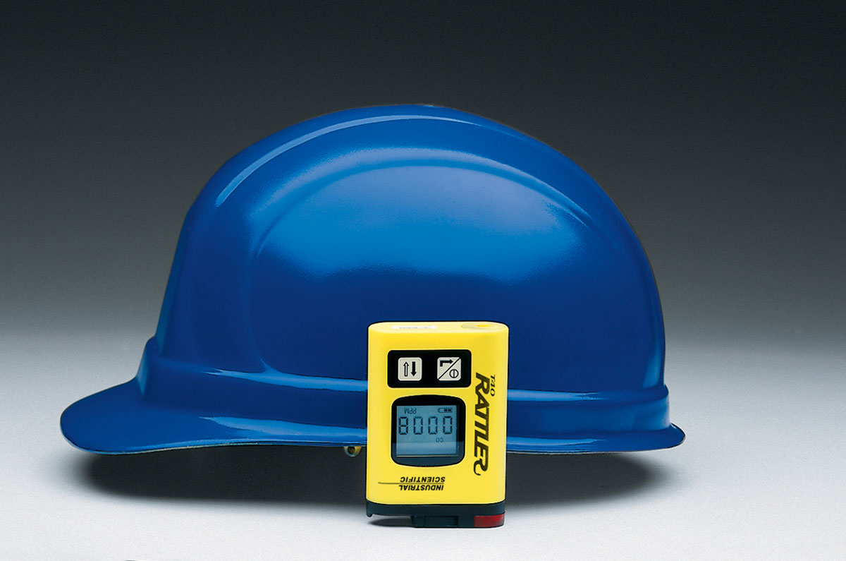
Portable Electronic
Portable Electronic
Notes:
Portable Electronic
Can be single gas or multi-gas
Usually handheld, clipped to belt, or carried in shirt pocket (should be in the breathing zone)
Some have LCD
Some alarm only

Slide 17
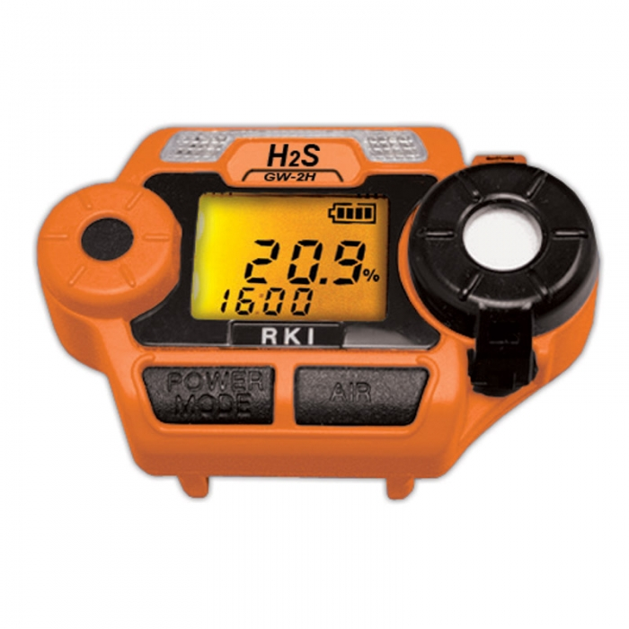
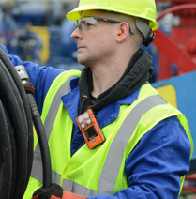
Portable Electronic
Diffusion type monitors have a sensor that allows gas to enter, then uses microprocessor to determine the amount of gas present

Slide 18
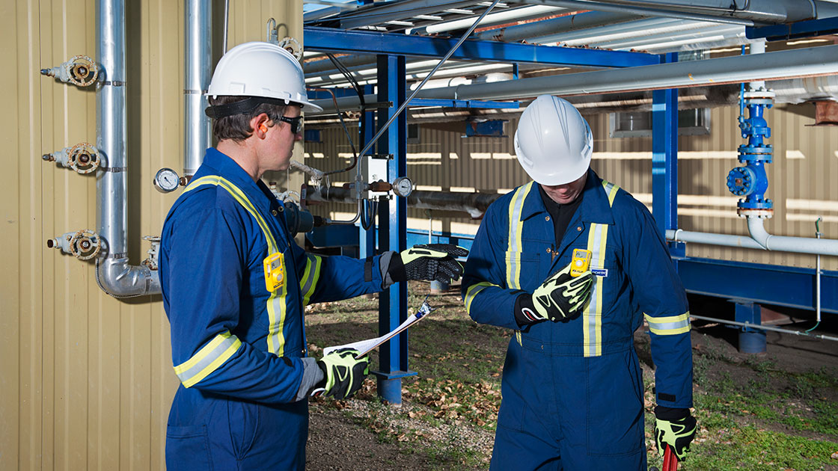

Slide 19
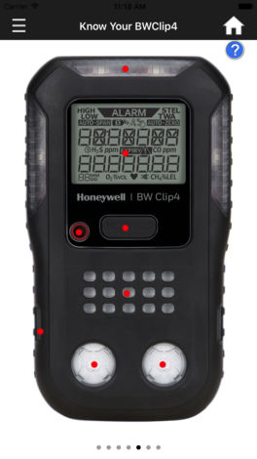
Portable Electronic Monitor
‘BW Clip4’ app
Notes:
The Honeywell BW Clip4 app duplicates the experience of operating a BW Clip4 handheld gas monitor. It comes with an interactive tutorial, which simulates navigation through the BW Clip4 user interface via the same buttons and display as an actual instrument. By default, the app shows normal readings for configured sensors. With the Honeywell BW Clip4 app, you can: - Familiarize yourself with the instrument and its functional features - Review key product features and specifications - Simulate sensor readings and alarm conditions - Review in-the-box and additional accessories - Provide feedback on the instrument and mobile app

Slide 20
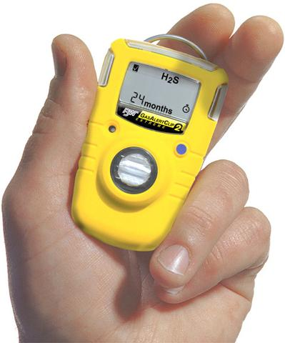
Portable Electronic - Advantages
Accurate
Light weight
“Go anywhere”
Easy to Use
Low Cost

Slide 21
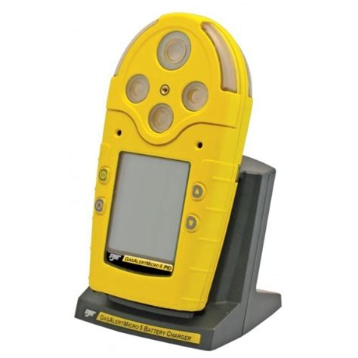
Portable Electronic - Disadvantages
Monitors must be calibrated and tested
Must order calibration gas
Sensors expire
Calibration gas expires
Sensors can be “overloaded”

Slide 22
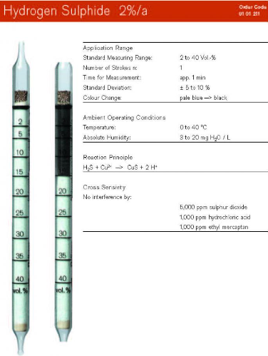
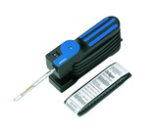
Portable Non-electronic
Pump draws known amount of air through tube filled with reagent
Reagent changes color
Amount of color determines amount of gas present
Notes:
Discuss how to use pump and tubes

Slide 23
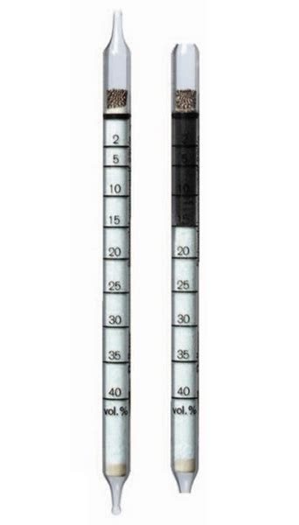
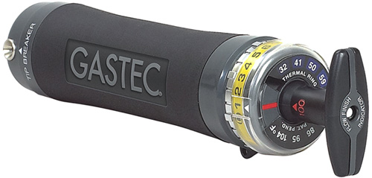
Portable Non-electronic: Advantages
Relatively low cost
No batteries
Easy to use
Notes:
Discuss how to use pump and tubes

Slide 24
Portable Non-electronic: Disadvantages
Accuracy is about + 25%
Pumps can leak
H₂S can corrode the pump
Have broken glass tubes
Notes:
Discuss how to use pump and tubes

Slide 25
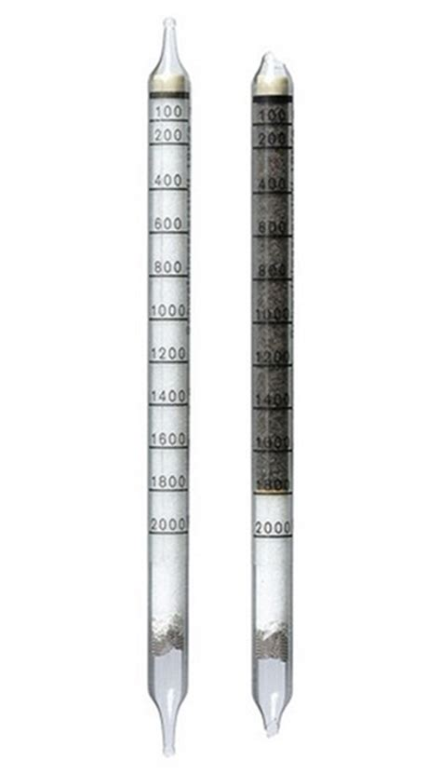
Portable Non-electronic: Disadvantages
Tubes expire
Cannot mix pumps and tubes from different manufactures
Colors may be hard to read
Notes:
Discuss how to use pump and tubes

Slide 26
Hydrogen Sulfide (H₂S) Safety Practices and
Methods of Detection
H₂S
Notes:
We discussed safety practices and methods of detection for Hydrogen Sulfide.

