Slide 1
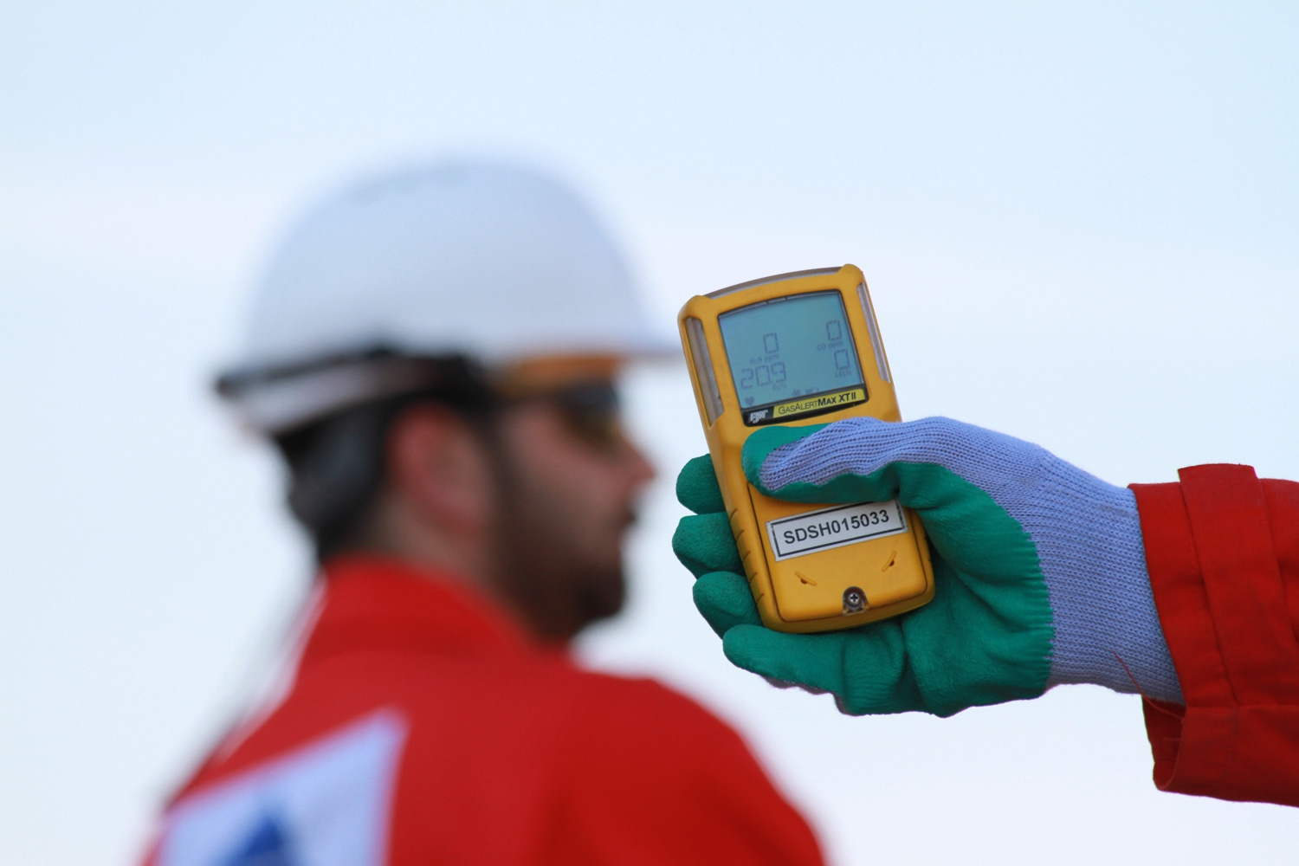
Hydrogen Sulfide (H₂S) Personal Protective
Equipment (PPE)
H₂S
Notes:
References:
ANSI Z390.1-2017
API 49 and 55
Texas Statewide Rule 36, Hydrogen Sulfide Safety
Instructor:
This course is designed to meet the requirements of ANSI Z390.1, including:
Hazards
Protection
Requirements of the ANSI Standard.
What the Instructor should do:
Introduce the Course
What Participant/s should do: Actively participate in the learning, including structured discussions.
Reference Material Used:
Class Props: Respiratory Protection, Personal H2S Monitors

Slide 2
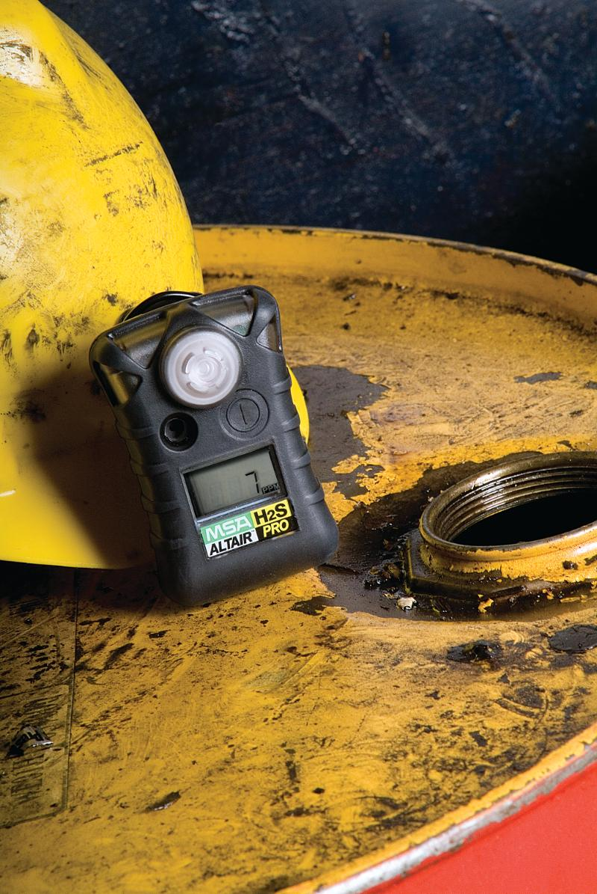
Objectives:
Review personal protective equipment requirements for H₂S environments
Proper use and maintenance of respiratory protection equipment
Need for instruction and hands-on practice with demonstrated proficiency
Notes:
Workers need to be provided with appropriate training for site-specific items of personal protection equipment designed for protection from H2S exposure.
Emphasis in this module is on respiratory protection and follows OSHA 29 CFR 1910.134.

Slide 3
Respiratory Protection
Describe appropriate respiratory protection.
List elements of an effective respiratory protection program.
Describe areas where H₂S may accumulate.
Notes:
Personnel who have received H2S certification and are subject to working under respiratory protection will successfully complete a respiratory protection training program, to include medical evaluation and fit-testing if they are to wear tight-fitting air supplied respirators in these hazardous atmospheres according to OSHA 29 CFR 1910.134 or applicable local regulatory requirements.

Slide 4
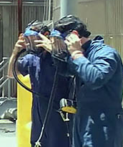
Requirements for Site-Specific Orientation
Location of Supplied Air Respirators (SAR) or Self-Contained Breathing Apparatus (SCBA)
Location of spare air cylinders
Muster locations for varying wind direction
Situations requiring respirators
Notes:
In addition to the annual H2S certification training, a site-specific orientation is required for individuals who have the potential to be exposed to H2S in concentrations greater than the occupational exposure limit. At a minimum, personnel shall be briefed on:
route(s) of egress
use and location of wind indicators
emergency assembly area(s)
applicable warning signals
how to respond in the event of an emergency
use and location of personal protective equipment
hands-on training with the specific H2S detector to be used in the field is required prior to use

Slide 5
Requirements for Site-Specific Orientation
Medical evaluation requirements
Fit testing requirements
Limitations and capabilities of positive pressure/full-facepiece respirators
Limitations and capabilities of air supplied respirators
Brand/model/size of respirators available
Notes:
In addition to the annual H2S certification training, a site-specific orientation is required for individuals who have the potential to be exposed to H2S in concentrations greater than the occupational exposure limit. At a minimum, personnel shall be briefed on:
route(s) of egress
use and location of wind indicators
emergency assembly area(s)
applicable warning signals
how to respond in the event of an emergency
use and location of personal protective equipment
hands-on training with the specific H2S detector to be used in the field is required prior to use

Slide 6
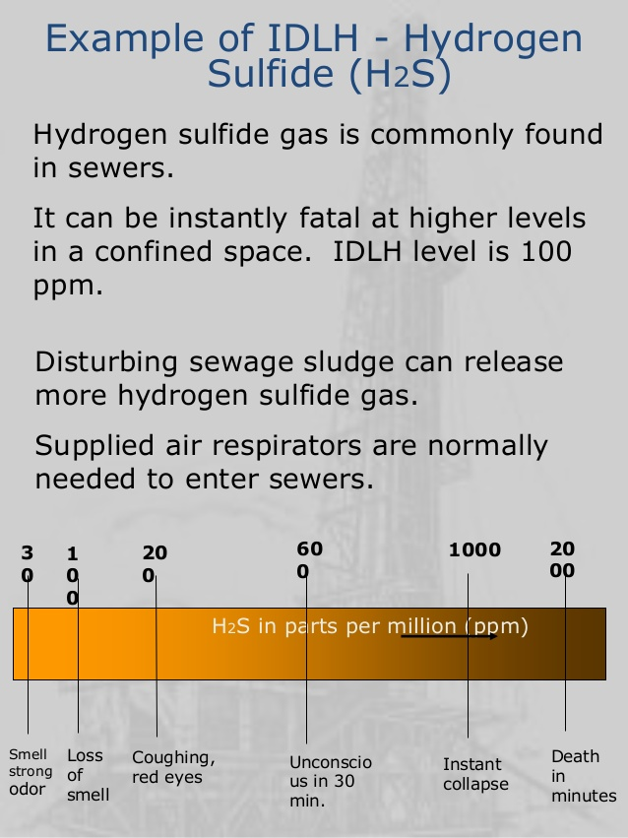
IDLH
Immediately Dangerous to Life and Health (IDLH): Any atmosphere that poses an immediate hazard to life, impairs ability for self-rescue, or poses immediate irreversible debilitating effects on health.

Slide 7
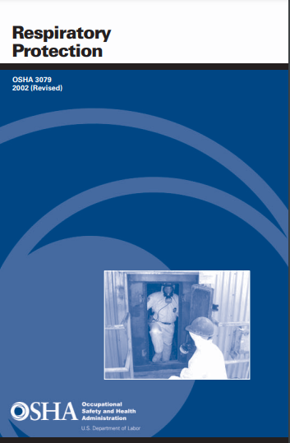
Respirator Program
8-Simple Steps in Establishing Respiratory Protection Program
Exposure Assessment
Written Respiratory Program
Respirator Selection
Medical Evaluation
Fit Testing
Breathing Air Quality and Use
Respirator Training
Program Evaluation
OSHA Publication 3079
Notes:
8-Simple Steps in Establishing Respiratory Protection Program
Exposure Assessment
Written Respiratory Program
Respirator Selection
Medical Evaluation
Fit Testing
Breathing Air Quality and Use
Respirator Training
Program Evaluation

Slide 8
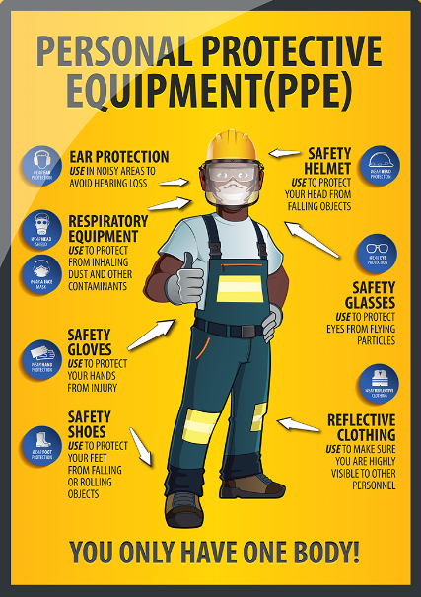
Exposure Assessment
1910.132(d)
"The employer shall assess the workplace to determine if hazards are present, or are likely to be present, which necessitate the use of personal protective equipment (PPE).”

Slide 9
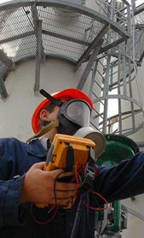
Respiratory Program
Exposure Assessment - 1910.134(d)
"The employer shall identify and evaluate the respiratory hazard(s) in the workplace…”
This evaluation shall include a reasonable estimate of employee exposures to respiratory hazard(s)
Identification of the contaminant's chemical state and physical form."

Slide 10
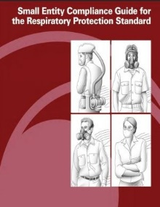
Respirator Program
Must develop written program with worksite-specific procedures when respirators are necessary or required by employer.
Must update program as necessary to reflect changes in workplace conditions that affect respirator use.
Note: OSHA has prepared Small Entity Compliance Guide containing criteria for selection of program administrator and sample program
OSHA Publication 3384

Slide 11
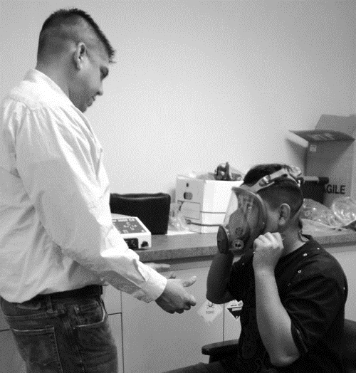
Respirator Program (cont’d)
Program Administrator – 1910.134(c)(3)
Employer shall designate a program administrator who is qualified by appropriate training or experience that is commensurate with the complexity of the program to administer or oversee the respiratory protection program and conduct the required evaluations of program effectiveness.”

Slide 12
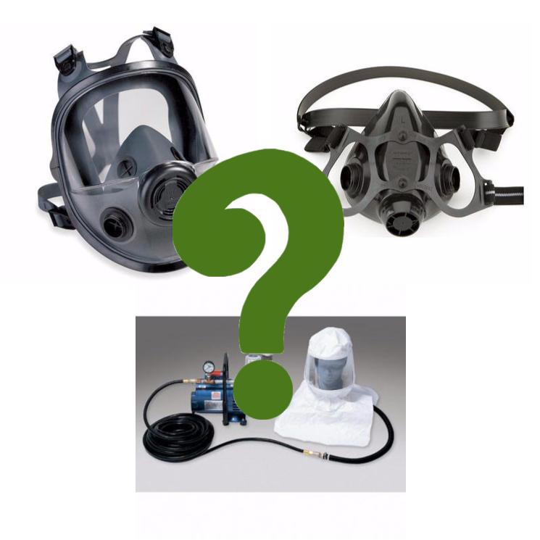
Respiratory Program
Respirator Selection
Respirator type or class is selected by comparing employee’s exposure to occupational exposure limit and determining minimum necessary respirator assigned protection factor
Where employer cannot identify or reasonably estimate employee exposure, OSHA requires employer to consider atmosphere as IDLH

Slide 13
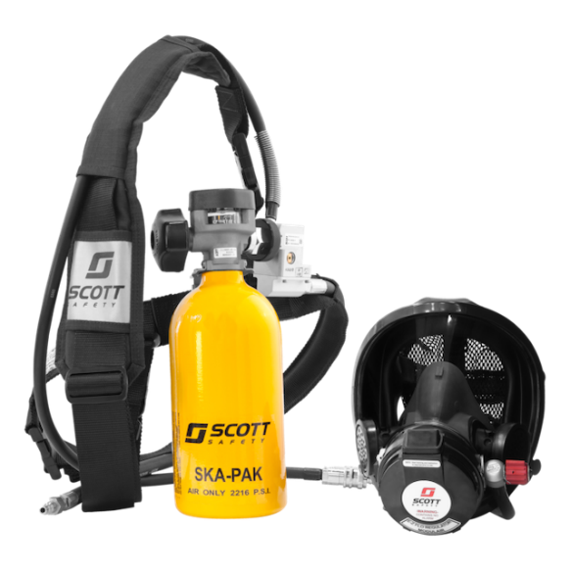
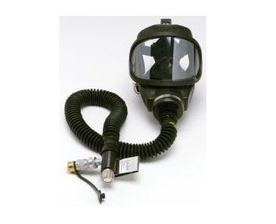
Respirator Program (cont’d)
There are three types of Atmosphere Supplying Respirators:
Self Contained Breathing Apparatus (SCBA) - air source designed to be carried by user
Supplied-Air - air source not designed to be carried by user
Combination SCBA and Supplied-Air

Slide 14
Respiratory Protection – Supplied-Air
Non-IDLH atmospheres:
Uses hose to deliver breathing air to full-facepiece mask
Must be at least Grade-D air or better
Air supply is from certified compressed cylinders or air compressor

Slide 15
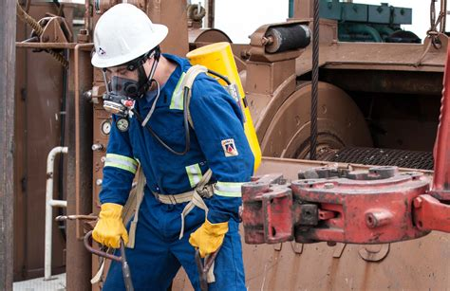
Respiratory Protection – SCBA
Wearer is independent of surrounding atmosphere
SCBA are also used for emergency response & escape

Slide 16
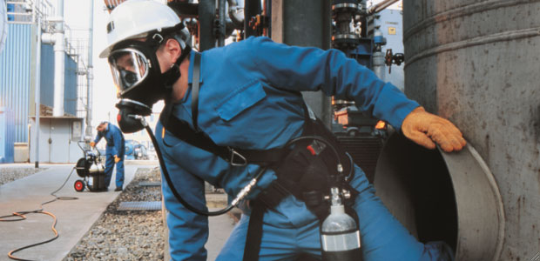
Respiratory Protection – Combination
These are air-line respirators with auxiliary self-contained air-supply
Auxiliary SCBA allows the wearer to evacuate area
With auxiliary SCBA, an air-line respirator can be worn in IDLH atmosphere

Slide 17
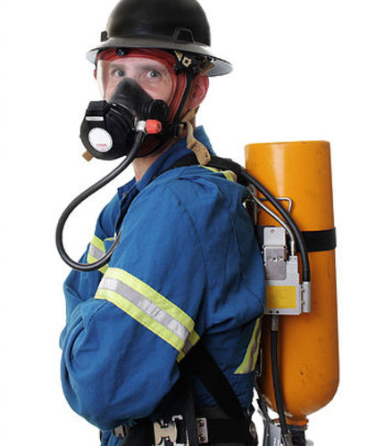
Selection of Respirators
For IDLH atmospheres provide:
Full facepiece pressure demand SCBA certified by NIOSH for a minimum service life of 30 minutes; OR
A combination full facepiece pressure demand supplied air respirator with auxiliary self-contained air supply

Slide 18
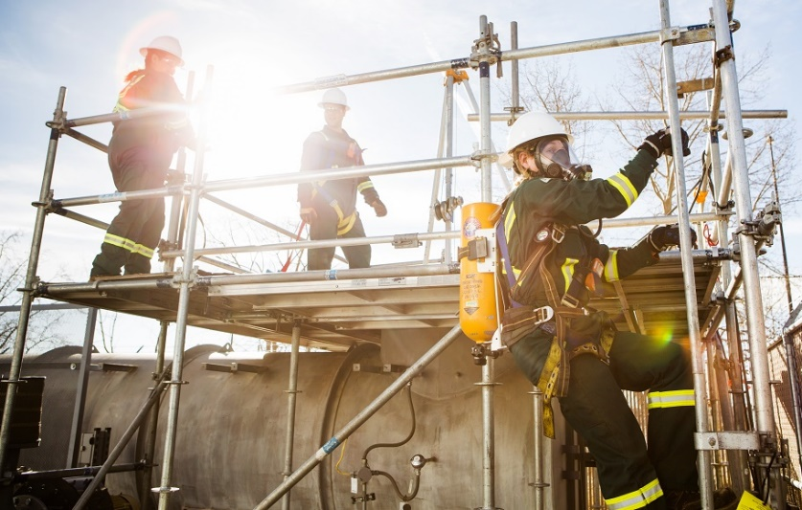
Medical Evaluations
Using a respirator may place a physiological burden on employees that varies with the type of respirator worn, job, and workplace conditions in which respirator is used, and medical status of the employee.
Accordingly, this paragraph specifies the minimum requirements for medical evaluation that employers must implement to determine employee's ability to use respirator. - 1910.134(e)

Slide 19
Respiratory Program
Medical Evaluation - 1910.134(e)
“Employer shall provide a medical evaluation to determine the employee's ability to use a respirator, before the employee is fit tested or required to use the respirator in the workplace.”

Slide 20
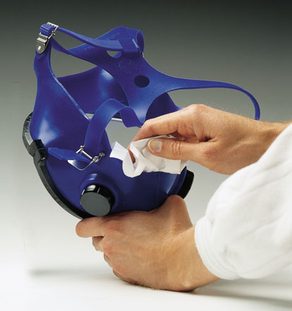
Respirator Program (cont’d)
Must establish and implement those elements of written program necessary to ensure employee is medically able to use respirator and that it is cleaned, stored, and maintained so it does not present health hazard to user - 1910.134(c)(2)(ii)
Notes:
Procedures and schedules for cleaning, disinfecting, storing, inspecting, repairing, discarding, and otherwise maintaining respirators.

Slide 21
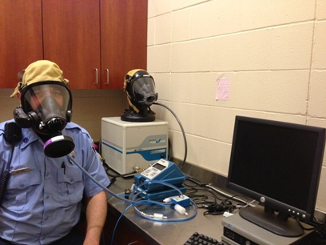
Respirator Program (cont’d)
Fit Testing - 1910.134(e)
“Employer shall ensure that employee using tight-fitting facepiece respirator is fit tested prior to…
Initial use of respirator
Whenever different respirator facepiece (size, style, model or make) is used
At least annually”

Slide 22
Respirator Program (cont’d)
Breathing Air Quality and Use - 1910.134(i)
“…Requires employer to provide employees using atmosphere-supplying respirators (Supplied-Air & SCBA) with breathing gases of high purity”

Slide 23
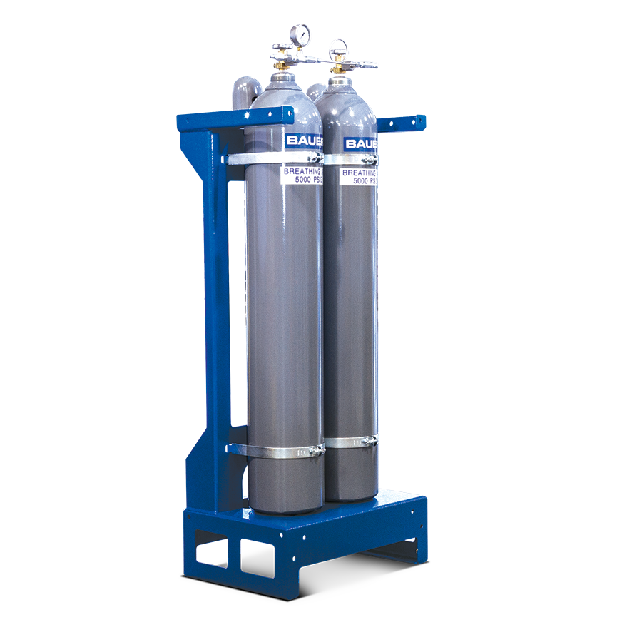
Supplied-Air
When using cylinders of air…
Cylinders must be tested
Cylinders must have certificate of analysis from supplier
Moisture content must not exceed dew point of -50 degrees F

Slide 24
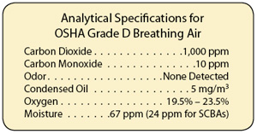
Grade-D Air
Air must meet ANSI/Compress Gas Association Commodity Specification for Air, G-7.1-1989 for Grade D:
Notes:
Compressed air standards provides data concerning quality verification systems, sampling, analytical procedures, containers, typical uses for various grades and supplemental specification tables.
CGA Grade Industrial Uses
A Industrial compressed air
L SCBA
D OSHA breathing air
E SCUBA
J Specialty grade air, analytical applications
N Medical/USP air
A variety of CGA G-7.1 grades are used depending upon the type of industry and application, but the two most common industrial air grades are Grade D, E, and F. OSHA requires all supplied air respirators, including SCBA, use Grade D or better air.
What are quality verification systems? There are several things to look for when checking air quality: water in the air, dew point / pressure dew point, oil in the air, dust, and contaminations like smells, and microorganisms. ‘
Canister or cartridge means a container with a filter, sorbent, or catalyst, or combination of these items, which removes specific contaminants from the air passed through the container.
Only approved cylinders with a certification must be used for breathing air. Different types of applications determine the type of container to be used.

Slide 25
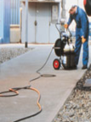
Respiratory Protection – Supplied-Air
When using air from compressors, the compressors must be situated to:
Prevent the entry of contaminants into the air-supply system
Minimize the moisture content
Have suitable in-line purifying sorbent beds to assure breathing air quality

Slide 26
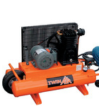
Supplied-Air
For compressors that are not oil-lubricated, ensure CO levels do not exceed 10 ppm
For oil-lubricated compressors, then shall use high temperature or CO alarm to ensure CO levels do not exceed 10 ppm

Slide 27
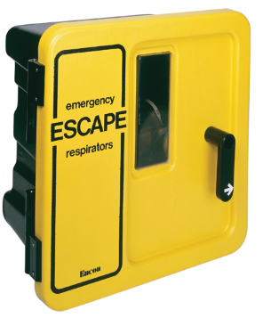
Maintenance & Care of Respirators
Storage of respirators for emergency use:
Kept accessible to work area
Stored in compartments or covers that are clearly marked
Stored in accordance with manufacturer instructions

Slide 28
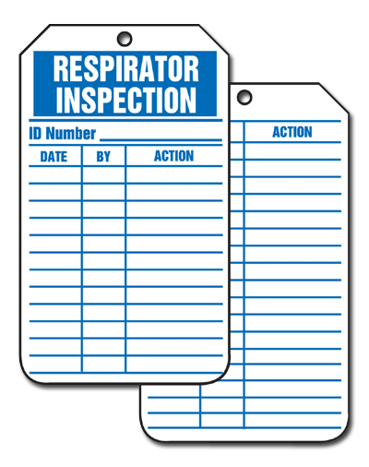
Maintenance & Care of Respirators
For emergency use respirators, employer shall certify respirator by…
documenting date inspection was performed,
name of person who completed inspection,
findings,
required remedial action, and
serial number to identify respirator

Slide 29
Respirator Program (cont’d)
Respirator Training - 1910.134(k) “This paragraph requires employer to provide effective training to employees who are required to use respirators
Training must be …
Comprehensive
Understandable
Recur annually and more often if necessary.”

Slide 30
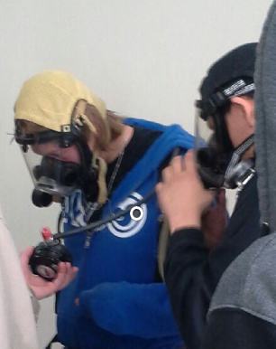
Additional Training for PPE
Additional training may be needed to ensure employees know:
Where emergency respirators are located
Location of spare air cylinders
Any site-specific conditions

Slide 31
Training & Information
Employee must be able to demonstrate at least the following:
Why respirator is necessary and how improper fit, usage, or maintenance can compromise protective effect of respirator;
Limitations and capabilities of the respirator

Slide 32
Training & Information
Employee must be able to demonstrate at least the following:
How to use respirator effectively in emergency situations, including situations in which respirator malfunctions;
How to inspect, put on and remove, use, and check seals of respirator;
What procedures are for maintenance and storage of respirator

Slide 33
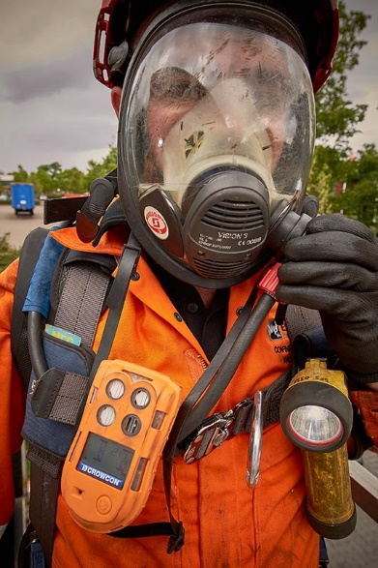
Training and Information
Employee must be able to demonstrate at least the following:
How to recognize medical signs and symptoms that may limit or prevent effective use of respirators; and
General requirements

Slide 34
Respirator Program (cont’d)
Program Evaluation – 1910.134(l)
“Employer conduct evaluations of the workplace to ensure that the written respiratory protection program is being properly implemented, and to consult employees to ensure that they are using the respirators properly.”
Notes:
Program Evaluation – 1910.134(l)
Procedures for regularly evaluating the effectiveness of the program.
Employer is required to conduct evaluations of the workplace to ensure that the written respiratory protection program is being properly implemented. The employer shall conduct evaluations of the workplace as necessary to ensure that the provisions of the current written program are being effectively implemented and that it continues to be effective.
The employer shall regularly consult employees required to use respirators to assess the employees' views on program effectiveness and to identify any problems. Any problems that are identified during this assessment shall be corrected.
To conduct a positive pressure seal, close off exhalation valve with palm of hand and exhale gently into the face piece. Proper seal is achieved if slight positive pressure can be built up inside. This method can also be used to locate areas of leakage. To conduct a negative pressure seal, close off inlet to the cartridge or canister with palm of hand and inhale slightly and hold breath. Mask should stay collapsed against the face. If the mask relaxes off the face, reposition and try again.

Slide 35
Other PPE
Hard hats
Impervious clothing & gloves
Face shields
Splash-proof safety goggles
Notes:
Other PPE requirements shall be determined by a detailed hazard assessment as required by OSHA 1910.132(d)
"The employer shall assess the workplace to determine if hazards are present, or are likely to be present, which necessitate the use of personal protective equipment (PPE).
Hard hats and gloves may be standard.
Some applicable protective equipment or clothing may include impervious clothing, gloves and face shields to protect workers’ skin from exposure to liquid H2S or vessels containing liquid H2S. This may also include splash-proof goggles where liquid may contact the eyes.
Any clothing that becomes wet with liquid H2S should be immediately removed and not re-worn until the H2S has evaporated.

Slide 36
Hydrogen Sulfide (H₂S) Personal Protective
Equipment (PPE)
H₂S
Notes:
Workers need to be provided with appropriate training for site-specific items of personal protection equipment designed for protection from H₂S exposure.
Emphasis in this module was on respiratory protection and follows OSHA 29 CFR 1910.134.

