Slide 1
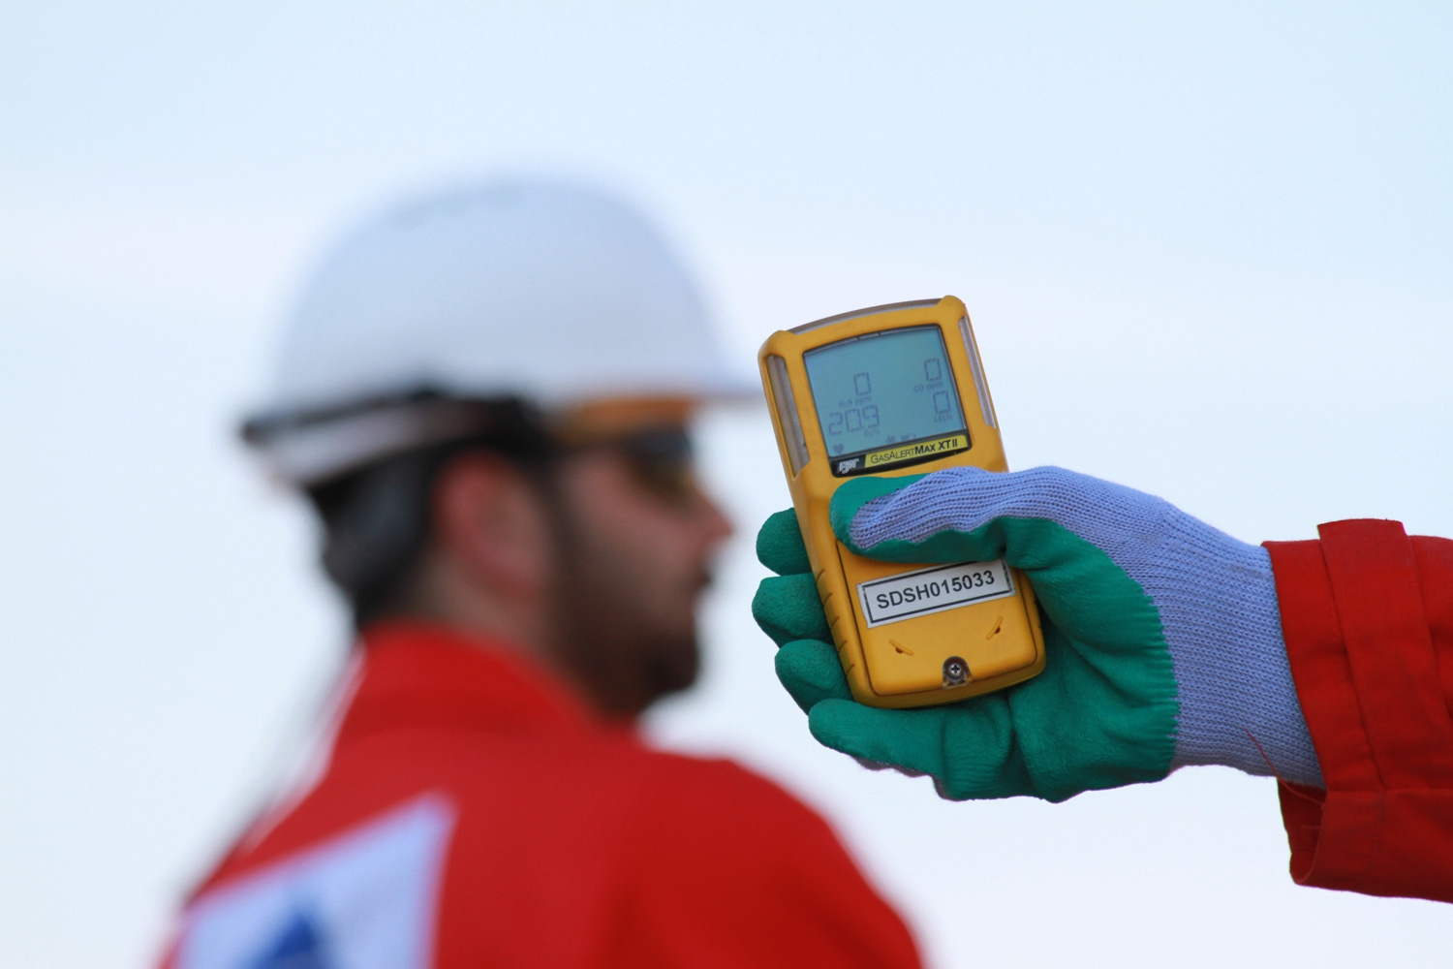
Hydrogen Sulfide (H₂S) Hierarchy of
Hazard Controls
H₂S
Notes:
References:
ANSI Z390.1-2017
API 49 and 55
Texas Statewide Rule 36, Hydrogen Sulfide Safety
Instructor Manual:
This course is designed to meet the requirements of ANSI Z390.1, including:
Hazards
Protection
Requirements of the ANSI Standard.
What the Instructor should do:
Discuss operations and controls using Hierarchy of Controls to provide a systematic approach to eliminating hazards and reduce or control H2S risks.
What Participant/s should do: Actively participate in the learning, including structured discussions.
Reference Material Used:
OSHA 29 CFR 1910.146 and/or 29 CFR 1926 Subpart AA.

Slide 2
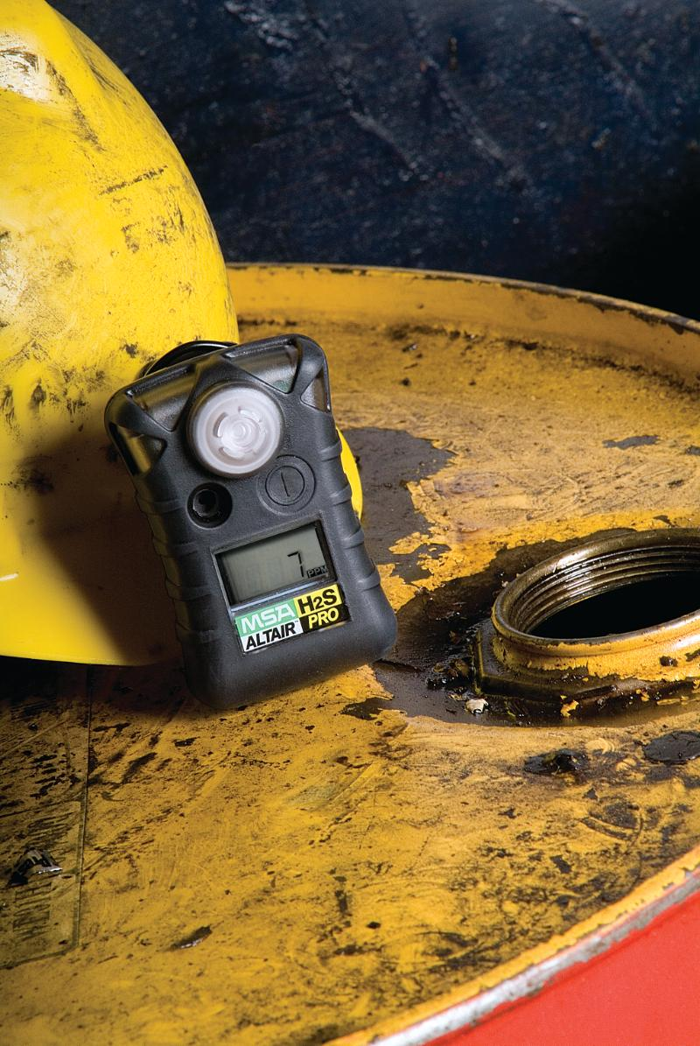
Objectives:
Discuss hierarchy of controls and provide overview of systematic approach to eliminating hazards, and reduction or control of H₂S risks.
Discuss workplace practices and relevant maintenance procedures established to protect personnel from hazards of H₂S and SO₂.
Notes:
. We will review several operations and issues that should be considered for controls. It is usual to combine several steps to reduce the H₂S risks to a level that is as low as reasonably practicable

Slide 3
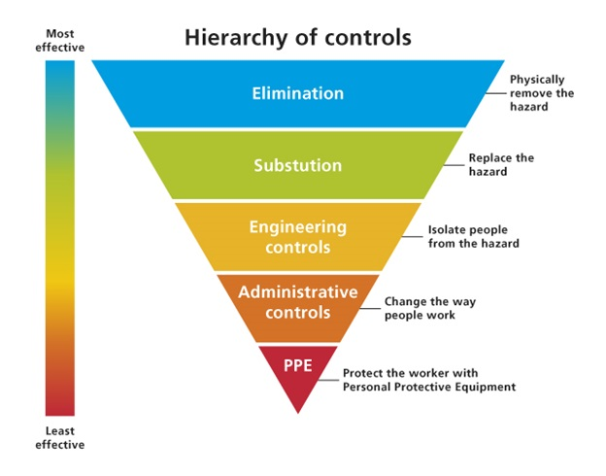
Notes:
The hierarchy of control provides a systematic approach to eliminating hazards and to reduce or control H2S risks.
The approaches at the top of graphic such as elimination and substitution are potentially more effective and protective ways than those techniques at the bottom.
Following this hierarchy normally leads to the implementation of inherently safer systems, where the risk of illness or injury has been substantially reduced.
Elimination and Substitution
Elimination and substitution, while most effective at reducing hazards, also tend to be the most difficult to implement in an existing processes. If the process is still at the design or development stage, elimination and substitution of hazards may be inexpensive and simple to implement. For an existing process, major changes in equipment and procedures may be required to eliminate or substitute for a hazard.
Engineering Controls
Engineering controls are favored over administrative and personal protective equipment (PPE) for controlling existing worker exposures in the workplace because they are designed to remove the hazard at the source, before it comes in contact with the worker. Well-designed engineering controls can be highly effective in protecting workers and will typically be independent of worker interactions to provide this high level of protection. The initial cost of engineering controls can be higher than the cost of administrative controls or PPE, but over the longer term, operating costs are frequently lower, and in some instances, can provide a cost savings in other areas of the process.
Administrative Controls and PPE
Administrative controls and PPE are frequently used with existing processes where hazards are not particularly well controlled. Administrative controls and PPE programs may be relatively inexpensive to establish but, over the long term, can be very costly to sustain. These methods for protecting workers have also proven to be less effective than other measures, requiring significant effort by the affected workers.

Slide 4
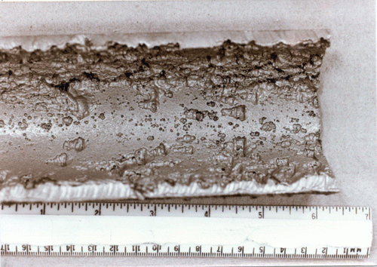
Potential Problem Areas
Corrosion
Fatigue
Leakage:
Age
Wear
Temperature changes
Pressure
Corrosion
Materials
Notes:
What are some potential problem areas?
We discussed earlier in this course the corrosive properties of H2S.
Recognize corrosion problems
Areas such as wastewater systems, gravity sewers with low velocities or long detention periods should be considered potential problem areas because of the potential for H2S to form. Pumping stations should be targeted for inspection because H2S is often produced in wet wells. Septic wastewater entering metering stations, junction chambers, drop manholes, and wet wells undergo sufficient turbulence to release H2S formed elsewhere. Piping is another area that should be considered. The corrosion rate of spun concrete pipe can be as little as one third of that found in cast concrete piping.
Performing a preliminary inspections of areas having the potential for corrosion problems can determine the presence of absence of corrosion, the extent of the problem, and the severity.

Slide 5
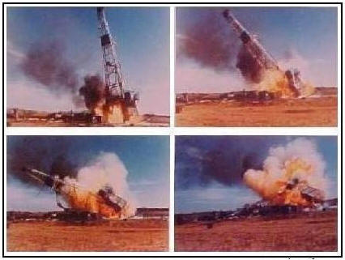
Well Control Procedures
Notes:
Well control procedures – is one of the most important aspects of oil and gas operations.
Improper handling of oil and gas equipment can result in blowouts with very grave consequences, including the loss of valuable resources. Although, the monetary loss is not as serious as other damages that may occur such as irreparable damage to the environment, ruined equipment, and most importantly, the safety and lives of personnel on location.

Slide 6
Common Types of Control
Hazard Elimination:
Avoiding risks; adapting work to workers
Substitution:
Replacement with less dangerous or safer material;
attacking risks at their source; integrating technical
progress
Engineering Controls:
Implement collective protective measures –
isolation, ventilation systems, mechanical handling,
specify appropriate construction materials

Slide 7
Common Types of Control cont’d
Administrative Controls:
Instructions to workers such as warning signs, lockout processes, safety equipment inspections, safety & health coordination with subcontractors, training, licensing, and worker rotation
Personal Protective Equipment (PPE):
Provide adequate PPE and instructions for its use and maintenance; safety shoes, safety glasses, self-contained and air supplied respirators
Administrative Controls:
Instructions to workers such as warning signs, lockout processes, safety equipment inspections, safety & health coordination with subcontractors, training, licensing, and worker rotation
Personal Protective Equipment (PPE):
Provide adequate PPE and instructions for its use and maintenance; safety shoes, safety glasses, self-contained and air supplied respirators

Slide 8
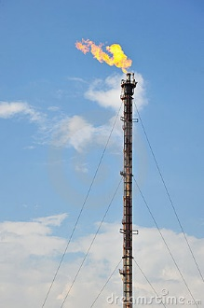
Industrial Operations
Controls:
Equipment Maintenance
Ventilation Systems
H₂S Detection Devices & Air Testing
Burning, Flaring, and Venting
Understand Processes
Work Procedures
Notes:
As we noted earlier in this course, H2S can form from a variety of sources and is involved in a number of industrial activities.
However, some basic protective measures can be followed:
Controls – use controls such as…
Equipment Maintenance – The main purpose of regular maintenance is to ensure that all equipment required for safe production is operating at 100% efficiency at all times. Failure to properly inspect and maintain equipment may lead to unintentional release of hazardous gases.
Ventilation systems. These need to be operating properly in areas where there may be concentrations of H2S such as storage areas and offloading terminals.
Ventilation - prevents the accumulation of hazardous levels of H2S. Common forms of ventilation are natural winds, powered air-blower systems and powered air-exhaust systems.
H2S Detection Devices. Use both fixed and portable devices. Personal detectors can be clipped to a shirt pocket of hard hat. Fixed systems provide alarm and notification. Air testing for the presence and concentration of H2S should be done by a qualified person. Testing should confirm if fire or explosion precautions may be necessary. Pre-entry and monitoring of Confined Spaces is also required as previously discussed.
Burning, Flaring, and Venting. These methods are used to safely gather and burn or otherwise eliminate H2S bearing gases. Flare systems should be equipped with a suitable and safe means of ignition. Where noncombustible gases are flared the system should be provided with supplemental fuel to maintain ignition.
Flaring – is an important safety measure during oil and gas operations. It disposes of gasses that might otherwise pose hazards to workers or nearby residents.
Understanding Processes. If you are involved in operating a process involving highly hazardous chemicals such as H2S, it is important to identify and understand the hazards involved in the process. This includes understanding the hazards of the chemicals use or produced. Some of the things you should know are…
Toxicity
PEL
Physcical data
Reactivity data
Corrosivity data
Thermal and chemical stability data
Hazardous effects of accidental mixing
Also understand the process itself and be familiar with information such as…
Process flow diagram
Process chemistry
Safe upper and lower limits of the process for things like temperature, pressure, composition, etc.
The consequences of deviations
Know about…
Construction materials
Piping and instrument diagrams
Electrical classification
Relief systems
Ventilation systems
Applicable design codes and standards
Safety systems

Slide 9
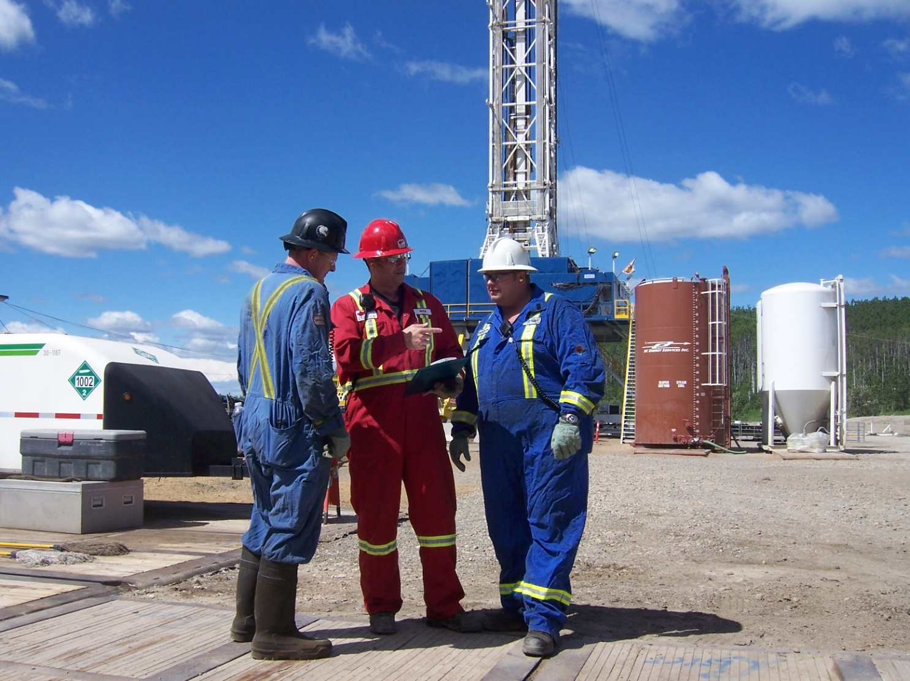
General Work Procedures
Site-specific safety meetings
Use of proper PPE
Inspections
Communication on work sites
Monitoring operations & conditions
Notes:
What are some examples of Work Procedures that can be used to reduce the risks?
Safe work procedures and practices should include but not be limited to:
conducting site-specific safety meetings
verifying that workers are properly trained
maintaining compliance with permit requirements
providing personnel qualified to perform rescue, first aid and CPR in a timely manner (if workers are exposed to IDLH environment, you shall provide standby rescue personnel and they shall be rigged and ready)
providing personnel with appropriate supplied air respirators when there is a potential for exposure above the IDLH
verifying that proper safety equipment is available, functioning properly, and is used
checking and remaining aware of wind conditions and direction (stand on the upwind side whenever possible when working on equipment)
performing a thorough check for personnel and ignition sources in the downwind area before starting any potentially hazardous work
notifying supervisory personnel, when necessary, before initiating operations that could involve the release of H2S
using the buddy system and never working alone in H2S areas above the IDLH concentration
monitoring conditions through implementation of an H2S detection and/or monitoring strategy
ventilating work areas, vents or purge lines on vessels before beginning work
keeping non-essential personnel away from work areas

Slide 10
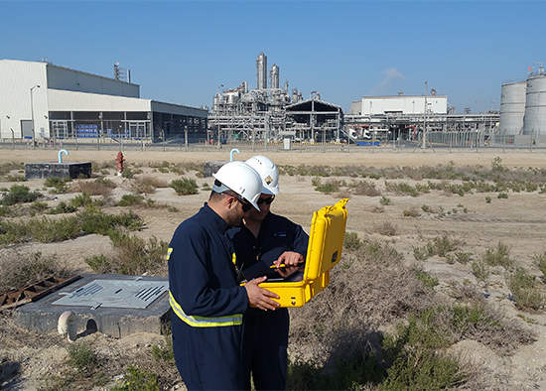
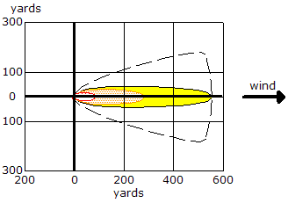
Working Upwind

Slide 11
Common Types of Controls
Operation | Controls
If H₂S can be released… | Then consider…
During refining of high-sulfur petroleum | Concentration and recovery of H₂SO₄
From accumulations of decaying organic matter in sewers and waste waters of tanneries, glue factories, fat-rendering plants, and fertilizer plants. | Provide continuous water discharge to sewer and cover and vent waste drains
As a by-product of dehairing and tanning processes | Provide separate sewage lines and cover and vent waste drains; add neutralizing agents (CaCl₂) as appropriate; local exhaust ventilation
During the manufacture of viscose rayon | Local exhaust ventilation
During production of sulfur dyes, carbon disulfide, sulfur, oleum, and thioprene | Local exhaust ventilation or process enclosure
Notes:
Here is a list of some common operations in various industries with H2S exposures and the controls that can be used to reduce the risk.

Slide 12
Common Types of Controls cont’d
Operation | Controls
If H₂S can be released… | Then consider…
During vulcanization of rubber; during manufacturing of coke or coal having high gypsum content | Local exhaust ventilation or process enclosure
During excavation | Respiratory protective equipment
In closed containers containing organic matter | Respiratory protective equipment; life support line
From pockets during underground mining operations near sulfide ores | Local exhaust ventilation; respiratory protective devices
Notes:
Here is a list of some common operations in various industries with H2S exposures and the controls that can be used to reduce the risk.

Slide 13
Hydrogen Sulfide (H₂S) Hierarchy of
Hazard Controls
H₂S
Notes:
We reviewed several operations and issues that should be considered for controls. It is usual to combine several steps to reduce the H₂S risks to a level that is as low as reasonably practicable.
Discussed the hierarchy of controls and provided an overview of a systematic approach to eliminating hazards, and reduction or control of the risks associated with H₂S.
Discussed workplace practices and relevant maintenance procedures to be established to protect personnel from the hazards of H₂S and SO₂.

