Slide 1
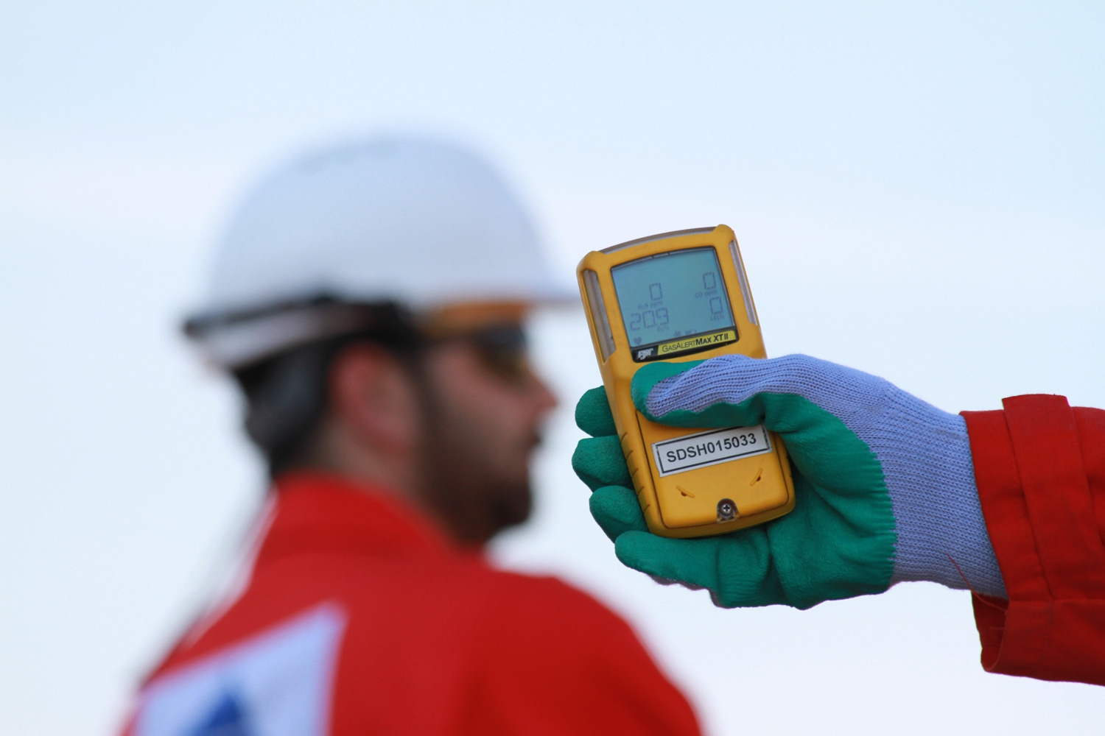
Hydrogen Sulfide (H₂S) Emergency Response
& Rescue
H₂S
Notes:
References:
ANSI Z390.1-2017
API 49 and 55
Texas Statewide Rule 36, Hydrogen Sulfide Safety
Instructor Manual:
This course is designed to meet the requirements of ANSI Z390.1, including:
Hazards
Protection
Requirements of the ANSI Standard.
What the Instructor should do:
Discuss Emergency Response and Rescue
What Participant/s should do: Actively participate in the learning, including exercises
Reference Material Used:
Class Props:

Slide 2
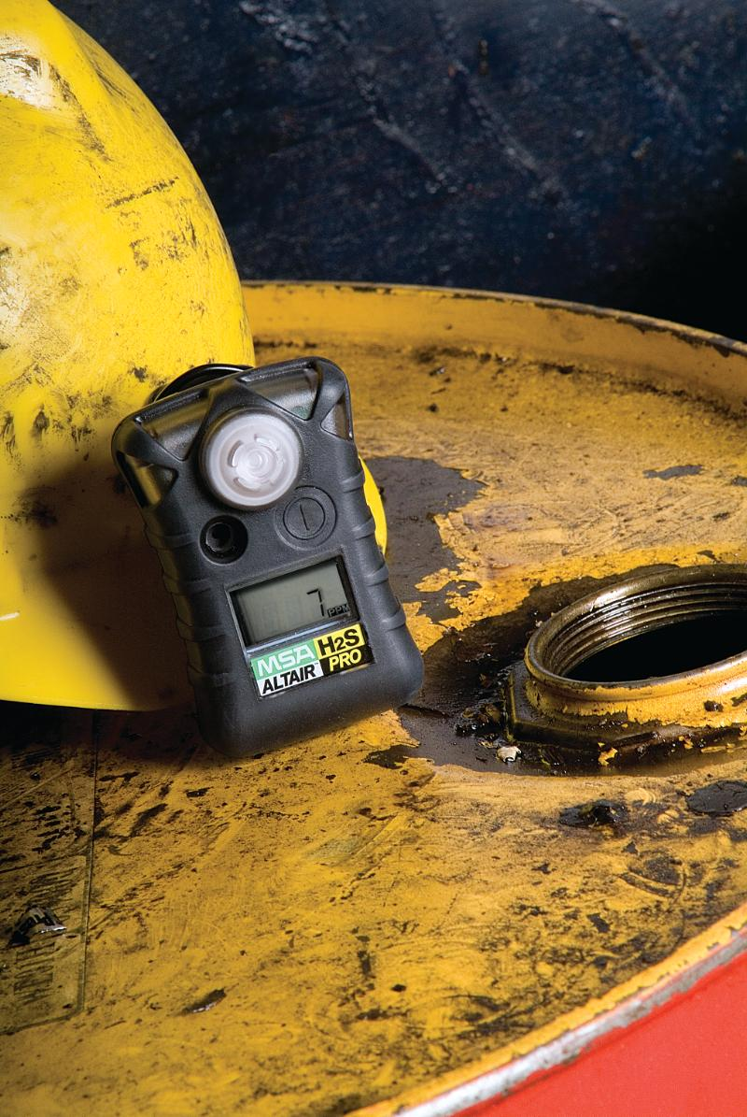
Objectives:
Purpose of Contingency Planning
Emergency Response Procedures

Slide 3
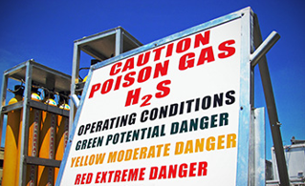
What is a Contingency Plan?
Notes:
What is a Contingency Plan?
As we have discussed in previous modules, H2S can pose a serious potential threat to workers. If there is a release that cannot be absorbed, neutralized, or controlled at the time of release you have a critical situation that must be handled quickly to protect workers. This means you need to have a plan already in place to deal with a serious or an emergency situation.
Emergency Response Plan
The site-specific emergency response or contingency plan should provide an organized immediate action plan for alerting and protecting employees and the public in the event of a major H2S release.

Slide 4
Contingency/Emergency Response Plan
Emergency Procedures:
Employee responsibilities
Immediate action plan
Notification information
Safety equipment and location of breathing air equipment
Location of first aid kits, litters, resuscitators, and spare oxygen bottles.
Notes:
Contingency/Emergency Response Plan
The contingency plan must contain information on the following subjects:
Emergency Procedures
• Responsibilities of employees
• Immediate Action Plan
• Telephone numbers and communication methods
Safety equipment and supplies available (e.g., number and location of breathing air equipment)
Location of first aid kits, litter or Stokes basket, resuscitators, and spare oxygen bottles.

Slide 5
Contingency/Emergency Response Plan
Characteristics of H₂S & SO₂
Facility Description
Training and Drills
Responsibilities/duties of essential personnel
Onsite or classroom drills
Training
Briefing of public officials
Notes:
Contingency/Emergency Response Plan
The contingency plan must contain information on, but not limited to, the following subjects:
Characteristics of Hydrogen Sulfide and Characteristics of Sulfur Dioxide (required if the facility is flaring or burning the H2S as a disposal method)
Facility Description, Maps and Drawings:
• Plants
• Tank Batteries, gas conditioning facilities, flow lines
• Compression facilities.
Training and Drills
• Responsibilities and duties of essential personnel
• Onsite or classroom drills
• Training and attendance documentation
• Briefing of public officials

Slide 6
Contingency & Emergency Response Plan
Is there the potential for H2S
Wear all required PPE
Continue H2S awareness according to your training
No
Yes
< 10ppm
CAUTION
Alert personnel –Monitor area
Investigate cause-Check equipment
What is concentration and source
Yes
> 10ppm
Evacuate crosswind and upwind from source
Return to work only after work area has been approved and cleared by qualified PIC
Yes
Notes:
Your Contingency Plan should be structured around your response to the levels of release. It should anticipate the appropriate response.
Always have a plan and know where to go. Know who to contact in case of an emergency. Everybody should know their duties and responsibilities.
Contingency plans and emergency response plans are site specific, but we can review some basics.
Understand How will you determine a situation exists?
What is the notification procedures?
What equipment is required to protect workers and respond to the situation?
What are your rescue and medical treatment plans?

Slide 7
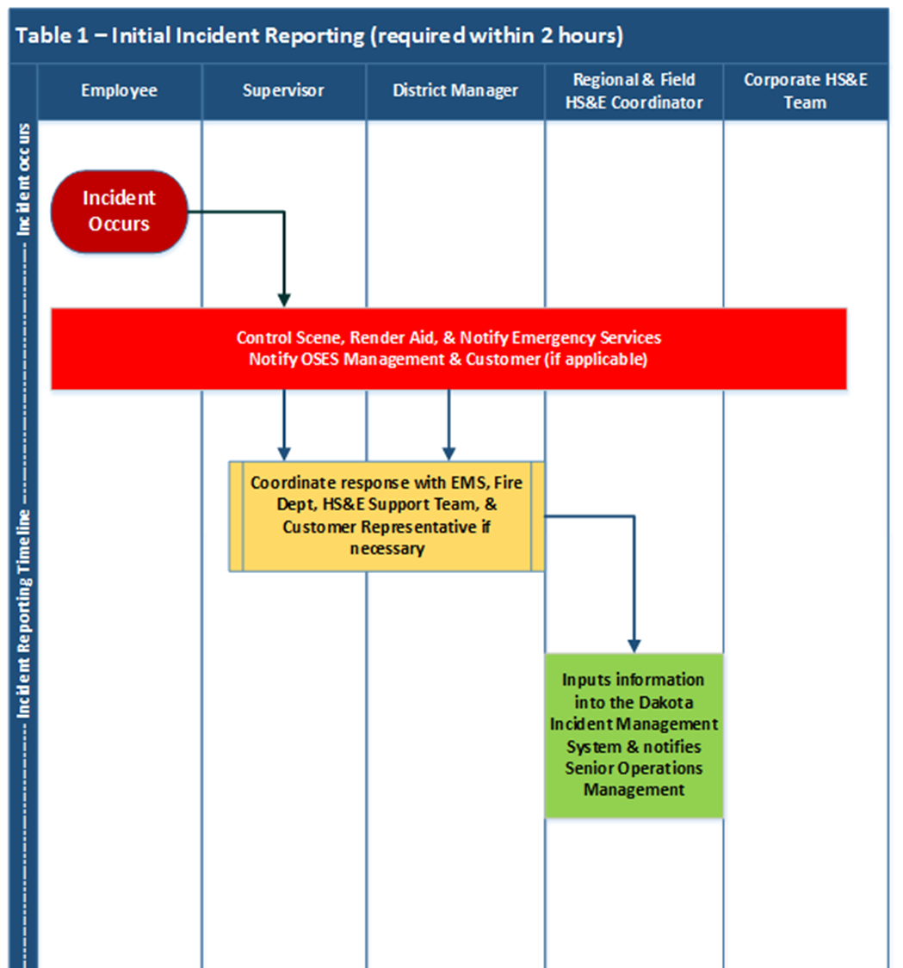
Contingency & Emergency
Response Plan
OSES H2S Program
Employee Responsibility
Supervisor/Management Responsibility
HSE Support Team Responsibility
Notes:
1. Instructor Notes
Discussion Points
Emergency policy will ensure that all potential sources of H2S where employees could possibly be exposed will be evaluated. This standard practice instruction is intended to address comprehensively the issues of; evaluating and identifying potential sources of H2S, evaluating the associated potential hazards, communicating information concerning these hazards, and establishing appropriate procedures and protective measures for employees.
The employee shall follow the H2S requirements for their work areas as explained by their team leader and described within this training. Report all incidents to their supervisor immediately. Complete and understand this training. Always use proper PPE. Maintain and/or replace PPE. In event of emergency, secure your own safety and do not attempt rescue. The best way to aid a downed co-worker is by securing your own safety first.
Management and supervisors shall ensure that all personnel are knowledgeable of the H2S requirements for the areas in which they work. Ensure all incidents are recorded in Dakota within two hours of the event. Inform all personnel of the locations where H2S may be expected. Ensure that all monitoring is completed. Ensure all warning systems are posted, mounted, or labeled, as appropriate. Provide visible leadership to ensure H2S policies and procedures are fully implemented.
HSE will provide training and technical resources and tools for H2S program application and monitor compliance through the audit and inspection process.
2. Student Notes
Takeaways
Employees need to familiarize themselves with the OSES H2S program and understand the responsibilities given to all levels of the operation.

Slide 8
Monitoring
Notes:
Fixed Monitors Areas where sources of H2S equal to or exceed 10 ppm and there is a potential for a sudden release of H2S should be evaluated for the installation of permanent fixed H2S monitoring systems.
Fixed monitor sensors should be placed in proximity to potential sources of an H2S release. Sensors should be situated in a manner that ensures adequate coverage under any wind direction situation. The monitor’s warning device, audible and visual, shall be located so that the alarm can be easily recognized throughout the facility.
Additionally, the following apply to fixed monitors:
• Continuous reading fixed area monitors shall be inspected and calibrated on a monthly basis and/or as recommended by the manufacturer, if more stringent.
• When an alarm sounds (personal, portable, or fixed), the employee(s) shall leave the area and shall not re-enter until the airborne concentration of H2S is below 10 ppm.
• If it is necessary to enter a work environment where concentrations are above 10 ppm, a full-facepiece supplied-air respirator operated in the positive pressure mode shall be used.
• All low level alarms shall be set at a maximum of 10 ppm or less H2S concentration. Warning

Slide 9
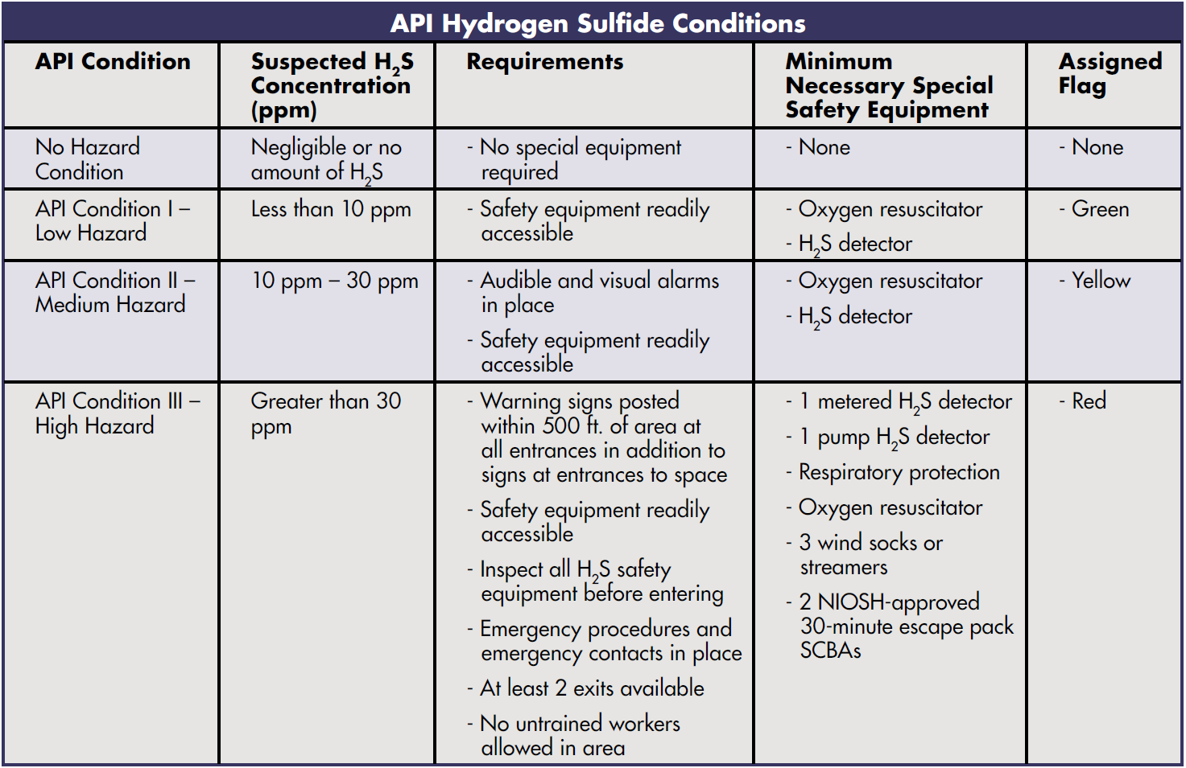
Notes:
API H2S well drilling sites classify hazards with posted signs.
The H2S concentration correspond to the condition hazard. The H2S concentration determines the hazard. The hazard condition also determines the appropriate requirements to take, special safety equipment and the color of flag to use.
What does the flag color indicate?

Slide 10
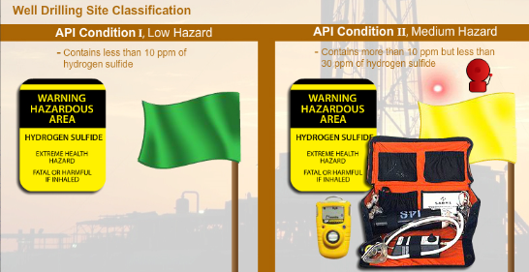
Warning Signs
Notes:
Warning Signs
Warning signs shall be posted to remind employees of potential hazards at all H2S facilities. In some cases, a facility may be designated as an H2S facility based upon a single source above a specified level say 20 ppm.
If a facility is classified based on one source (e.g., an amine unit above 10 ppm with all other sources less than 10 ppm), signs may be posted only in that area of the facility.
The following are additional warning sign requirements:
• For offshore operations, signs are to be located on the outboard sides of the production platform to inform boaters of a potential H2S danger.
• The sign shall be legible and large enough to be read by all persons approaching the facility.
• All signs, and when appropriate, flags, shall be visible to all personnel when approaching the facility under normal lighting and weather conditions.

Slide 11
Warning Signs

Slide 12
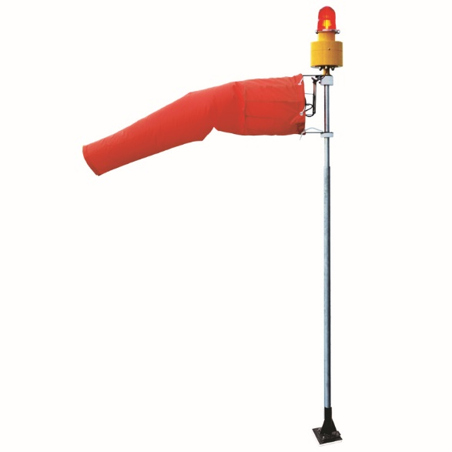
Wind Indicators
Wind indicators placed at locations and heights which enable free movement and accurately indicate wind direction.
Indicators visible from normal entrances to the facility.
Work tasks should be performed upwind from source to reduce potential exposure.
Personnel should develop wind direction consciousness.
Notes:
Wind Indicator
Wind indicators such as wind socks, streamers or vanes, are required in facilities where there are sources of H2S.
Wind indicators shall be placed at locations and heights which enable free movement and accurately indicate the wind direction. The indicators shall be visible from normal entrances to the facility.
Wind direction shall be determined prior to performing outdoor tasks where H2S may be encountered.
If possible, work tasks should be performed upwind from an H2S source to reduce the potential for exposure.
All personnel should develop wind direction consciousness.

Slide 13
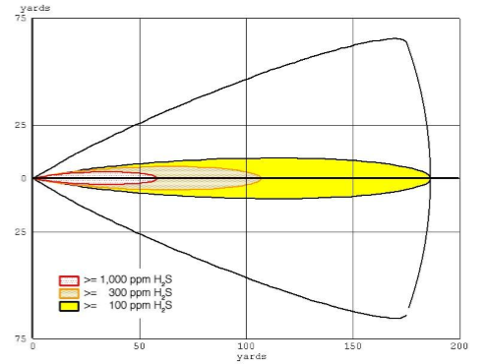
H₂S Release Dispersion Models
Notes:
Atmospheric dispersion modeling is the mathematical simulation of how an accidental release might disperse in the ambient atmosphere. It is performed with computer programs that solve the mathematical equations and algorithms which simulate the pollutant H2S gas dispersion.
They can also be used to predict future concentrations under specific scenarios.
The models serve to assist in the design of effective control strategies to reduce the effects of harmful releases.
The results of dispersion modeling, using worst case accidental release source terms and meteorological conditions, can provide an estimate of areas impacted, ambient concentrations, and be used to determine protective actions appropriate in the event a release occurs. Appropriate protective actions may include evacuation or shelter in place for persons in the downwind direction.
2. Student Notes
Takeaways
Remember to have the emergency contact information list available in your JSA. Use the buddy system when working in an H2S environment.

Slide 14
Flares
Notes:
Flares
A flare system, when appropriate, shall be designed and installed to safely gather and burn H2S bearing gas.
The flare system shall be equipped with a suitable and safe means of ignition.
Where noncombustible gas is to be flared, the system shall be provided supplemental fuel to maintain ignition.

Slide 15
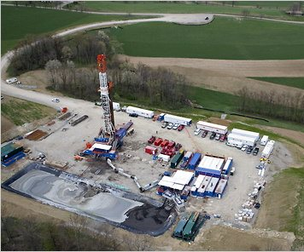
Contingency & Emergency Response Plans
Sign in/out Sheet
Muster Areas
Wind Direction
Low Lying Areas
Location of Emergency Equipment
Notes:
1. Instructor Notes
Discussion Points
Locate the sign in/out sheet usually located at the entrance location or the company’s representative’s office/trailer. Sign in sheets are used to conduct roll calls at the muster points whenever there is an emergency.
A muster point is the location where all personnel in the area gathers in the event of an emergency. Once all personnel are assembled at the muster point, a person in charge will conduct a roll call to ensure that all personnel have safely evacuated the area. In the event that there is a missing person, the person in charge will notify the emergency response team of the person/s missing. There should be a minimum of two muster areas on location and at our facilities.
Always be aware of the wind direction since H2S is easily dispersed by wind. It is also critical to know the wind direction when reacting to an H2S emergency.
H2S is heavier than air and will accumulate in low lying areas. Make sure you identify these areas so you don’t end up in one when reacting to an H2S emergency.
Familiarize yourself with the location of the emergency equipment such as visible/audible alarms and escape packs.
2. Student Notes
Takeaways
Employee should understand and familiarize themselves with the basic layout of the job location they will be working on. Having this knowledge will ensure that he/she properly respond to an H2S emergency and are able to secure their safety and of their co-workers.

Slide 16
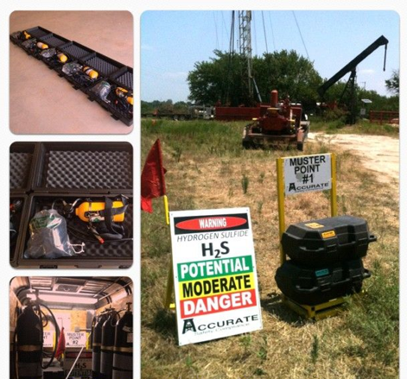
Emergency Response
Recognize Problem
Emergency Equipment
Take Control
Call for Help
Notes:
1. Instructor Notes
Discussion Points
Recognize the problem by listening for sirens or alarms from nearby work stations. Strong initial smell of rotten eggs or by spotting a worker down in the field.
Know the location of the emergency equipment such as: escape packs, SCBAs, monitors, control panels and alarms.
Take control of the situation by shutting off any machinery being operated (if possible). Alert others by sounding the horn, whistling, or shouting. Indicate that it is an H2S emergency and evacuate the area immediately. Also, when evacuating remember to hold your breath but do not inhale. Move quickly cross wind/up wind and/or up hill. Do not wait for anything or anyone.
Call out for help by contacting the company representative on site or by immediately contacting your supervisor/manager.
2. Student Notes
Takeaways
Employees must be able to understand the procedure for responding to an H2S emergency.

Slide 17
Emergency Contacts
Location Directions
Notes:
Make sure to have a good emergency contact number for your immediate supervisor and the company representative. You must also know who to call in case your primary contact is not able to answer your call.
Make sure you can give clear and easy to follow directions to and out of the job location. You might need to guide an EMS team to location.
2. Student Notes
Takeaways
Employees must always have good contact number for their supervisors and must be able to coordinate/guide EMS teams if needed.

Slide 18
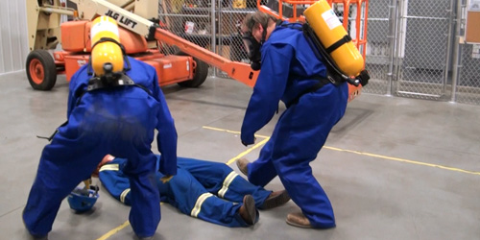
Rescue Procedures
When there is potential for presence of H₂S, there is potential for someone to be overcome.
Rescue has to be done safely

Slide 19
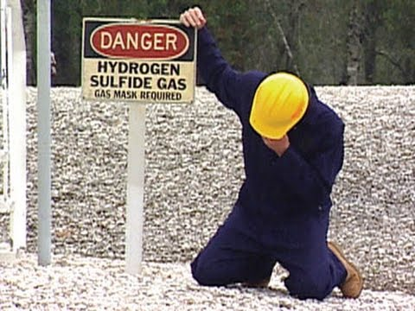
Rescue Procedures
Cardinal Rule of H₂S rescue:
Rescue must not be attempted unless the rescuer is adequately protected!
Notes:
Cardinal rule!

Slide 20
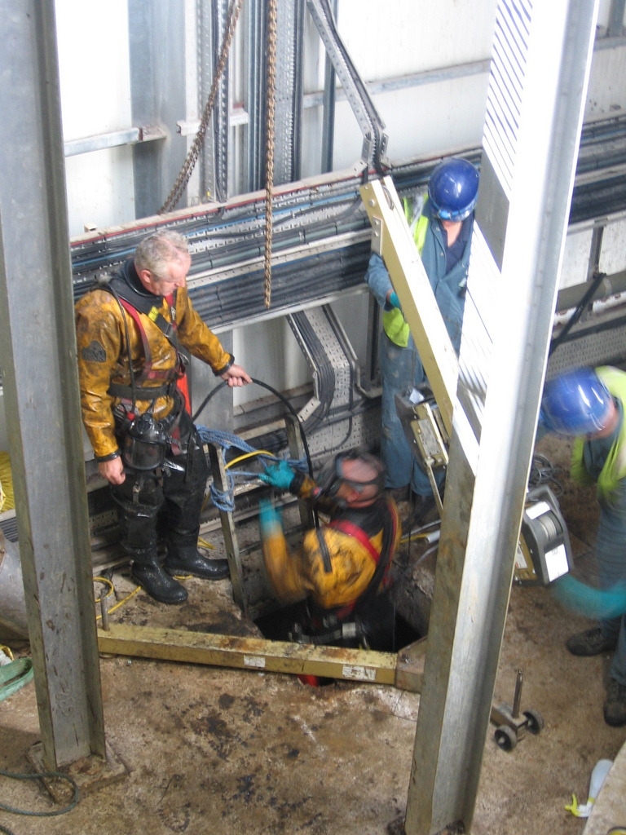
Rescue Procedures
Protect yourself first!
You can’t help someone else if you go down!
Chances are, if the air was bad for them, it’s bad for you too!

Slide 21
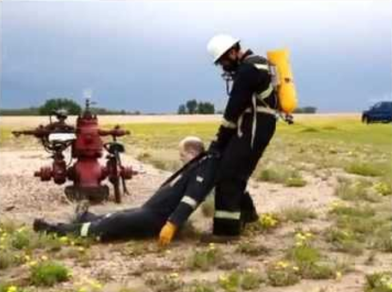
Rescue Procedures
If possible, remove victim without entering H₂S area
Use lifelines or safety harnesses
If entry into H₂S area is required, first don SCBA

Slide 22
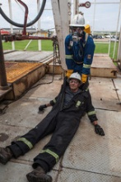
Rescue Procedures
Victim needs to be moved to safe area
If more than one victim, move victim with longest exposure first
Once victim(s) are removed from H₂S area, determine if they are breathing

Slide 23
Rescue Procedures
If not breathing…
Call 911 or other emergency #’s
Include physical address
Check for pulse
Begin rescue breaths or CPR as needed
Notes:
This is not a First Aid/CPR class, however it is best to discuss how to check for breathing and pulse, safety devices that can be used for rescue breaths, and CPR.
The American Heart Association recommends 100 compressions per minute for CPR. They are also advocating “Hands Only” where you press “Hard and Fast”.

Slide 24
Follow-up Procedures
Anyone who has been overcome by H₂S should seek medical attention
Should have medical clearance prior to returning to work
H₂S does not cumulate in body, however, there may be lingering effects:
Pulmonary edema
Dizziness
Photophobia
Nausea

Slide 25
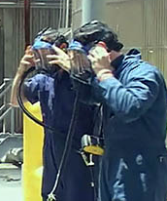
Requirements for Site-Specific Orientation
Route(s) of egress
Use and location of wind indicators
Emergency assembly area(s)
Applicable warning signals
Response in event of emergency
Use and location of personal protective equipment (PPE)
Hands-on training with H2S detectors used on site
Notes:
In addition to the annual H2S certification training, a site-specific orientation is required for individuals who have the potential to be exposed to H2S in concentrations greater than the occupational exposure limit. At a minimum, personnel shall be briefed on:
route(s) of egress
use and location of wind indicators
emergency assembly area(s)
applicable warning signals
how to respond in the event of an emergency
use and location of personal protective equipment
hands-on training with the specific H2S detector to be used in the field is required prior to use

Slide 26
Respiratory Protection
Describe appropriate respiratory protection.
Describe areas where H₂S may accumulate.
Notes:
Personnel who have received H2S certification and are subject to working under respiratory protection, shall also have successfully completed a respiratory protection training program, to include medical evaluation and fit-testing if they are to wear tight-fitting air supplied respirators in these hazardous atmospheres according to ANSI Z88 and/or OSHA 29 CFR 1910.134 or applicable local regulatory requirements.

Slide 27
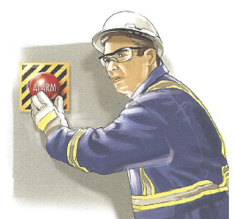
H2S Staying Alive
Contingency & Emergency Response Plans
Recognize the Problem
Emergency Equipment
Take Control
Call for Help
Notes:
1. Instructor Notes
Discussion Points
Recognize the problem by listening for sirens or alarms from nearby work stations. Strong initial smell of rotten eggs or by spotting a worker down in the field.
Know the location of the emergency equipment such as: escape packs, SCBAs, monitors, control panels and alarms.
Take control of the situation by shutting off any machinery being operated (if possible). Alert others by sounding the horn, whistling, or shouting. Indicate that it is an H2S emergency and evacuate the area immediately. Also, when evacuating remember to hold your breath but do not inhale. Move quickly cross wind/up wind and/or up hill. Do not wait for anything or anyone.
Call out for help by contacting the company representative on site or by immediately contacting your supervisor/manager.
2. Student Notes
Takeaways
Employees must be able to understand the procedure for responding to an H2S emergency.

Slide 28
Hydrogen Sulfide (H₂S) Emergency Response
& Rescue
H₂S
Notes:
We discussed Emergency Response and Rescue

