Slide 1
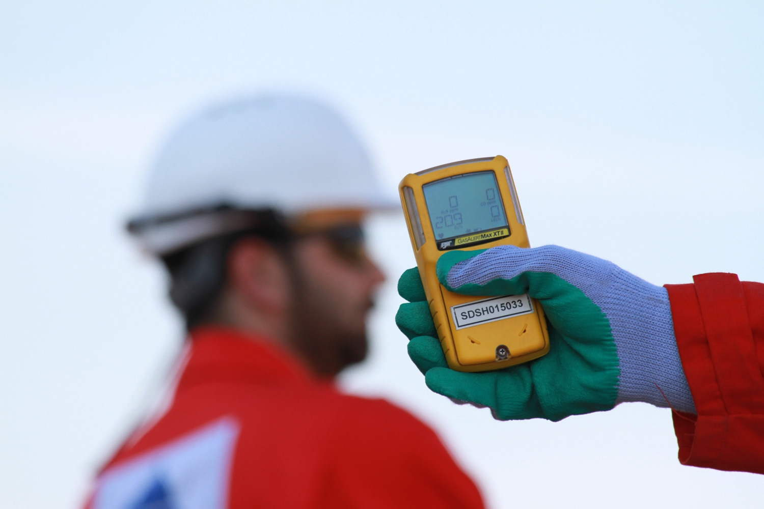
Chemical Properties, Physiological Effects and Chemical Reactions of H₂S
H₂S
Notes:
Appendix C of ANSI/ASSE Z390.1 requires you to cover the hazards, characteristics and properties, and safe exposure limits
Hydrogen Sulfide. Hydrogen sulfide is a heavier-than-air, colorless gas with a sweetish taste and characteristic odor of rotten eggs (HSDB 2013). The odor threshold for hydrogen sulfide is variable and various ranges have been reported. Ruth (1986) reviewed odor thresholds of several hundred chemicals (including hydrogen sulfide) from the industrial hygiene literature and other compilations of odor threshold data; an odor threshold range of 0.0005–0.010 ppm was reported. Guidotti (1994) reported an odor threshold range of 0.01–0.3 ppm. Since high concentrations of hydrogen sulfide (150–200 ppm) can paralyze the olfactory nerve, odor may not be a reliable indicator of the presence of this gas (Beauchamp et al. 1984).
Chemical Family: inorganic sulfide
Chemical Formula: H2S
Normal Physical State: highly toxic, colorless gas, slightly heavier than air.
Vapor density = 1.19 (air = 1.00). H2S may collect in low-lying areas or confined spaces.
Auto-Ignition Temperature: 500 degrees F (260ºC)
Flash Point: -76.4 degrees F (-60.2ºC)
Melting Point: -117.2 degrees F (-82.9ºC)
Flammable Limits: 4.3% 46% vapor by volume in air
Solubility: soluble in water and oil; solubility decreases as the temperature of the liquid increases
Combustibility: burns to produce SO2, a very irritating gas with a burnt match odor.
SO2 is a colorless gas appreciably heavier than air.
Vapor density = 2.26 (air = 1.00)
Odor and Warning Properties: H2S has an unpleasant odor, characteristic of rotten eggs, and may be easily detected at low concentrations. Due to the rapid onset of olfactory fatigue and paralysis (loss of the sense of smell), your sense of smell is not a reliable indicator for the presence of H2S.

Slide 2
Objectives:
Discuss chemical properties of H₂S
Discuss physiological effects of H₂S
Cover chemical reactions of H₂S
Notes:
Appendix C of ANSI/ASSE Z390.1 requires you to cover the hazards, characteristics and properties, and safe exposure limits

Slide 3
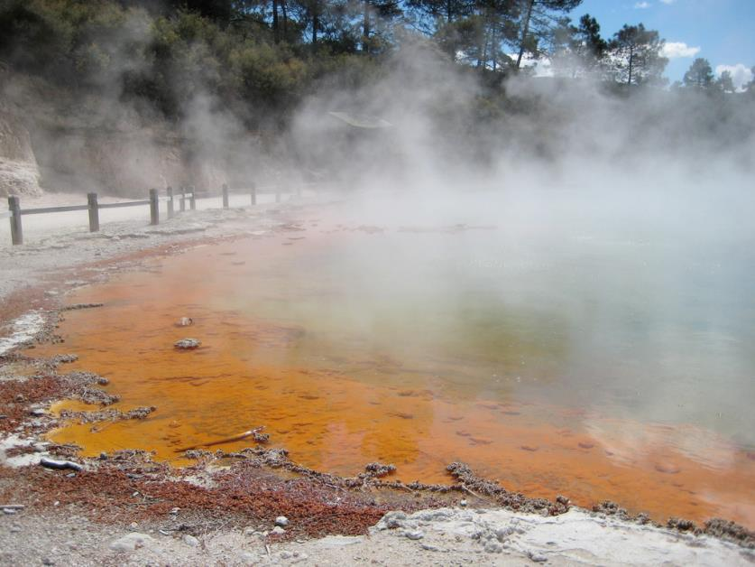
Natural Sources of H₂S
Crude Petroleum
Natural Gas
Volcanic Gasses
Undersea Vents
Swamps
Stagnant Water
Low oxygen environments (bogs)
Sewage Systems
Refuse Systems
Mines
Decomposition of Organic Material
Liquid Manure
Sulfur Deposits
Sulfur Springs
Notes:
It naturally occurs in the gases from volcanoes, sulfur springs, undersea vents, swamps and stagnant bodies of water and in crude petroleum and natural gas.
Additionally, bacteria, fungi, and actinomycetes release hydrogen sulfide during the decomposition of sulfur-containing proteins and by the direct reduction of sulfate (SO42-).

Slide 4
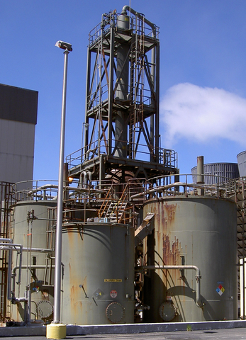
Industrial Sources of H₂S
H₂S is a, product, by-product, or waste material of many industrial processes:
petroleum refining,
tanning,
mining,
Woodpulp processing,
rayon manufacturing,
sugar-beet processing,
and hot-asphalt paving.
As a by-product it is often recovered and converted to elemental sulfur or sulfuric acid
Notes:
It naturally occurs in the gases from volcanoes, sulfur springs, undersea vents, swamps and stagnant bodies of water and in crude petroleum and natural gas. Additionally, bacteria, fungi, and actinomycetes release hydrogen sulfide during the decomposition of sulfur-containing proteins and by the direct reduction of sulfate (SO42-).

Slide 5
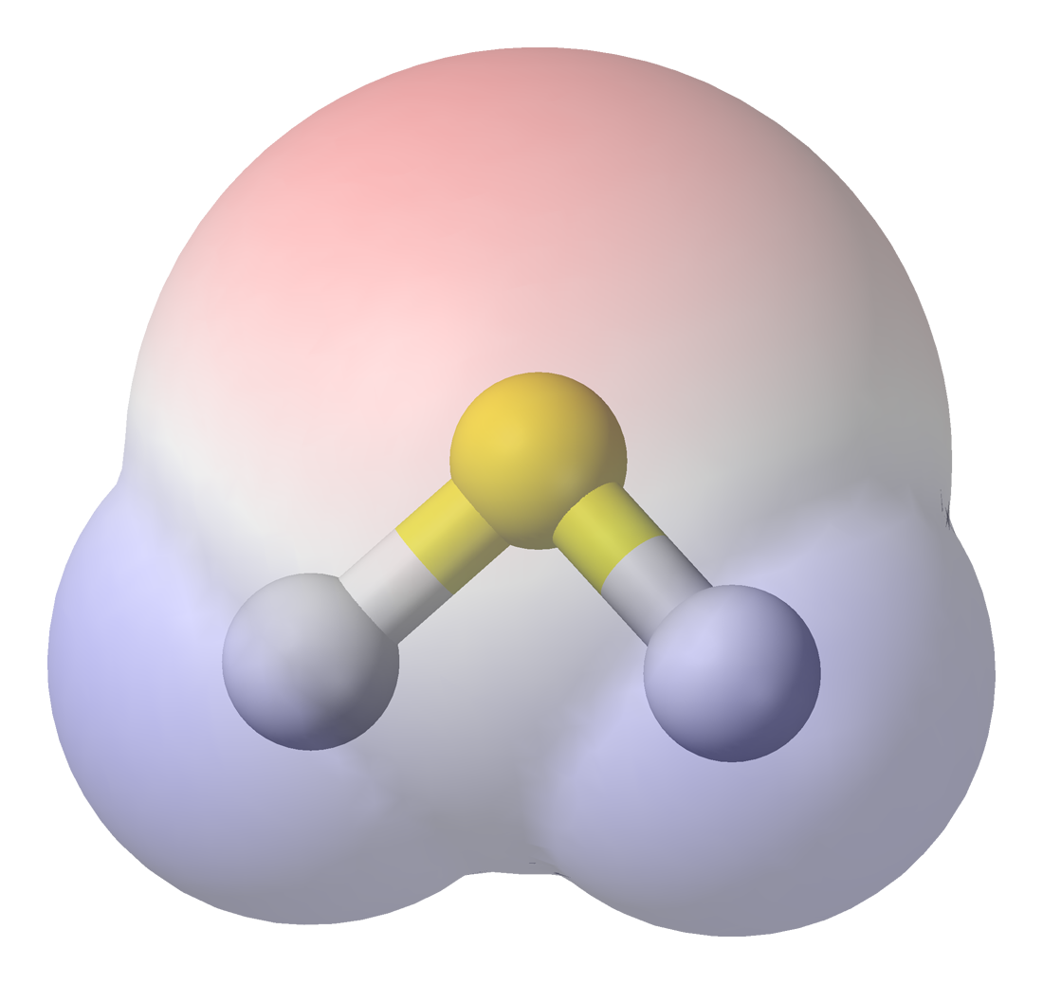
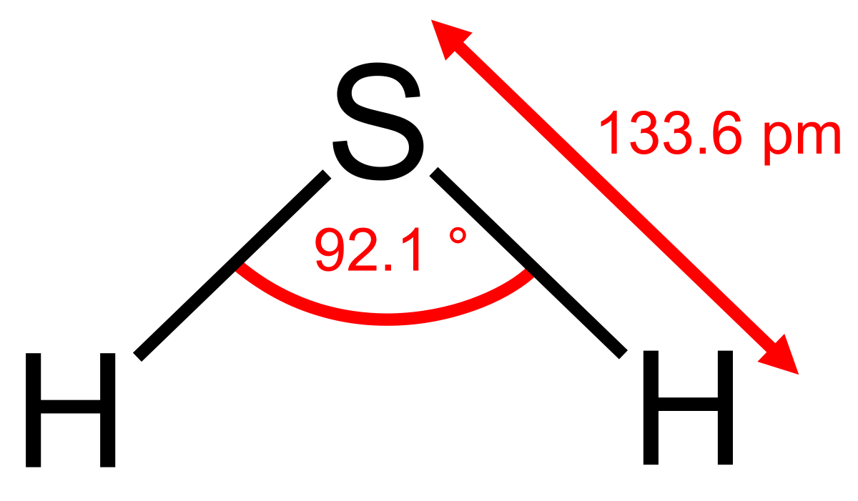
Synonyms for H₂S
Sulfuretted Hydrogen
Dihydrogen sulfide
Sulfur hydride
Hydrosulfuric acid
Sewer gas
Rotten egg gas
Notes:
Physical and Chemical Properties of H2S
The physical and chemical properties of H2S, including but not limited to the following, shall be
discussed as part of H2S training:
Synonyms: sulfuretted hydrogen, sulfurated hydrogen, hydrosulfuric acid, H2S, disulfur
hydride, sour gas, rotten egg gas, sulfane, sewer gas, swamp gas, sulfur ode hidrogeno,
gas venenoso and others

Slide 6
Synonyms for H₂S
Swamp gas
Hepatic acid
Sour gas
Stink damp
Devil’s Breath
Meadow gas
Notes:
Physical and Chemical Properties of H2S
The physical and chemical properties of H2S, including but not limited to the following, shall be
discussed as part of H2S training:
Synonyms: sulfuretted hydrogen, sulfurated hydrogen, hydrosulfuric acid, H2S, disulfur
hydride, sour gas, rotten egg gas, sulfane, sewer gas, swamp gas, sulfur ode hidrogeno,
gas venenoso and others

Slide 7
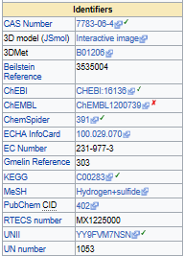
H₂S Identifiers

Slide 8
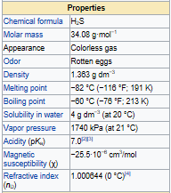
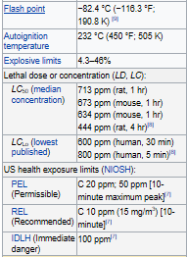
Physical & Chemical Properties of H₂S
Notes:
Refer to SDS provided.
Physical and Chemical Properties of H2S
The physical and chemical properties of H2S, including but not limited to the following, shall be
discussed as part of H2S training:
Chemical Family: inorganic sulfide
Chemical Formula: H2S
Normal Physical State: highly toxic, colorless gas, slightly heavier than air.
Vapor density = 1.19 (air = 1.00). H2S may collect in low-lying areas or confined spaces.
Auto-Ignition Temperature: 500 degrees F (260ºC)
Flash Point: -76.4 degrees F (-60.2ºC)
Melting Point: -117.2 degrees F (-82.9ºC)
Flammable Limits: 4.3% 46% vapor by volume in air
Solubility: soluble in water and oil; solubility decreases as the temperature of the liquid
increases
Combustibility: burns to produce SO2, a very irritating gas with a burnt match odor. SO2 is
a colorless gas appreciably heavier than air.
Vapor density = 2.26 (air = 1.00)
Odor and Warning Properties: H2S has an unpleasant odor, characteristic of rotten eggs,
and may be easily detected at low concentrations. Due to the rapid onset of olfactory fatigue
and paralysis (loss of the sense of smell), your sense of smell is not a reliable indicator for
the presence of H2S.

Slide 9
Physical & Chemical Properties of H₂S
Notes:
Since the vapor density is greater than 1, it is heavier than air and tends to accumulate in low areas such as pits, ditches, etc.
Normal Physical State: highly toxic, colorless gas, slightly heavier than air.
Vapor density = 1.19 (air = 1.00). H2S may collect in low-lying areas or confined spaces.

Slide 10
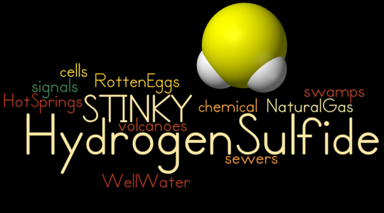
Physical & Chemical Properties of H₂S
Notes:
Odor and Warning Properties: H2S has an unpleasant odor, characteristic of rotten eggs,
and may be easily detected at low concentrations. Due to the rapid onset of olfactory fatigue
and paralysis (loss of the sense of smell), your sense of smell is not a reliable indicator for
the presence of H2S.

Slide 11
Physical Properties of H₂S
Odor: Rotten Eggs
Odor Threshold 0.13 ppm
Olfactory Fatigue
100 ppm -Rapidly lose sense of small
200 ppm -Deadens the sense of smell almost immediately
Odor cannot be used as the only warning for presence of H₂S
Notes:
Olfactory fatigue or adaptation is the temporary, normal inability to distinguish a particular odor after a prolonged exposure to that airborne compound. Olfactory fatigue is an example of neural adaptation or sensory adaptation. Our bodies become desensitized to stimuli in order to prevent the overloading of our nervous system, thus allowing it to respond to new stimuli that are ‘out of the ordinary’.
This is also a good place to reiterate the fact that 1% is equal to 10,000 ppm. So 0.13 ppm is equal to 0.000013%

Slide 12
Chemical Reactions
H₂S reacts with:
Oxygen forming Sulfur Dioxide
Iron forming Ferrous Sulfide (Iron Sulfide or Iron Sponge) which is pyrophoric
Water forming hydrosulfurous acid
Other metals to form metal sulfides
Notes:
Pyrophoric means it is able to ignite spontaneously on contact with air

Slide 13
Chemical Reactions
Chemical reaction of O₂ and H2S produces: sulfur dioxide and water
2H₂S + 3O₂ = 2SO₂ + 2H₂O
Chemical reaction of Fe2O3 and H2S produces: FeS, sulfur and water
Fe2O3 + H2S = 2 FeS + S + 3 H₂O
Chemical reaction of Fe2O3 and H2S produces: hydrosulfurous acid
H₂S + H₂O = H₃O + HS

Slide 14
Reactivity
H₂S reacts violently with:
Oxidizers
Acids
Notes:
H2S is a highly flammable gas. It becomes unstable at elevated temperatures.
When it burns it produces toxic vapors and gases such as sulfur dioxide.
Precautions must be taken when opening vessels or containers that previously contained concentrated H2S. The vapors can spontaneously ignite when opened to air.
Reaction with iron sulfide in air to form iron oxide produces enough heat to ignite flammable vapors.
H2S must be kept away from strong oxidizers and oxidizing materilas to minimize the risk of fire or explosion. H2S is incompatible with strong oxidizers, strong nitric acid and metals.

Slide 15
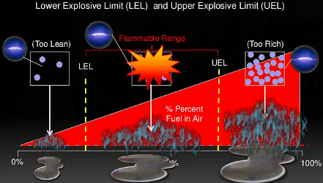
4%
45%
Notes:
Concentrations between 4% and 45% can result in fires and/or explosions.
H2S can react with iron oxide to form an iron sulfide that is pyrophoric when dry. Pyrophoric iron sulfide has caused fires in coke piles , rubbish bins and in operating equipment including strainer filters, demister pads, piping, exchanger tubes, compressors, spent catalyst, tanks, and enclosed sulfur pits.

Slide 16
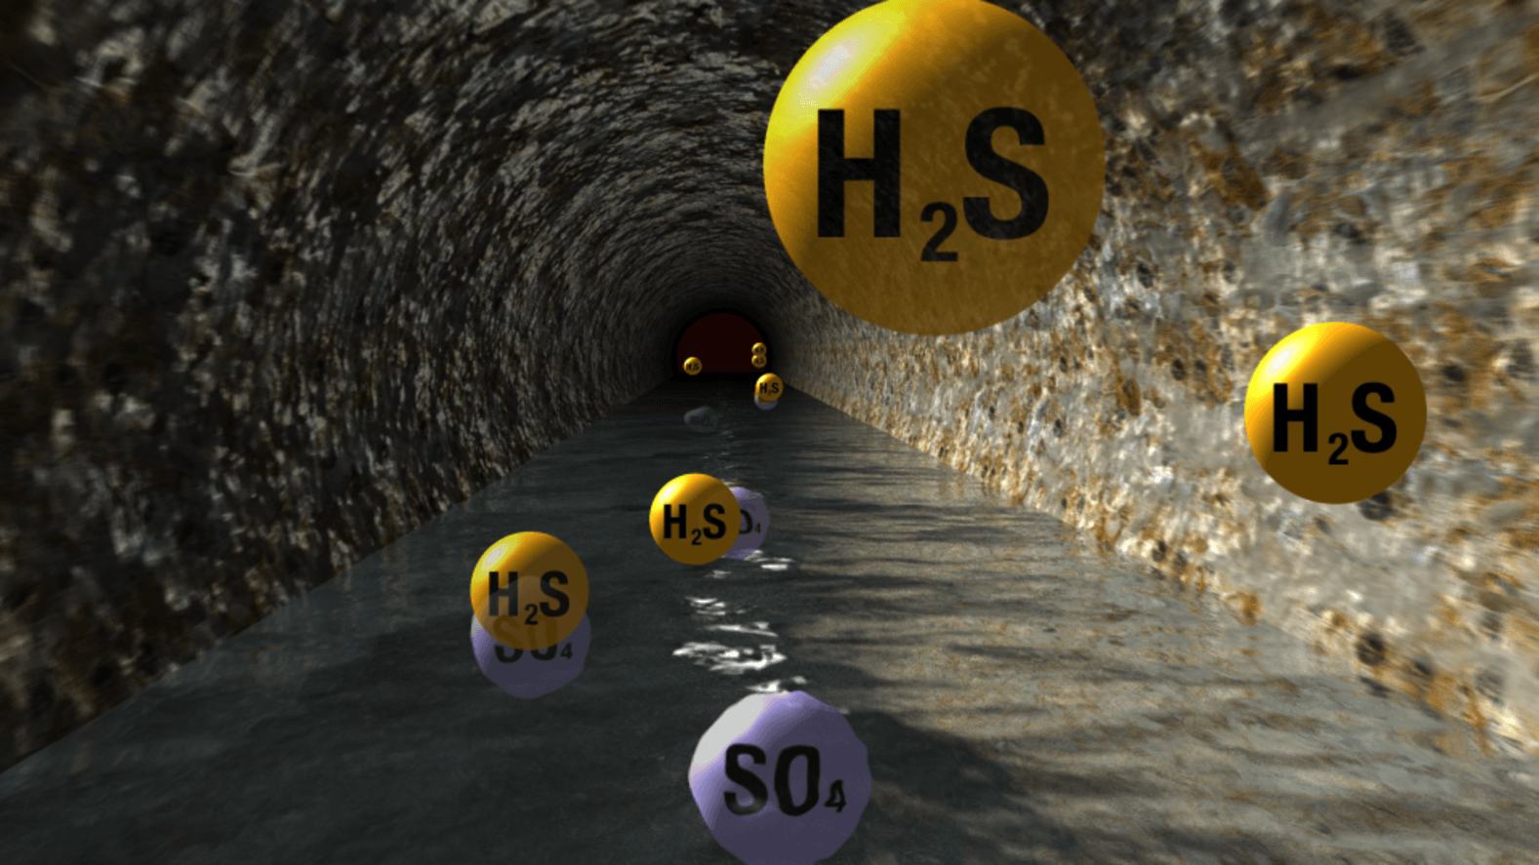
Notes:
H2S in the presence of water is highly corrosive to metals including high-tensile steel which it can make brittle.
This can lead to loss of containment and accidental releases. Hydrogen sulfide gas is biologically converted to sulfuric acid in the presence of moisture.
Sulfuric acid attacks exposed concrete and unprotected surfaces such as iron, steel, and copper which results in corrosion and deterioration of exposed materials.
Electrical and instrumentation are particularly vulnerable. This makes equipment failure and reliability of control systems possible.

Slide 17
Notes:
H2S in the presence of water is highly corrosive to metals including high-tensile steel which it can make brittle.
This can lead to loss of containment and accidental releases. Hydrogen sulfide gas is biologically converted to sulfuric acid in the presence of moisture.
Sulfuric acid attacks exposed concrete and unprotected surfaces such as iron, steel, and copper which results in corrosion and deterioration of exposed materials.
Electrical and instrumentation are particularly vulnerable. This makes equipment failure and reliability of control systems possible.

Slide 18
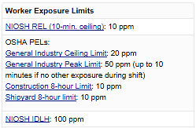
Occupational Exposure Levels
Notes:
Remember 1% equals 10,000 ppm!
OSHA PEL
20 ppm Acceptable Ceiling
50 ppm Maximum Peak for 10 min with no other measurable exposure
NIOSH REL
– 10 Ceiling
ACGIH TLV
– 1 ppm TWA as of 2009
(Previously 10 ppm)

Slide 19
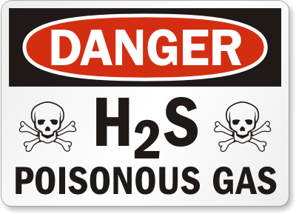
H₂S is DEADLY
Notes:
Hydrogen Sulfide is deadly!
Slightly less lethal than HCN
More lethal than CO

Slide 20
Toxicity of Various Gases
Common Name | Chemical Formula | Specific Gravity | TLV (ppm) | PEL (ppm) | IDLH (ppm)
Hydrogen Cyanide | HCN | 0.94 | 4.7 (STEL) | 10 TWA | 50
Hydrogen Sulfide | H₂S | 1.18 | 1 TWA | 20 (C) 50 (MP) | 100
Sulfur Dioxide | SO₂ | 2.21 | 0.25 STEL | 5 TWA | 100
Chlorine | Cl | 2.45 | 0.5 TWA, 1 (C) | 1 (C) | 10
Carbon Monoxide | CO | 0.97 | 25 TWA | 50 TWA | 1,200
Carbon Dioxide | CO₂ | 1.52 | 5,000 TWA | 5,000 TWA | 40,000
Notes:
This table is taken from the PETEX Hydrogen Sulfide in Production Operations manual, it shows the ACGIH TLVs.
An Additional column was added to show the OSHA PELs.
Hydrogen Sulfide is deadly!
Slightly less lethal than HCN
More lethal than CO

Slide 21
Routes of Exposure
Inhalation is primary route
Skin/Eye Contact
Absorption through intact skin is minimal
Eye Irritation
Liquid H₂S can cause frostbite
Ingestion is unlikely to occur

Slide 22
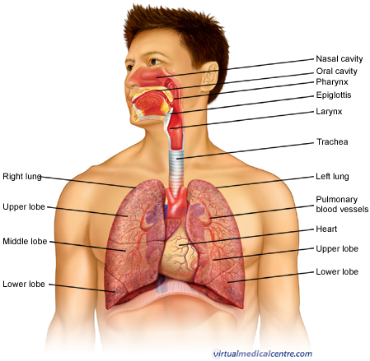
Human Physiology – Respiratory System
Notes:
The respiratory system consists of all the organs involved in breathing. These include the nose, pharynx, larynx, trachea, bronchi and lungs. The respiratory system does two very important things: it brings oxygen into our bodies, which we need for our cells to live and function properly; and it helps us get rid of carbon dioxide, which is a waste product of cellular function. The nose, pharynx, larynx, trachea and bronchi all work like a system of pipes through which the air is funnelled down into our lungs. There, in very small air sacs called alveoli, oxygen is brought into the bloodstream and carbon dioxide is pushed from the blood out into the air. When something goes wrong with part of the respiratory system, such as an infection like pneumonia, it makes it harder for us to get the oxygen we need and to get rid of the waste product carbon dioxide. Common respiratory symptoms include breathlessness, cough, and chest pain.

Slide 23
Human Physiology – Respiratory System
Notes:
Rrespiratory Center - the center in the medulla oblongata and pons that integrates sensory information about the level of oxygen and carbon dioxide in the blood and determines the signals to be sent to the respiratory muscles
The medulla oblongata controls autonomic functions of the body. It relays nerve signals between the brain and spinal cord. The medulla oblongata is the lower portion of the brainstem. It is inferior to the pons and anterior to the cerebellum.

Slide 24
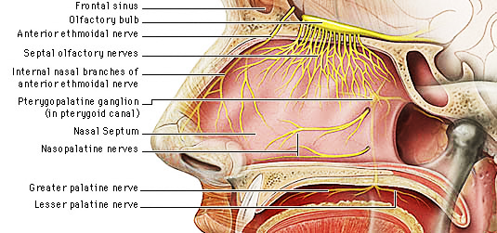
Human Physiology – Olfactory Nerve
Notes:
nasal cavity (in human respiration (physiology): The nose, is lined by skin that bears short thick hairs called vibrissae. In the roof of the nose, the olfactory organ with its sensory epithelium checks the quality of the inspired air. About two dozen olfactory nerves convey the sensation of smell from the olfactory cells through the bony roof of the nasal cavity to the central nervous system.

Slide 25
Human Physiology – Olfactory Nerve

Slide 26
Human Physiology – Eyes
Notes:
Discuss irritation to the eyes caused by H2S.

Slide 27
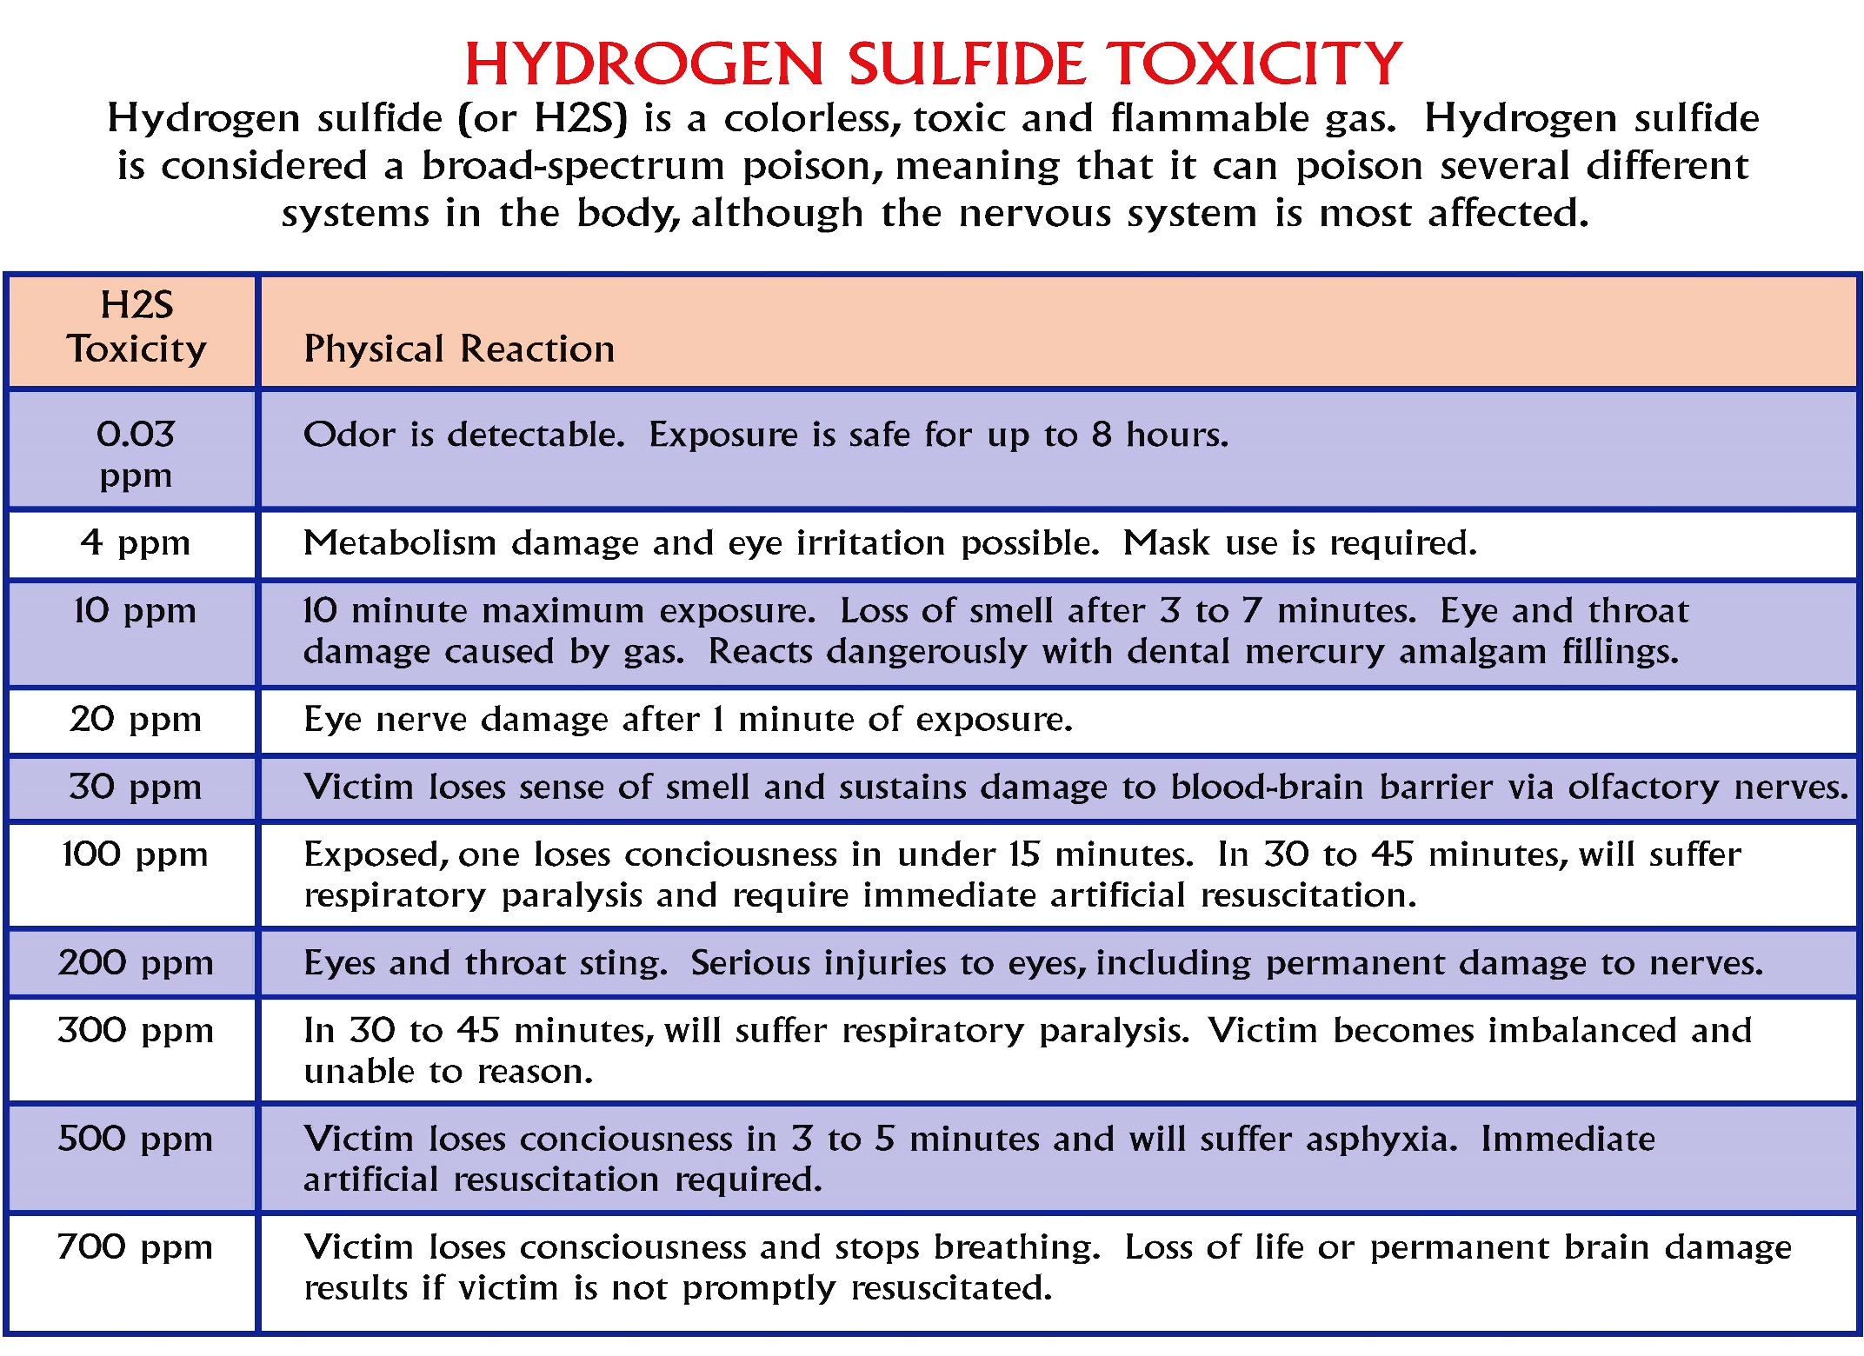

Slide 28
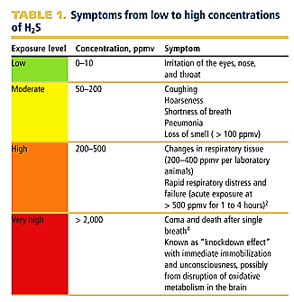
Symptoms from Low to High H₂S Concentrations

Slide 29
Health Effects - Acute
Hydrogen sulfide is a mucous membrane and respiratory tract irritant;
Pulmonary edema, (immediate or delayed), can occur after exposure to high concentrations.

Slide 30
Health Effects - Acute
Inhalation of high concentrations of hydrogen sulfide can produce extremely rapid unconsciousness and death.
Exposure to the liquefied gas can cause frostbite injury.
Notes:
Acts on the Basal Ganglia of the brain. This is where involuntary muscle actions get their directions from the brain. Essentially, H2S works at the very nerve center and shuts down the instructions to the lungs to continue breathing.

Slide 31
Health Effects - Acute
Symptoms of acute exposure:
Olfactory paralysis
Excitement
Eye irritation
Coughing
Headaches
Sneezing

Slide 32
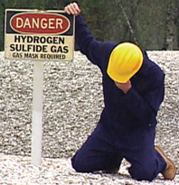
Health Effects - Acute
Symptoms of acute exposure: (cont’d)
Nausea
Irritation of respiratory tract
Diarrhea
Dizziness
Confusion
Staggering gait

Slide 33
Health Effects - Acute
Symptoms of acute exposure: (cont’d)
Photophobia
Pulmonary edema
Brain damage
Respiratory arrest
Cardiac arrest

Slide 34
Health Effects - Chronic
Symptoms of chronic exposure:
Neurologic symptoms, including psychological disorders, have been associated with chronic exposure.
Chronic exposure may be more serious for children because of their potential longer latency period.
H₂S does not accumulate in the body.

Slide 35
Health Effects - Chronic
Symptoms of chronic exposure: (cont’d)
Eye irritation
Corneal blistering, pitting, and opacity
Headaches
Nausea

Slide 36
Health Effects - Chronic
Symptoms of acute exposure: (cont’d)
Irritation of the respiratory tract
Pulmonary edema
Anorexia
Sleep disturbances

Slide 37
Physiological Effects
ppm by Vol | Effects of Exposure
0.13 | Barely perceptible odor
4.6 | Easily detectable moderate odor
10 | Beginning eye irritation
27 | Strong, unpleasant odor, not intolerable
100 | Coughing, eye irritation, loss of smell after 2-5 mins
200-300 | Eye inflammation and resp tract irritation after 1 hour exposure
500-700 | Loss of consciousness, and possibly death in 30 min-1 hour
700-1000 | Rapid unconsciousness, stopping of resp, death
1,000-2,000 | Immediate unconsciousness, early stopping of resp., death in a few minutes
Notes:
This table is taken from the PETEX Hydrogen Sulfide in Production Operations manual.

Slide 38
Physiological Effects
OSHA has a slightly different chart on exposures:
https://www.osha.gov/SLTC/hydrogensulfide/hazards.html

Slide 39
Dose-Response Relationship
Effects of H₂S body are dependent on several factors:
Exposure
Concentration
Exposure Frequency
Exposure Duration
Individual
Variables

Slide 40
Dose-Response Relationship
Individual variables:
Body Mass
Overall Physical Condition
Age
Smoker/Non-smoker

Slide 41
Interaction w/ Drugs and Alcohol
Alcohol, prescription drugs, and illicit drugs may result in hypersensitivity to H₂S
Additionally, multiple toxins being filtered from bloodstream by liver may slow metabolism rate

Slide 42
Chemical Properties, Physiological Effects and Chemical Reactions of H₂S
H₂S
Notes:
We reviewed the chemical properties, the physiological effects, and chemical reactions of Hydrogen Sulfide as well as hazards, characteristics, and safe exposure limits.

